Slide 1
West Virginia School-Based Health Assembly
Vision
The vision of the West Virginia School-Based Health Assembly is for all of West Virginia's youth and adolescents are healthy and achieving to their fullest potential.
Mission
Our mission is to advance comprehensive health care in school settings through responsive policies, practices, and partnerships. .
Goals
Increase the delivery and access of health services to all students in West Virginia
Develop a public relations plan that defines WVSBHA's identity, mission and role and maintains a continuity of message to members and partners
Diversify our funding base to sustain WVSBHA

Slide 2
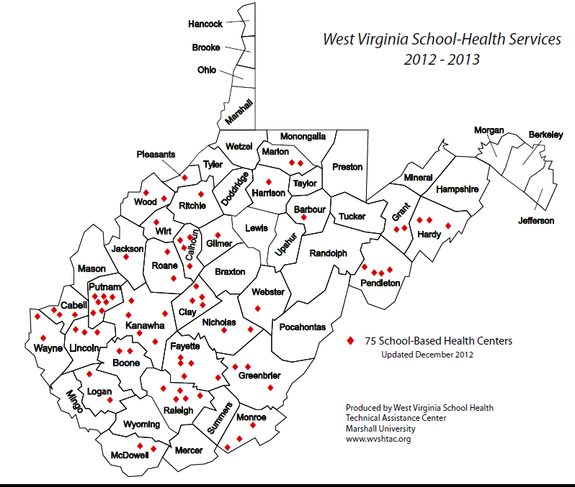
State Overview of SBHCs
Currently, there are 75 SBHCs, serving 94 schools in 28 counties.

Slide 3
State Overview of SBHCs
38 serve high schools and technical centers
28 serve middle schools
28 serve elementary schools
These numbers will be updated when the new SBHC Directory
is published in early 2013.

Slide 4
Mental Health Services in WV’s SBHCs
Mental health services are the fastest growing component of SBHCs in our state.
Currently, 37 out of 75 SBHCs have staff or contract with another agency to provide mental health services
17 out of 28 counties that have SBHCs provide these services

Slide 5
Mental Health Services in WV’s SBHCs
Barriers
Funding (reimbursement)
Recruitment and retention of providers
Coordination of care

Slide 6
Mental Health Services in WV’s SBHCs
NEXT STEPS FOR WVSBHA:
The WVSBHA Communications Team is working on a mental health assessment of the state, which will continue once we learn the results of the state assessment.
A new mental health liaison will be named this week to our board of directors. The liaison will help guide WVSBHA in the assessment of services in SBHCs.
Long-term goal: After a comprehensive assessment of services, develop a position paper and strategic plan to expand mental health services in SBHCs

