Slide 1
Pt. 2: Frustrated with Obesity Management?
5210 & Motivational Interviewing to the Rescue!
Jamie Jeffrey, MD, FAAP
Medical Director, Children’s Medicine Center &
HealthyKids Pediatric Weight Management Program
Clinical Associate Professor, WVU-Charleston
Project Director, KEYS 4 HealthyKids

Slide 2
The 15 minute
Obesity Prevention Protocol
Step 1-Assessment
Step 2-Agenda Setting
Step 3-Assess motivation
Step 4-Sumarize and clarify Goal
easy…………………………..

Slide 3

Frustrated?

Slide 4
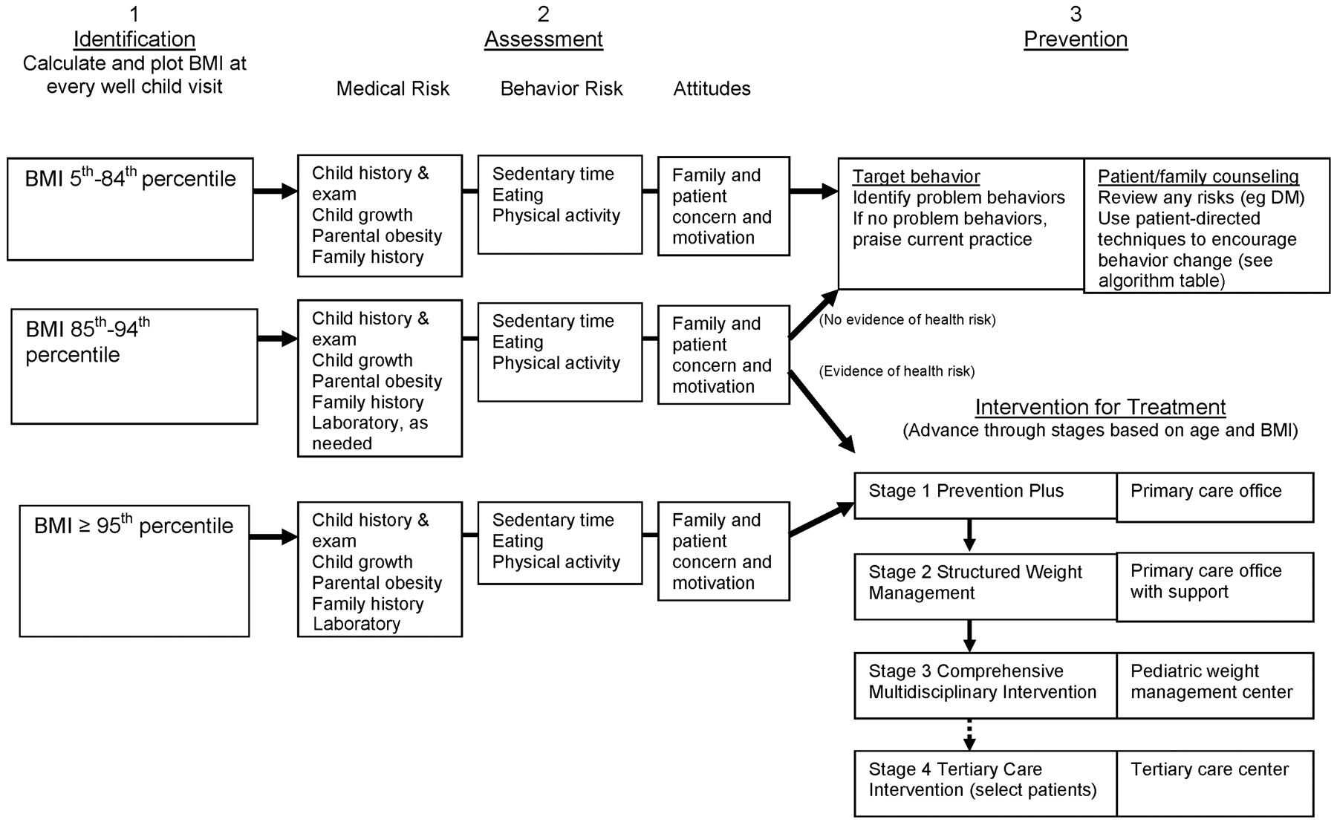
Obese
Notes:
Again for those with BMI in obese range, get the history, do a careful exam and assess risks. Treatment should be initiated.

Slide 5
STAGE 1-PREVENTION PLUS
Dietary Habits & Physical Activity
  Review 5 2 1 0
Behavioral Counseling
  Eating breakfast daily
  Limiting meals outside the home
  Family meals 5-6 times a week
  Allow child to self regulate at meals without overly restrictive behavior
Notes:
Stage one of treatment
Dietary Habits and Physical activity: Assess # of family meals, eating out, eating breakfast, sedentary time, physical activity.
Behavioral counseling: suggest ways to improve health
Follow up in 3-6 months. Depending on BMI and medical risk these patients may need labs as well which we will discuss later.

Slide 6
STAGE 1-PREVENTION PLUS
Goal
  Weight maintenance with growth resulting in decreased BMI
  Monthy Follow-up
  After 3-6 months, no BMI change, advance to stage 2 Tx
Notes:
Stage one of treatment
Dietary Habits and Physical activity: Assess # of family meals, eating out, eating breakfast, sedentary time, physical activity.
Behavioral counseling: suggest ways to improve health
Follow up in 3-6 months. Depending on BMI and medical risk these patients may need labs as well which we will discuss later.
6

Slide 7
Stage 2: STRUCTURED WEIGHT MANAGEMENT
Dietary Habits and Physical Activity
  Plan for balanced diet, emphasizing low amounts
  of energy dense foods.
  Increased structured daily meals and snacks
  Supervised active play at least 60 min/day
  Screen time 1 hour or less a day
  Increased monitoring by provider, patient and/or family
Notes:
More structured plans for weight management with emphasis on self monitoring.
Goals weight maintenance and weight loss
More frequent follow-up, suggested every month.

Slide 8
Stage 2: STRUCTURED WEIGHT MANAGEMENT
Goal:
  Weight Maintenance with decreasing BMI
  Weight loss not to exceed 1 lb/mo in ages 2-12
  Average weight loss of 2 lb/week in older children and adolescents
  Monthly Follow-up
  If no BMI improvement, advance Stage 3
Notes:
More structured plans for weight management with emphasis on self monitoring.
Goals weight maintenance and weight loss
More frequent follow-up, suggested every month.
8

Slide 9
Motivational Interviewing
A directive, person-centered counseling style for increasing self-determination by helping people explore and resolve ambivalence-Miller & Rollnick, 2002

Slide 10
MOTIVATIONAL INTERVIEWING
Patient centered care approach
Nonjudgmental, empathetic and encouraging
Behavior change influenced more by motivation than by information.
Core principle: People are more likely to accept and act on opinions that they voice themselves.
Notes:
References: Miller & Rollinick
Core principle is a way to elicit change talk. Use scale fro 0-10 for change talk.

Slide 11
MOTIVATIONAL
INTERVIEWING-”OARS”
O = Open ended questions (start with asking permission)
A = Affirmation
R = Reflective Listening (Repeat and summarize)
S = Summarize

Slide 12

MI…..Step 1
ASK
Permission

Slide 13
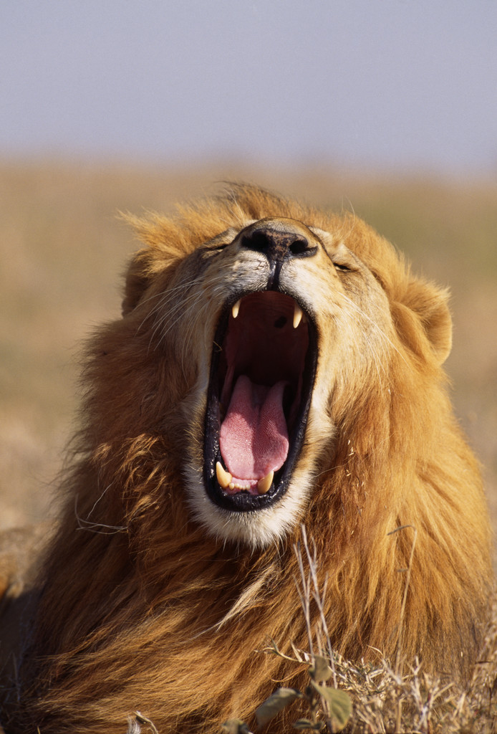


Slide 14
MI: OPEN THE ENCOUNTER
Ask permission: Would you be willing to spend a few minutes talking about Suzy’s weight? Are you interested in ways to stay healthy?
Ask open ended question – Listen – Summarize
  What do you think? How do you feel about your weight & health? What have you tried so far to work towards a healthier lifestyle?

Slide 15
Good ? or NOT
What do you think keeps you from getting to class on time?
Why don’t you try eating more veggies?
Why would you want to study anyhow?
What’s wrong with just trying a few days without coke?
What would be better for you if you lost weight?

Slide 16
MI Continued
Share BMI/Weight Information
  Your current weight puts you at risk for developing heart disease and diabetes. Your BMI is 95nd percentile and show on colored chart
  Ask for patient’s interpretation, what do you make of this?
  Add your own interpretation/advice as needed after eliciting the response of the patient/parent.

Slide 17
“WORDS” of Advice
Neutral Language….
  Other pts have found that…
  Others have benefited from…
  I had one pt that…
Conditional Words
  Might consider
  Maybe you can try
“I” and “Y” Words
  I think you should….
  You should….
Directive
  You should
  I want you to try….

Slide 18
Use “wiggle” words
Perhaps
Maybe
If you don’t mind
One option is
You might consider
Here’s a thought
What do you think

Slide 19
Importance/Confidence Ruler
Willingness/ Importance ?
On a scale of 0—10, how willing/important is it to you to make
a change toward a healthier lifestyle?
0—–—1—–—2—–—3—–—4—–—5—–—6—–—7—–—8—–—9—–—10
Not Important Somewhat Very Important
Confidence?
On a scale of 0—10, how confident are you that you can succeed?
0—–—1—–—2—–—3—–—4—–—5—–—6—–—7—–—8—–—9—–—10
Not Confident Somewhat Very Confident

Slide 20
MI: NEGOTIATE THE AGENDA
Some ideas for staying healthy include…
What are your ideas for working toward a healthy weight?
Introduce 5 2 1 0 and ask if the patient is interested in discussing one of these further, ask if they have other ideas.

Slide 21
MI: ASSESS READINESS &
TAILOR THE INTERVENTION
Stage of Readiness |  | Key Questions
Not ready 0—3 *Raise awareness *Elicit “change talk” *Advise and Encourage | -Would you be interested in knowing more about ways to stay healthy? -How can I help? -What might need to be different for you to consider a change in the future?
Unsure 4—6 *Evaluate Ambivalence *Elicit “change talk” *Build readiness | -Where does that leave you now? -What do you see as your next step? -What are you thinking/feeling at this point? -Where does ______ fit into your future?
Ready 7—10 *Strengthen commitment *Elicit “change talk” *Facilitate action planning | -Why is this important to you now? -What are your ideas for making this work? -What might get in the way? How might you work around these barriers? -How might you reward yourself along the way?
Notes:
On a scale of 1 to 10 how ready are you to consider [option discussed earlier]. Using this scale can encourage the child/family to change.
On a scale from 1 to 10 how confident are you that you can make this change?
If they answer 5, ask why they didn’t choose a lower number. What would it take to get you to a higher number.

Slide 22
EXPLORE AMBIVALENCE
Step 1: Ask a pair of questions to help patient explore the pros and cons.
  What are the advantages of keeping things the same? AND What are the advantages of making a change? What would be better for you if…..

Slide 23
EXPLORE AMBIVALENCE
Step 2: Summarize ambivalence
  Let me see if I understand what you’ve told me so far… (start with reasons for maintaining status quo end with reasons to make a change)

Slide 24
CLOSE THE ENCOUNTER
Summarize: Let’s review what you have worked on today
Show appreciation for willingness to discuss change.
Offer advise, emphasize choices, express confidence
Confirm next steps and schedule F/U.

Slide 25

Brave Volunteer?

Slide 26
The 15 minute
Obesity Prevention Protocol
Step 1-Assessment
  BMI
  Ask permission to discuss weight
  Elicit parents concern
  Reflect/Probe
  5210 Questionnaire (Short vs Long)
  Reflect/Probe Cycle

Slide 27
The 15 minute
Obesity Prevention Protocol
Step 2- Agenda Setting
  Target behavior willing to change
  5210 with Goal
  Goal Trackers

Slide 28
The 15 minute
Obesity Prevention Protocol
Step 3-Assess Motivation & Confidence
  Ruler
  Pocket Guide
Step 4-Summarize & Clarify Goal

Slide 29
The 15 minute
Obesity Prevention Protocol
Schedule Follow-up Office Visit
  F/U 1-3 months depending on level of commitment
  Remember Chronic Care Model

Slide 30


Practice Makes Perfect

Slide 31
Resources
www.aap.org
www.mcph.org/Major_Activities/keepmehealthy.htm
www.letsgo.org
www.nichq.org
www.letsmove.gov

Slide 32
HealthyKids Team
  Pediatrician Dietician Psychologist
  Nurse Educator Exercise Physiologist PAC

