Slide 1
Part 1: Frustrated with Obesity Management?
5210 & Motivational Interviewing to the Rescue!
Jamie Jeffrey, MD, FAAP
Medical Director, Children’s Medicine Center &
HealthyKids Pediatric Weight Management Program
Clinical Associate Professor, WVU-Charleston
Project Director, KEYS 4 HealthyKids

Slide 2
Objectives
Pediatric Policy Guidelines and 5210 for Prevention and Treatment of Pediatric Overweight/Obesity
Implementation of 5210, MI and goal setting into workflow
Motivational Interviewing 101

Slide 3
Obesity Trends* Among U.S. Adults
BRFSS, 1990, 1998, 2006
(*BMI ≥30, or about 30 lbs. overweight for 5’4” person)
1990
1998
2006
No Data <10% 10%–14% 15%–19% 20%–24% 25%–29% ≥30%

Slide 4
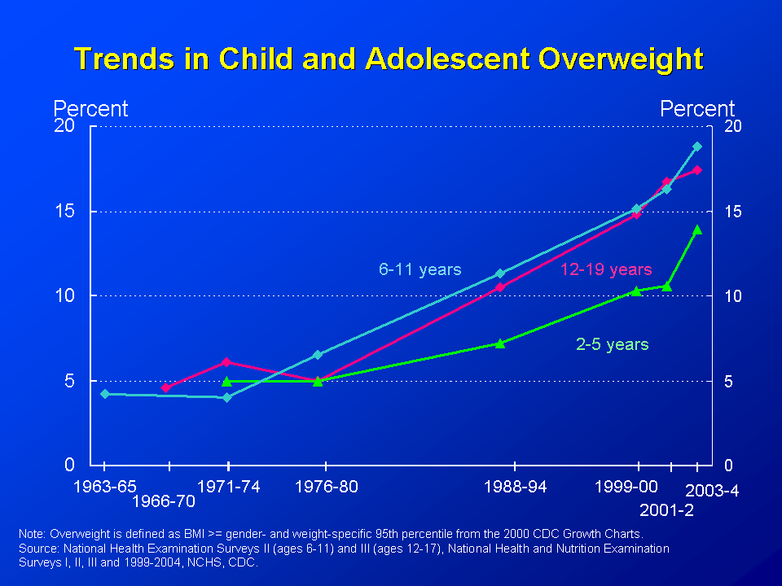
NHANES DATA
Notes:
For example in the 2-5 year old age group the prevalence has increased from 7.2 in 1988-94 to 13.9% in 2003-04.
Latest NHANES numbers from
4

Slide 5
Age of Onset of Pediatric Overweight and Obesity in CMC

Slide 6
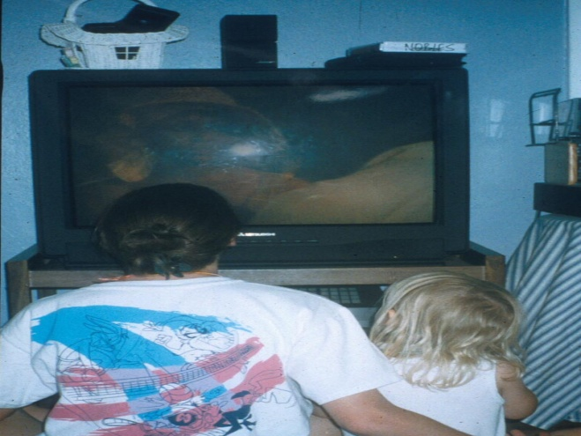
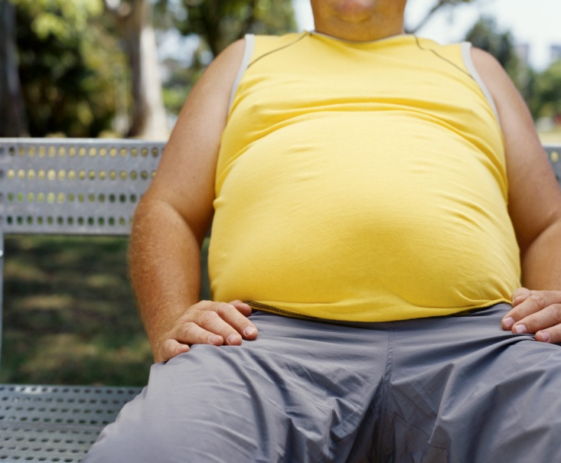
Etiologies
Nature Vs Nuture
Notes:
.
Knowing the vast number of contributing etiologies have lead to an educational campaign…but the harder we try the fatter we get.
Why?? Again, isolated tx approach from medical communtiy and lack of appropriate community support…..
Community vs pt approach. Today we will deal with a patient and family approach and accountablity and personal desire and choice are entered into the equation
What is causing this rise in obesity? Genes and environment
Twin studies demonstrate genetic risk
High birth weight, maternal diabetes, and obesity in family members are factors, in fact obesity in family members strongest risk factor in children age < 10, regardless of their weight
Behavior and environment strongly influence the development of obesity in genetically at risk people.
The increase in prevalence is too rapid to be explained by a genetic shift.
It must be result of shifted balance in energy intake and energy expenditure.

Slide 7
Number and Percentage of U.S. Population with Diagnosed Diabetes, 1958-2008
CDC’s Division of Diabetes Translation. National Diabetes Surveillance System available at http://www.cdc.gov/diabetes/statistics
Notes:
Methodology
Number and percent of the U.S. population with diagnosed diabetes were obtained from the National Health Interview Survey (NHIS, available at http://www.cdc.gov/nchs/nhis.htm) of the National Center for Health Statistics (NCHS), Centers for Disease Control and Prevention (CDC) for years. Conducted continuously since 1957, the NHIS is a health survey of the civilian, noninstitutionalized population of the United States. The survey provides information on the health of the United States population, including information on the prevalence and incidence of disease, the extent of disability, and the utilization of health care services. The multistage probability design of the survey has been described elsewhere (1,2). Estimates for years 1958-1979 were obtained from published data (3) and estimates from 1980 forward were derived directly from the NHIS survey data.
References
1. Massey JT, Moore TF, Parsons VL, Tadros W. Design and estimation for the National Health Interview Survey, 1985-1994. Hyattsville, MD: National Center for Health Statistics. Vital and Health Statistics 1989;2(110).
2. Botman SL, Moore TF, Moriarity CL, Parsons VL. Design and estimation for the National Health Interview Survey, 1995–2004. National Center for Health Statistics. Vital and Health Statistics 2000;2(130).
3. Harris MI: Prevalence of noninsulin-dependent diabetes and impaired glucose tolerance. Chapter VI in Diabetes in America, Harris MI, Hamman RF, eds. NIH publ. no. 85-1468, 1985.

Slide 8


Age-adjusted Percentage of U.S. Adults Who Were Obese or Who Had Diagnosed Diabetes
Obesity (BMI ≥30 kg/m²)
1994
2000
2008
No Data <14.0% 14.0-17.9% 18.0-21.9% 22.0-25.9% >26.0%
Diabetes
1994
2000
2008
No Data <4.5% 4.5-5.9% 6.0-7.4% 7.5-8.9% >9.0%
CDC’s Division of Diabetes Translation. National Diabetes Surveillance System available at http://www.cdc.gov/diabetes/statistics

Slide 9
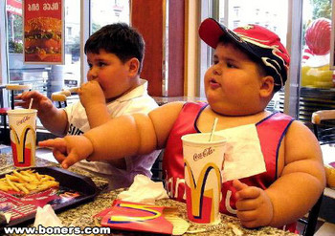
Pediatric Obesity……
American Feast's Sustainable Food Blog
Notes:
9

Slide 10
….is a chronic health disease…..a DIAGNOSIS
Diabetes
Hypertension
Dyslipidemia
Coronary Heart Disease
Stroke
Sleep Apnea
Gallbladder Disease
Osteoarthritis
Notes:
10

Slide 11
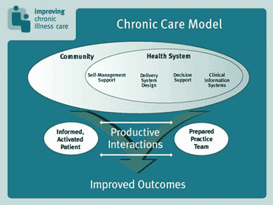
Chronic Care Model
Wegner, 1998
Notes:
So moving on to treatment…something has to change…. And one thing is that we, as providers, and the health care system has to begin to see the treatment of obesity as a chronic illness. And this model calls for a “informed, activated pt” this is where MI comes in…to assess the “readiness” of the pt to make the required lifestyle changes needed to improve Sx, health and Dx

Slide 12
Shift in
Treatment Paradigm
Educate, Educate, Educate
Pick issues important to patient-→
Educate, Educate, Educate
Notes:
Remember education is only one aspect
Think smoking cessation

Slide 13

Shift in
Treatment Paradigm
COLLABORATE!!
Patients make agenda when ready to change
Notes:
Again-think smoking cessation

Slide 14

Expert Committee Guidelines
Pediatrics 2007;120;S164-192
Notes:
Also copy with implementation guide on NICHQ site. Reference: Expert Committee Rec Regarding the Prevention, assessment, and treatment of obesity: Summary Report. Pediatrics 2007; 120;S164-192

Slide 15
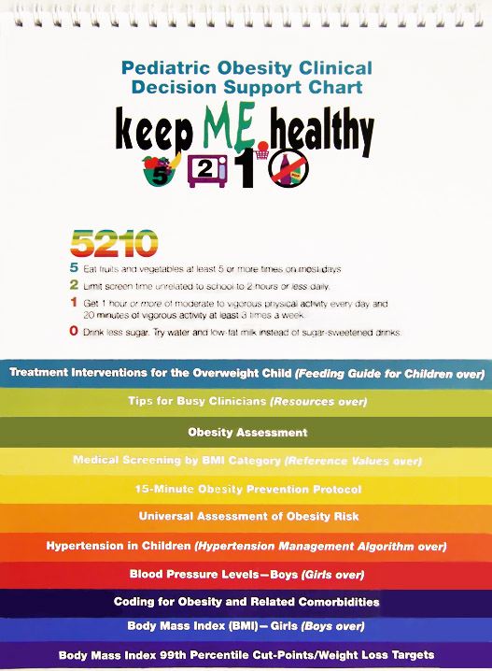
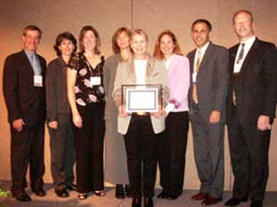
Maine “Keep ME Healthy”
Notes:
Maine Overweight Youth Colloborative-presented Workshop at the first NICHQ Obesity Congress-
Shown is the toolkit they prepared for practices and providers which has been edited and published by the AAP
This is the toolkit that will be used as part of the AAP Kidnitiative 5210 Obesity QI Project

Slide 16
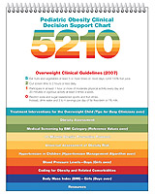
5210 Flip Chart

Slide 17
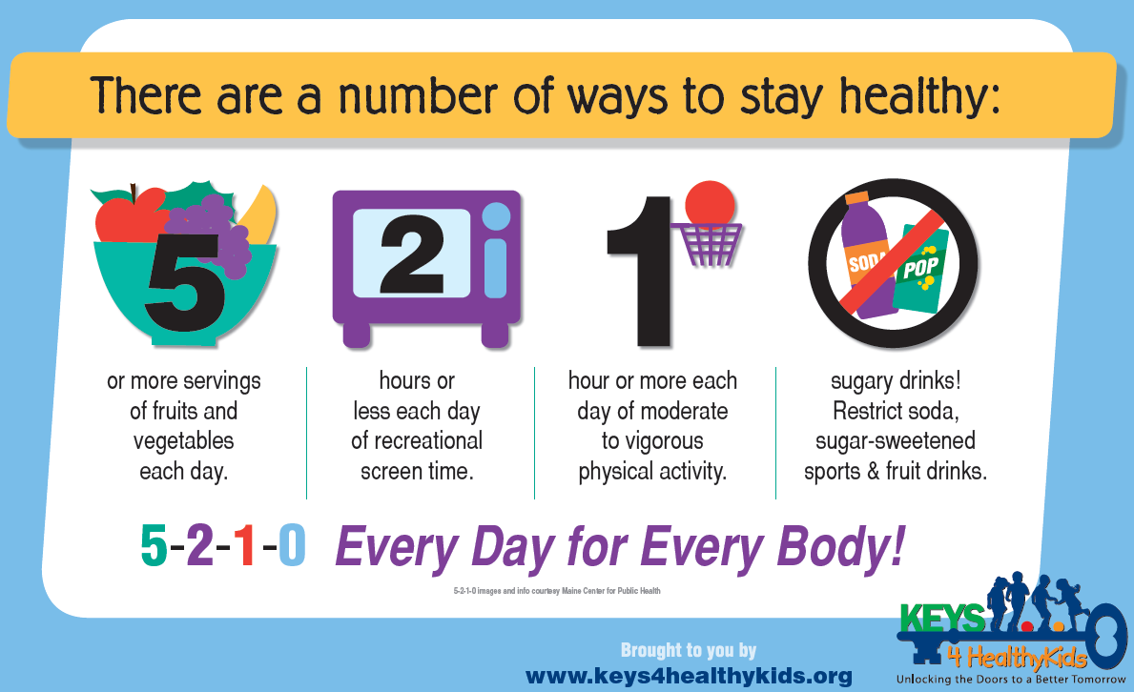

Slide 18
UNIVERSAL ASSESSMENT
OF OBESITY RISK
Identification: Calculate and plot BMI at every well child visit
Assessment: Identify medical risk, problem behaviors, and attitudes about healthy lifestyle
Prevention: Make a plan based on patients motivation, BMI category and risk factors
Notes:
As I said earlier prevention starts with identification: calculate, plot and diagnose
ID and recognize where the BMI falls and what risk that holds for the child in light of their lifestyle habits and family history risk

Slide 19
BMI
Notes:
Remember !st step
Knowing it and doing it are quite a bit different

Slide 20
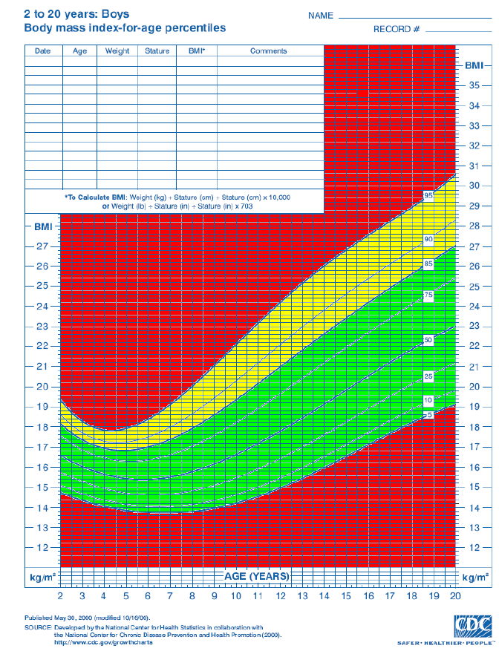
Preventing obesity
starts with a
calculator &
growth chart
OR
EMR that does it all!
Obese
Overweight
Healthy Weight
Notes:
This is a copy of a CDC growth chart with BMI for age data. These are included in every chart for patients over 2 years old in our clinic at CMC and should be a part of every well child check-up.
The clinic attendings and residents have been compiling data to evaluate how frequently we are actually calculating BMI and plotting this on the growth chart. The results we have are discouraging.
20

Slide 21
BASIC DEFINITIONS
Body Mass Index (BMI)=
Weight (kg)/Height (m)²
BMI <5th %ile - Underweight
BMI 5-84th %ile - Healthy Weight
BMI 85-95th %ile, Overweight
BMI >95th %ile or older adolescents with BMI > 30 kg/m2, Obese
Notes:
Now that I have reviewed some risk factors for obesity, it is important that we are all on the same page about defines obesity and overweight. It is all in the BMI. Review CDC vs 2007 expert committee guidelines-names of categories. Wt /ht/ht
Note that BMI normative values for children <2 years old are not available.
BMI correlates with more accurate measures of body fatness, but is easier to measure than other methods. It is a surrogate for adiposity. Since obesity refers to excess adiposity, BMI is a logical tool for evalutaion.
BMI has been correlated with obesity related comorbid conditions.
BMI in the 5th-84th percentile represents body fat levels that are unlikely to cause health concerns.
At a BMI in the 85th-95th percentile range the level of body fat may pose health risks that vary depending on body composition, BMI trajectory and family history.
A BMI > 95th percentile or using adult standards > 30kg/m2 means that body fatness is likely to cause health problems.

Slide 22
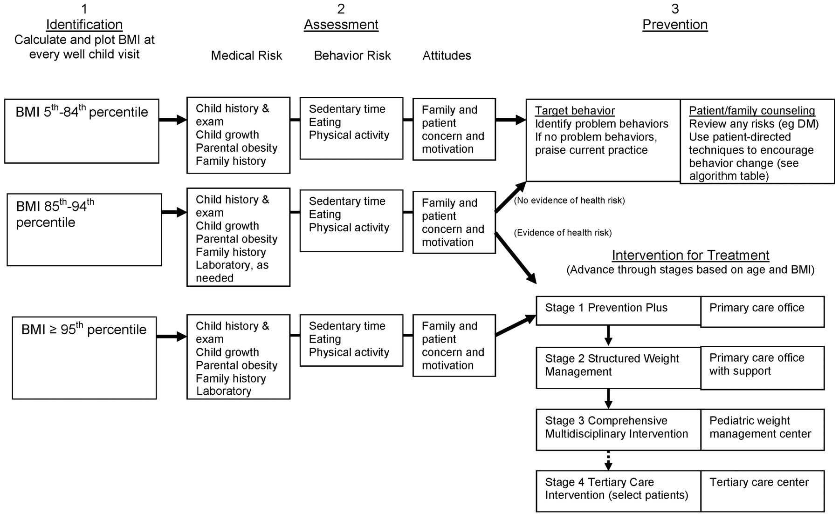
Overweight
Notes:
If BMI overweight, and risk factors are present, such as acanthosis, or FH of early CAD, continue to assess for behavior risk and patient and family concern and start a treatment plan, which we will go over in more detail later.
SHOW CHART & WEIGHT PREDICTIONS-these pts most likely will NOT LOOK obese
We will review the stages of Tx in more detail in a minute

Slide 23
Obese
Notes:
Again for those with BMI in obese range, get the history, do a careful exam and assess risks. Treatment should be initiated.

Slide 24
Blood Pressure-4th Report
Pre-HTN
Stage I
Stage II
90%-<95%
95%- 99%
>99% + 5
Notes:
** Reference

Slide 25
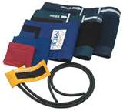
Blood Pressure
Correct Cuff Size
  Cuff width cover ¾ between acromion & olecranon
  Cuff bladder length 80-100% of arm circumference
Manual vs Dynamap
Notes:
4th report on Dx, Eval, Tx of high blood pressure

Slide 26
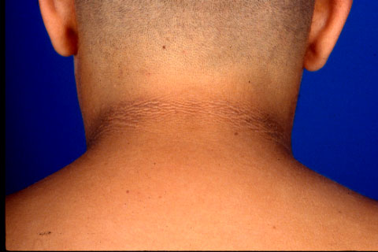
Acanthosis Nigricans

Slide 27
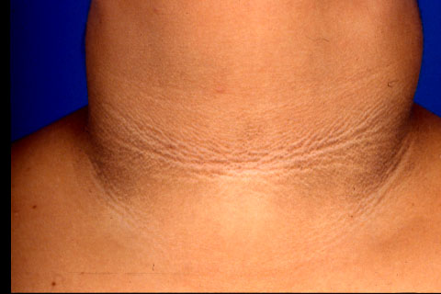
Acanthosis Nigricans

Slide 28
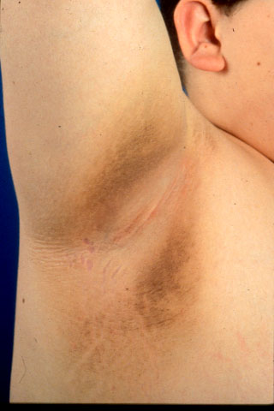
Acanthosis Nigricans

Slide 29
LABORATORY WORK-UP
FLP
CMP (FBS, ALT/AST)

Slide 30
The 15 minute
Obesity Prevention Protocol
Step 1-Assessment
Step 2-Agenda Setting
Step 3-Assess motivation
Step 4-Sumarize and clarify Goal
easy…………………………..

