Slide 1
The Mental Health Component of a Community School
Webinar
February 25, 2014
Notes:
Introduction: Please begin the recording. Hello. Welcome to this webinar on Mental Health and Community Schools. Today’s webinar is geared to school personnel who want to learn more about how to develop or strengthen mental health services in their schools through collaboration with community providers. I am Linda Anderson with the West Virginia School Health Technical Assistance Center at Marshall University
If you wish to interact during the discussion period, you will need to dial in to the webinar in addition to connecting via the web link. During the WebEx your microphone will be on mute and you may type questions in the chat box on the WebEx. At the end of the presentations, we will open it up for discussion and questions. If we run out of time, and are unable to answer your question(s), you can email the presenters directly

Slide 2
The Mental Health Component of a Community School
To join the audio conference only ------------------------------------------------------- Please Join us on the Teleconference: 1-888-236-9224 Guest# 228872 ------------------------------------------------------- For assistance ------------------------------------------------------- You can contact Marshall University at: simpson13@marshall.edu

Slide 3
Acknowledgements
WV Bureau for Behavioral Health, DHHR
WV Department of Education
Center for School Mental Health, University of Maryland
Amy and Kevin, Marshall TA staff
ESMH Steering Team
Notes:
Thank you: We would like to acknowledge the funders, presenters and staff for making this event possible. In particular, the Bureau for Behavioral Health , which funds the mental health component of the technical assistance provided by the Marshall TA Center; the West Virginia Department of Education- Office of Special Programs and other divisions for their continuing support, staff and guidance in promoting the importance of mental health and the role of communities in schools; the Center for School Mental Health at the University of Maryland, and Amy Leedy and Kevin Simpson from our staff at Marshall for the behind the scenes work to make this webinar possible.

Slide 4
Purpose
Increase understanding of the Community Schools model
Increase understanding of Expanded School Mental Health in West Virginia
Identify at least three resources for implementing school mental health services in a school.
Notes:
Participants will:
Increase understanding of the Community Schools model
Increase understanding of Expanded School Mental Health in West Virginia
Identify at least three resources for implementing school mental health services in a school

Slide 5
Agenda
3:10 Community Schools and Mental Health
Paula Fields, WVDE
3: 20 Overview of ESMH and Planning Basics –
Linda Anderson, Marshall
3: 30 Greenbrier County –
Judy Koehler, Rainelle Medical Center
3:40 Tucker and Pocahontas Counties –
Margy Burns, Executive Director, Youth Health Services, Elkins
3:50 Question and Answer
Notes:
Our presenters today are:
Paula Fields, Community Schools Coordinator, Office of Special Programs, WVDE
Linda Anderson, Marshall TA Center
Judy Koehler,Director , School based Services, Rainelle Medical Center
Margy Burns, CEO, Youth Health Services, Elkins
After the presentations we will open it up for questions and discussion. I would also like to mention that we have Tiffany Pittman from the Bureau for Behavioral Health on the call. Tiffany is Coordinator for the school based programs which the Bureau funds. She has worked as a mental health counselor in a school based mental health program in Cabell County. And she will participate in the discussion as well.
Evaluation: After the WebEx you will be asked to complete an evaluation. We value your feedback and would like your suggestions for additional webinar topics that might be helpful to you.
At this time I will turn it over to Paula Fields who will get us started.

Slide 6
What is a community school?
A community school is both a place and a set of partnerships between the school and other community resources.
Notes:
Its integrated focus on academics, health and social services, youth and community development and community engagement leads to improved student learning, stronger families and healthier communities. Community schools offer a personalized curriculum that emphasizes real-world learning and community problem-solving. Schools become centers of the community and are open to everyone – all day, every day, evenings and weekends.
Define community schools, community learning center, parent learning centers, hub, call it whatever works but let’s get them moving
Realizing that community schools refers to a framework but each model is unique based on data driven needs

Slide 7
An easier way to explain…
Conventional School Model
Community School Model
Community Schools…Connected…
“There’s an APP for That”

Slide 8
Community Schools Include
Strategic Alignment of:
Health and Social Supports
Engaging Instructions
Extra Learning Opportunities
Early Childhood Development
College, Career & Citizenship
Community Engagement
Family Engagement
Strategic Alignment
Youth Development

Slide 9
How Do You Determine a “School” is a “Community School”?
Community Schools Coordinator
Each school has a focus on a set of results
Strategic alignment

Slide 10
How does mental health work as part of a community school?
Universal prevention activities and presentations (Tier 1)
Targeted interventions (Tier 2)
Intensive therapy (Tier 3)
Substance abuse therapy (ATOD)
Contributes to improved attendance, reduced disciplines and improved course completion
Notes:
ATOD-alcohol, tobacco and other drugs

Slide 11
WV Standards for High Quality Schools
Expanded School Mental Health Supports
Standard 1: Positive Climate and Cohesive Culture
Standard 4: Student Support Services and Family/Community Connections
Notes:
W. Va. 126CSR12, West Virginia Board of Education Policy 2322
...describes the seven common standards expected of schools to ensure a high quality education, in an engaging learning environment. The policy represents a coherent and aligned set of expectations necessary to transform schools into outcome focused, innovative, accountable learning organizations that can prepare all students to be contributing citizens for the global, digital age of the 21st century. Effective August 18, 2011

Slide 12
What’s the bottom line?
Community schools are about focusing joint community and school resources on student success which leads to community success.
Notes:
• Student Learning: Community school students show significant and widely evident gains in academic achievement and in essential areas of non-academic development.
• Family Engagement: Families of community school students show increased stability and are more able to meet basic needs. They communicate more with teachers and are more involved in their children’s school.
• School Effectiveness: Community schools enjoy improved parent-teacher
relationships and increased teacher satisfaction. School environments are more positive and community support increases.
• Community Vitality: Community schools promote better use of school buildings, and their neighborhoods enjoy increased security, heightened
community value and better rapport among students and residents.

Slide 13
www.communityschools.org
Notes:
Plan to attend national community schools forum in Cincinnati OH

Slide 14
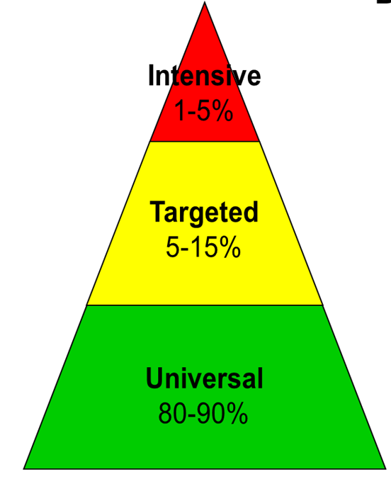
Definition
Expanded School Mental Health refers to programs that build on the core services typically provided by schools. It is a three-tiered framework that includes the full continuum of:
Prevention
Early intervention
Treatment
Emphasizes shared responsibility between schools and community providers
Notes:
Expanded school mental health is a term used to describe a comprehensive school mental health program. It refers to programs that build on the core services typically provided by schools. It uses the three tiered framework which originated in public health as a way to think about mental health in its broadest context. It includes the full continuum of prevention, early intervention, and treatment; it emphasizes shared responsibilty between schools and community providers ( the old “it takes a village to raise a child” notiion) it focuses on ALL students, - those in general education as well as in special education; and it builds on existing school services and programs.
Today we are focusing on the middle and top tiers of this pyramid – tiers 2 and 3. But I want to emphasize that a strong base of universal or school wide programs is essential to long term success. Theoretically – if you have effective, evidence based programs and practices at the universal level, the number of students needing the more intensive services should be fewer. This should be the long term goal of any program.

Slide 15
Tier 1 - Universal Prevention Recommendations
Infrastructure
Positive behavior supports
Developmental guidance
Early identification
School climate
Connectedness
Family engagement
Staff development
School safety
Support for transitions
Notes:
Our state steering team has identified ten components that should be part of any ESMH school.. We are in the process of developing tool kits for each of these recommendations. You will find resources for the 1 through 8 on our website.
But the point I want to make is that Universal Prevention should be part of your planning and your long term improvement. There is a very good assessment tool that can help to guide you in identifying strengths and weaknesses in your school. It’s call the MH-PET and I will give you’re the reference in a later slide.

Slide 16
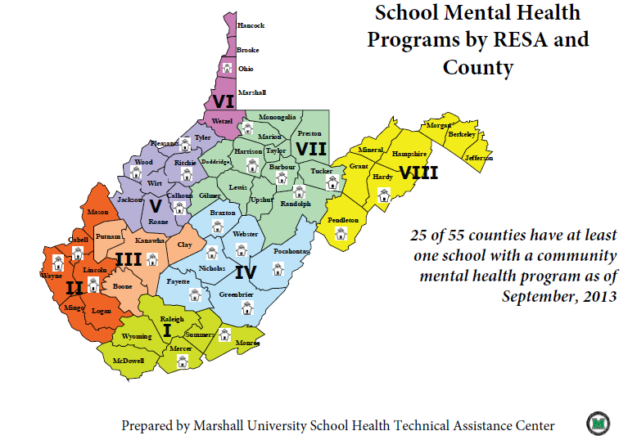
Notes:
As of last September, in WV, about 100 schools had regular, weekly mental health services provided by a community agency. Program staff usually consists of a master’s level, licensed social worker, counselor, or psychologist; some programs have behavioral health educators and/or case managers; most will have consultation from psychiatrists or PhD level psychologists. Services are provided on a regular weekly schedule at least ½ day/week; in some cases it’s full time; depending on size of school and resources. The sponsoring agencies are usually school based health centers or community mental health agencies. Funding differs but usually is a combination of grants, billing of insurers, and sometimes partial funding from the school district.

Slide 17
WV ESMH Pilot Programs
Notes:
A few years ago the Bureau for Behavioral Health funded projects in five counties as Expanded School Mental Health Pilot sites. You will be hearing from two of the grantees today. The results so far are promising in terms of outcomes – with data showing improvements in attendance, suspensions and rate of promotion

Slide 18
Response to Intervention
PBIS
Student Assistance Team
Student Mental Health Initiative
Safe Schools, Healthy Students
Special Education
Crisis management
Systems of Care
Social and Emotional Learning
School linked
Wrap around
NCLB
Shared Agenda
Multiculturalism
Family support services
Where to Begin?
Cultural competence
Risk and protective factors
School based
Strengths based
Multi system approach
School linked
Student Support Services
Suicide Prevention
Mental Health Services Act
IDEA
School climate
School connectedness
Peer-to-Peer Support
Coordinated school health program
Evidence based practice
Notes:
18
18
Schools are overwhelmed with mandates, new programs, new initiatives; it is difficult to know where to begin

Slide 19
Recommended Reading
Realizing the Promise of the
Whole-School Approach to Children’s
Mental Health: A Practical Guide for Schools
National Center for Mental Health Promotion and Youth Violence Prevention:
http://promoteprevent.org/Publications/
Notes:
Start by educating yourself. This is the single best resources we have found.
WVDE OSP has hard copies available; I can send the entire PDF and the work sheets

Slide 20
Planning Process
Educate yourself about ESMH
Readiness?
Administrative support - district and school
Point person(s)
Space
Involve key school staff (school nurse, SRO, school counselor, attendance, SBHC)
Convene reps from the broader school and community
Mental health, DHHR, parents, Regional Wellness Specialist, Family Resource Network, business, potential funders
Meet regularly
Educate one another, review models
Build RELATIONSHIPS = TRUST = SUSTAINABILITY
Notes:
Is your school ready? Do you have administrative support, is ther e space that is private, confidential, desk, chairs,? Who will be the point persons (s) for facilitating the planning process, maintaining communication, convening meetings? Often this is the school counselor; but it may be someone else; for Priority Schools, the school improvement specialist may initiative the conversation but ultimately the school must have ownership. ; and does the school/district improvement plan include mental health expansion?
Who are the key leaders within the school? School nurse, School Resource Officer, social worker, school psychologist; attendance adminstrator, counselor, SBHC
Build a base of community support; identify potential resources.
Priority Schools: Talk with your school improvement specialist. Your collaborative team meeting would be a place where the initial conversation may begin.
20

Slide 21
Planning Process
Assess needs, resources, feasibility
School / community data; SWOT analysis
School Improvement Plan
MH-PET: www.nasbhc.org/mhpet
Develop an implementation plan
Set vision, goals, objectives, timeframes
Secure financial resources
Establish a Memo of Understanding (MOU)/contract with a MH provider: Hours, funding, staffing, liability
8. Monitor, re-assess, evaluate progress
Notes:
Use existing data; conduct an internal assessment of current activities: MH-PET
Set Priorities; develop work plan
Determine financial resources
Identify a community provider; establish a written MOU/contract
Evaluate progress
21

Slide 22
Strategies for Integrating MH into School Environment
Build relationships with community providers
Start small – focus on “low hanging fruit”. Examples:
Referral process and procedures
Include mental health in school improvement plan
Offer parent / community education on MH issues
Offer staff training on building positive relationships with students, school connectedness, trauma
Screen certain grades for risk
Notes:
Some schools and communities have relationships and resources that seem to come together fairly easily and they have services in a short time;
Other schools may have to work on building the relationships; seeking the resources; my advice is :
Don’t give up; and if you don’t have an agency that steps up to work with you immediately, seek other resources; and also start small with what is possible. You may not be able to get a full time therapist immediately; but you should be talking with your community providers about what is possible; can they continue the dialogue ; perhaps conduct a sucicide prevention education program; address stigma, train school personnel on trauma and its effects; strengthen the procedures for referral or response to emergencies.

Slide 23
Resources
Center for School Mental Health
University of Maryland: www.csmh.umaryland.edu
National Assembly on School Based Health Care: www.nasbhc.org
WV Child Care Association: http://www.wvcca.org/directory.html
WV Division of Child and Adolescent Behavioral Health:
http://www.dhhr.wv.gov/bhhf/Sections/programs/ProgramsPartnerships/ChildandAdolescent/Pages/ChildAdolescentBehavioralHealth.aspx

Slide 24
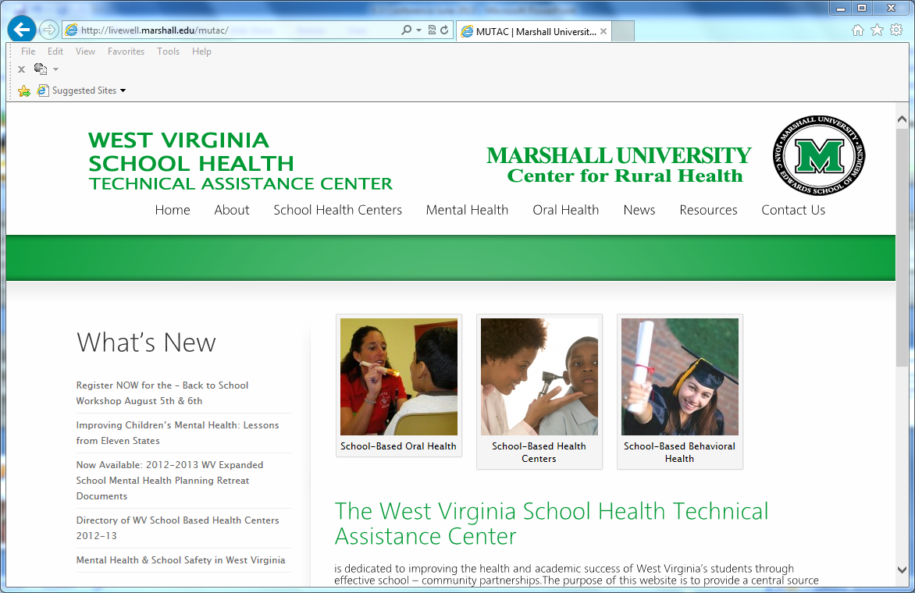

Slide 25
WV School Health Technical Assistance Center www.wvshtac.org
Linda Anderson, MPH
Marshall University
Huntington, West Virginia
304-544-3917
landerson@marshall.edu

Slide 26
School-Based Mental Health
Rainelle Medical Center, Inc.

Slide 27
History
Started with one Mental Health Counselor in 2002 serving 3 sites and 4 schools
Added another in 2004
And another in 2005
And a fourth in 2012
The need was and is great!

Slide 28
Expanded School Mental Health
Four full time MH counselors on staff
3 LICSWs, 1 LCSW
2 Alcohol and Drug Counselors, 1 CCS (supervisor)
2 billing coordinators but each MHC schedules their own appointments, etc.
Regular work week is 32 hours at school, 8 hours at RMC (appointments and admin)

Slide 29
Referrals and protocols
How will students be referred to the SBMH provider?
Self or parent referrals
School counselor, principal
Teachers
Friends
Screenings
Appointments and walk ins
Appointments are scheduled but walk-ins happen
Usually 30-60 minutes
Every effort made to not pull from core classes

Slide 30
Crisis Interventions and Supportive Counseling
Student crisis intervention
Grief counseling
Supportive counseling
Phone consults
ISE & SAT team meetings
Court appearances

Slide 31
School Staff/Faculty Education
Prepared presentations about our services
Individual consultations with teachers, administration and staff regarding students
Educational handouts on mental health i.e. recognizing signs in students
Faculty team meetings

Slide 32
Judy Koehler Director, School-Based Health
Rainelle Medical Center
jkoehler@rmchealth.org 304.438.6188 ext. 1020

Slide 33
Expanded School Mental Health Services
In
Rural Communities
Youth Health Service, Inc.
Elkins, WV
(Randolph, Tucker, Pocahontas,
Barbour, Upshur Counties)

Slide 34
Serving Five (5) Very Rural Schools
Green Bank Elementary/Middle School
Pocahontas County High School
Tucker Valley Elementary/Middle School
Davis-Thomas Elementary/Middle School
Tucker County High School
Combined student population - 2,131 students

Slide 35
Development up to present
~ Planning Process Complete
~ In two counties (Tucker and Pocahontas) - 5 schools
~Now working with Randolph, Upshur and Barbour County Schools to develop ESMH programs in these counties

Slide 36
The “We” Position
~ School said: “We need Tier 3 mental health services to get to our students.”
~ We said: “We have Tier 3 and a lot more services, but we can't get to your students.”
4+years later~ working together we are achieving good things for children and families thanks to the ESMH Program.

Slide 37
Initial Problems ~
High social stigma associated with MH services.
15% of all school-age students at one time will have a mental health problem.
Teachers feel unprepared to screen children.
School counselors identify but do not have time to provide treatment services.
Good prevention services, but severely limited treatment services for children.
No evidence-based treatment services.

Slide 38
Goals:
Increase access to quality, evidence-based mental health services for children and adolescents
Improve school attendance, academic performance and psycho-social functioning of students
Notes:
Our program goals are consistent with the mission of both YHS’s Division of Behavior Health Services and that of the public schools who are our partners.

Slide 39
AGENCY STRATEGIES
Strategy 1- Develop Infrastructure, Collaboration Plan and MOU
Strategy 2 - six (6) month planning period for a comprehensive ESMH program
Strategy 3 - Improve quality through EBPs
Strategy 4 - Offer Telemental Health services supported by Electronic Medical Records
Strategy 5 - Develop Centralized Scheduling

Slide 40
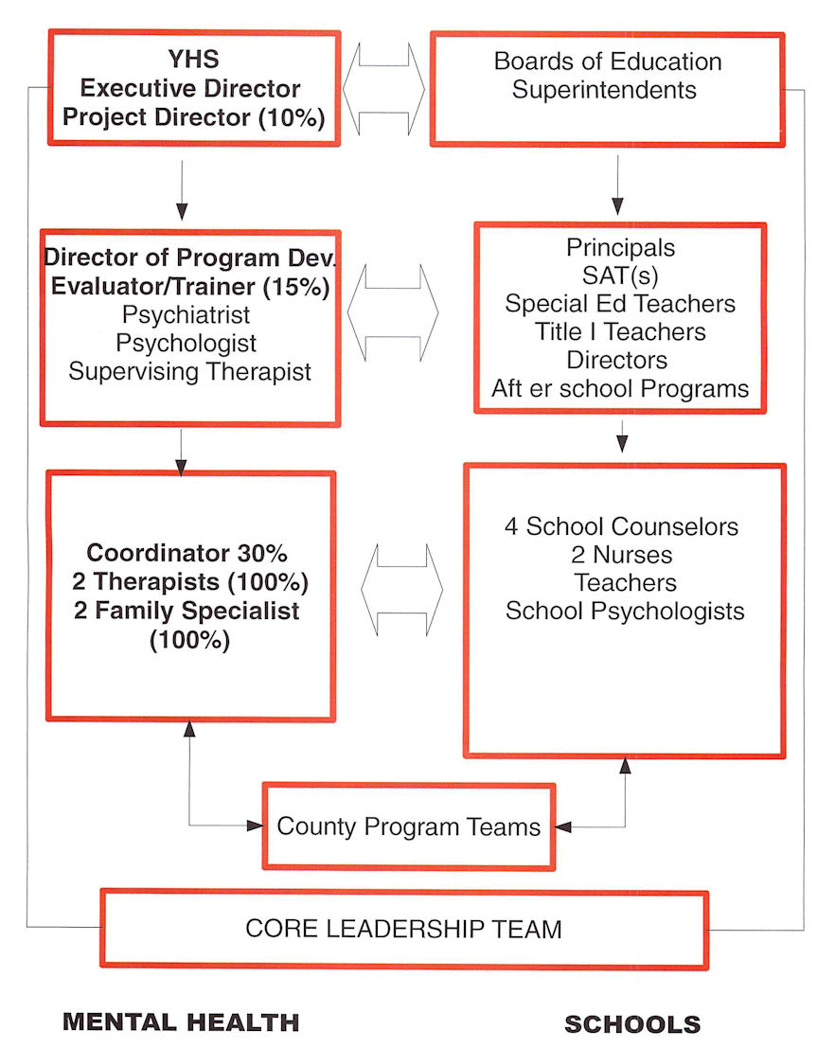

Slide 41
Client Flow Process in YHS ESMH Program
Referrals may be initiated by parent, teacher, school nurse, principal, SAT or student.
All in-school referrals go to the school counselor first.
Notes:
Youth are referred in multiple ways and once referred receive an intake in their local school or they can choose to come to a YHS service site. If services are to be provided in the school, the school counselor notifies the parent, and explains the program. With the parent’s permission she/he then sends the referral to YHS’ case manager (Family Services Specialist) who then contacts the family, further explains the program and the schedules an enrollment appointment. During the enrollment process the family provides informed consent to receive services within the local school and the assessment process begins. All interventions provided in the schools are evidence-based (either listed on SAMHSA’s National Registry of Evidenced-Based Model programs or on the California Department of Social Services Registry of Evidence-based mental health and social program for youth.

Slide 42
Short-term Outcome: Remove Barriers to MH Services
BARRIER
High social stigma associated with MH & services
Teachers/other school personnel feel unprepared
PROGRAM RESPONSE
Move services to youths’ natural environment (schools) & have a low profile initially~
Establish & train work teams
Community (Core Team),
Program team (school counselors, nurse, MH staff) work with SATs
Train all school personnel
Notes:
Significant to the success of any service is the reduction or elimination of barriers to that service. The following barriers presented formidable challenges to youth and their parents who were seeking mental health services in the more remote communities we serve. Today, thanks to our ESMH program, “Health Connections” we have successfully addressed these barriers.

Slide 43
Barriers & Response(cont.)
High gasoline prices & parents must miss work to get youth to appointments
Lack of local access to high-end MH services
Confidential clinical records
Difficulty in keeping up with staff working in schools
Move services closer to clients to eliminate travel
Utilize telemental health services called, YHS-Telecare
Web-based electronic records
Central scheduling
Notes:
$4 per gallon of gasoline was a major barrier to services. Long distances to travel during winter months over two-lane roads in mountainous terrain is also a significant barrier the has been eliminated for many youth.
Most rural parent’s can not afford loss work hours to get their child to MH services, therefore they do not enroll the child in services. A loss to the child, the school and the agency. This is a very family and consumer friendly service and is highly rated by 95% of our clients and parents who use it each month.
Most rural communities have extremely limited access to a child psychiatrists or psychologists, both so important to the provision of quality mental health services for children. Prior to our ESMH program some children traveled 2-4 hours each way to see our child psychiatrist requiring the child to miss a whole day of school and the parent a whole day of work, each month. YHS-Telecare eliminates these significant barriers and provides ready access to our child psychiatrists and psychologists, regardless of where they live, through the use of HIPPA compliant, secure video-conferencing and inexpensive lap top computers, cameras and microphones.

Slide 44
Current Services
Tier 3
Individual & Group Therapies (all must be evidence-based)
Family Therapy
Psychiatry
Psychology
Tier 2
Early Intervention Groups (small groups, or classroom intervention)
Tier 1
Dinosaur School Classroom Intervention (Kindergarten, early elementary)
SOS for Suicide Prevention
Summer Group Program (Pocahontas County)
Primary Prevention Classroom group interventions
Notes:
Our major work is at the Tier 3 level, as this is the most needed service in all of the schools we serve.

Slide 45
Original forecasts which turned out to be true ~ Children & Parents will Benefit Schools and Communities will Benefit Collaborative Mental Health Organizations will Benefit

Slide 46
Original forecasts which turned out NOT to be true ~ Instituting telemental health services would be easy! Schools would not be receptive! Staff would not be receptive!

Slide 47
Youth Health Service, Inc.
Elkins, WV
www.youth-health.org
304-636-9450

Slide 48
Questions?
What training is provided to students, staff, parents? How extensive? What topics?
Referral process and protocols
Consent from parents
Sharing of student information?
Do you consult with teachers and other staff re individual students?

Slide 49
Thank you for your part in building
bridges to the future success of
our students.
Notes:
Our New River Gorge Bridge is a great metaphor for school mental health because most everything we do is related to building bridges between entities.
So let me describe my role in and provide some background or context . I am with the School Health Technical Assistance Center which is based in the School of Medicine at Marshall University in Huntington. Marshall has been involved with school health centers and child mental health projects since the mid-90s, providing technical assistance, training and evaluation through a number of different contracts and grants. Prior to joining Marshall I was with a community health center system and developed and administered three SBHCs.
As you may know, West Virginia is a rural state with a relatively small population of about 1.7 million persons. Our total public school enrollment is around 280,000 students. The school districts are based on county lines which means we have 55 school districts ranging in size from as few as 900 to as many as 27,000 students. WV ranks poorly on most health indicators – including mental, behavioral, and substance abuse. For example, we rank 11th in suicides among 15-24 year olds (14.45/100,000 vs. 9.76 for the US) and among 20-24 year olds the rate is double the national average.

