Slide 1
Best Practice in Chronic Pain and Drug Misuse
Rebecca King MSN, MEd, NCSN, RN
WVDE-Office of Special Education

Slide 2
Objectives
Participants will be able to:
Understand the epidemiology of chronic pain and misuse of opioids;
Know the indications for opioids in chronic pain treatment including general characteristics, toxicities and drug interactions;
Understand initiation and ongoing management of chronic pain of a patient treated with opioid based therapies; and
Learn about safe use, storage and disposal of opiates

Slide 3
Opioids are commonly prescribed for pain
An estimated 20% of patients presenting to physician offices with noncancer pain symptoms or pain-related diagnoses (including acute and chronic pain) receive an opioid prescription . In 2012, health care providers wrote 259 million prescriptions for opioid pain medication, enough for every adult in the United States to have a bottle of pills. Opioid prescriptions per capita increased 7.3% from 2007 to 2012, with opioid prescribing rates increasing more for family practice, general practice, and internal medicine compared with other specialties. Rates of opioid prescribing vary greatly across states in ways that cannot be explained by the underlying health status of the population, highlighting the lack of consensus among clinicians on how to use opioid pain medication (CDC, 2016).

Slide 4
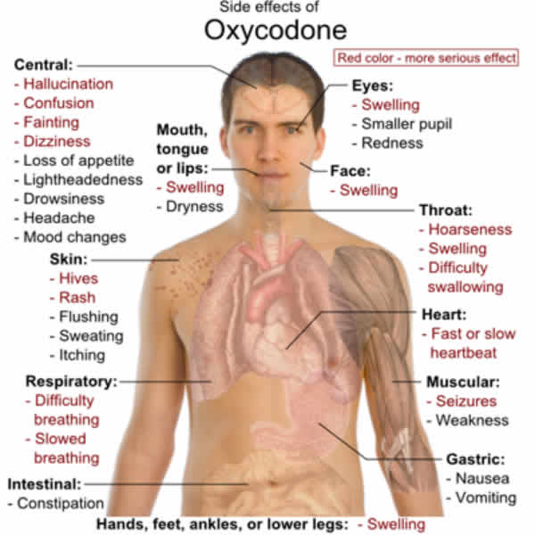
The WV Story…

Slide 5
The epidemiology of chronic pain and misuse of opioids
What is Pain?
An unpleasant sensory and emotional experience associated with actual or potential tissue damage.
Categories of Pain
Acute Pain – results from disease, inflammation or injury to tissues; generally comes on suddenly and may be accompanied by anxiety or emotional distress.
Chronic Pain – widely believed to represent disease itself and can be made much worse by environmental and psychological factors; persists over a long period of time and is resistant to most medical treatments

Slide 6
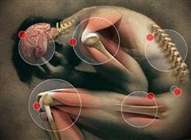
Types of Pain
Nociceptive Pain (sprains, bone fractures, burns, bruises)-special nerve endings which heal with time…somatic and visceral pain,
Neuropathic Pain (shingles, neuralgia, phantom limb pain, Carpal Tunnel Syndrome /CTS, peripheral neuropathy)-nervous system dysfunction pain
Mixed category Pain (migraine headaches)-complex mixture of nociceptive and neuropathic
Central Pain-caused by dysfunction of nervous system such as Fibromyalgia

Slide 7
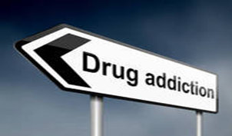
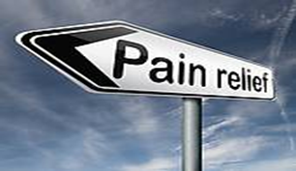
Undertreated Pain vs Over-Prescribing
Contributing Factors
Lack of knowledge among prescribers about current pain management guidelines, risk management practices and research in pain medicine.
Lack of knowledge among prescribers about addiction, dependence and misuse.

Slide 8
2015 National Drug Threat Assessment (NDTA) Summary

Slide 9
2015 National Drug Threat Assessment (NDTA)
The Centers for Disease Control and Prevention reported that 46,471 of our citizens died of a drug overdose in 2013, the most recent year for which this information is available. Drug overdose deaths have become the leading cause of injury death in the United States, surpassing the number of deaths by motor vehicles and by firearms every year since 2008. Overdose deaths, particularly from prescription drugs and heroin, have reached epidemic levels.

Slide 10
2015 National Drug Threat Assessment (NDTA)
Prescription opioid analgesics— specifically those containing oxycodone and hydrocodone—are the most common type of diverted and abused drugs. Opioid pain relievers include, for example, codeine, fentanyl, morphine (MS Contin), hydromorphone (Dilaudid), oxycodone (OxyContin/Percocet/Tylox), methadone, meperidine (Demerol) and hydrocodone (Vicodine). The most common drug diverted from the healthcare facility setting are opioids.

Slide 12
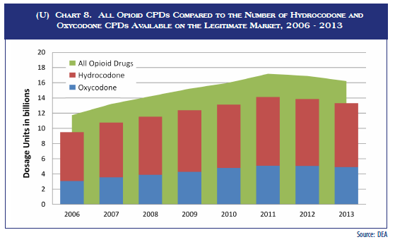

Slide 13
Opioids
An opioid is a chemical that works by binding to opioid receptors, which are found principally in the central nervous system and the gastrointestinal tract. The receptors in these two organ systems mediate both the beneficial effects and the side effects of opioids.

Slide 14
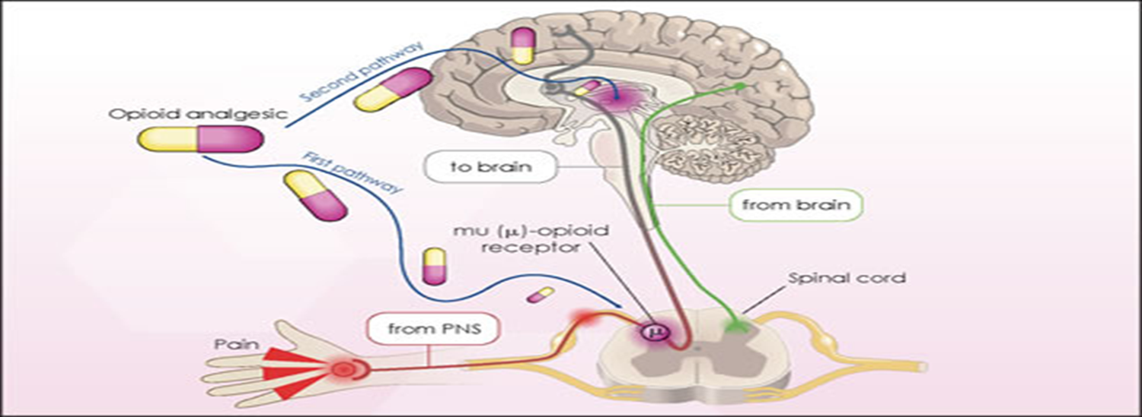

Slide 15
Opioids
The analgesic effects of opioids are due to decreased perception of pain, decreased reaction to pain as well as increased pain tolerance. The side effects of opioids include sedation, respiratory depression, and constipation.
Physical dependence can develop with ongoing administration of opioids, leading to a withdrawal syndrome with abrupt discontinuation. Opioids can produce a feeling of euphoria, and this effect, coupled with physical dependence, can lead to recreational use of opioids by many individuals.

Slide 16
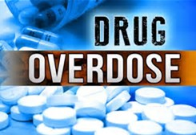
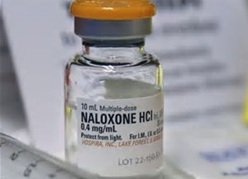
West Virginia Stats
Between 1999-2004
In 2015…
There was a 550% increase in unintentional poisoning mortality in WV, with more than 90% of the deaths due to prescription drug overdoses.
WV had the highest rate of prescription drug overdose deaths in the U.S., surpassing both motor vehicle crashes and falls as the leading cause of accidental death.

Slide 17
WV Overdose Deaths by Year

Slide 18
CDC/NCHS, National Vital Statistics System, Mortality Data
In 2015, the five states with the highest rates of death due to drug overdose were West Virginia (41.5 per 100,000), New Hampshire (34.3 per 100,000), Kentucky (29.9 per 100,000), Ohio (29.9 per 100,000), and Rhode Island (28.2 per 100,000).

Slide 19
CDC/NCHS, National Vital Statistics System, Mortality Data
Significant increases in drug overdose death rates from 2014 to 2015 were primarily seen in the Northeast and South Census Regions.
States with statistically significant increases in drug overdose death rates from 2014 to 2015 included Connecticut, Florida, Illinois, Kentucky, Louisiana, Maine, Maryland, Massachusetts, Michigan, New Hampshire, New Jersey, New York, North Carolina, Ohio, Pennsylvania, Rhode Island, Tennessee, Washington, and West Virginia.

Slide 20
Fundamental Tenets of Responsible Opioid Prescribing
Patient Evaluation & Selection
Treatment Plans
Periodic Review & Monitoring

Slide 21
Patient Evaluation Pain Assessment
Patient
Evaluation
&
Selection
The best way to begin assessing a patients pain is to ask about and listen.
Acknowledge the patient’s pain and treat it in a manner that provides the most effective pain control with the least amount of risk.
Tools for Evaluation of Pain
Tools for Assessing Addiction Risk

Slide 22
Pain Assessment Tools
Free Pain Assessment Tools and Addiction Risk Tools
CDC-Injury Prevention and Control: Opioid Control Clinical Tools at https://www.cdc.gov/drugoverdose/prescribing/clinical-tools.html

Slide 23
Tools for Assessing Pain

Slide 24
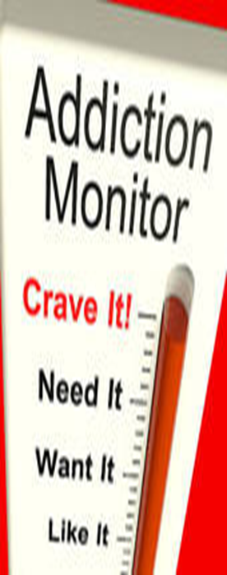
Tools for Assessing Addiction Risk
Opioid Risk Tool – Clinician Form,
Family History of Substance Abuse,
Personal History of Substance Abuse,
History of preadolescent sexual abuse, and
Psychological disorders
(ADD, OCD, Bipolar, depression)
SOAPP 14 Q - Screener and Opioid
Assessment for Patients with Pain Tool
at http://nhms.org/sites/default/files/Pdfs/SOAPP-14.pdf

Slide 25
Patient Evaluation
What to Document
Medical history and physical examination
Document nature and intensity of pain
Document current and past treatments for pain
Document underlying or coexisting diseases or conditions
Document effect of pain on physical and psychological function
Document history of substance abuse
Document the presence of one or more recognized medical indications for the use of controlled substances

Slide 26
Informed Consent
Minimum risk patients
Risks / Benefits must be discussed
Prescriptions to be obtained from one physician only
Prescriptions to be obtained from one pharmacy whenever possible
High risk patients
Written agreement (outlining patient responsibility)
Drug screening / Pill counts

Slide 27
The WV Story…

Slide 28
Treatment Plan Guidelines
Functional Goals
Progress in physical therapy
Better sleeping patterns
Increased activities of daily living
Return to work
Increased social activities
Regular exercise

Slide 29
Treatment Plan Documentation
Must document objectives that will be used to determine.
Treatment success (e.g. pain relief and improved physical and psychosocial function).
If other diagnostic evaluations or treatments are planned.

Slide 30
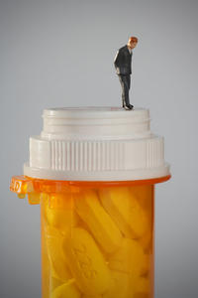
Opioid Care Plan
A written “Plan of Care for Pain Management with Opioids” should
include …
Diagnosis
Goals (maximize quality of life & level
of functioning)
Ways to help patient reach goals
Your specific plan of care for the patient
Follow – up instructions

Slide 31
Periodic Review Guidelines
Never continue long-term treatment if there is inadequate progress toward functional goals
Consult with Specialists when problem exceeds your expertise
Exercise compassion but always VERIFY
Prescription Drug Monitoring Programs (PDMP), urine screening, etc.

Slide 32
Monitoring & Documentation
Benefit to harm evaluation
History & physical
Appropriate diagnostic testing
Tools
Opioid Risk tool
Screener and assessment tool
Verify
Urine drug screening / PDMP’s
Periodic Review
&
Monitoring

Slide 33
Patient Education
Safe Use of Opioid medication
Storage and disposal of medication
Accountability through PDMP’s, drug screening & pill counts
Termination strategies for chronic therapy
** Opioid Treatment Fact Sheet **

Slide 34
Prescription Drug Monitoring Programs (PDMP’s)
Statewide programs that collect data on various controlled substance prescriptions
49 states and one US territory have enacted PDMP legislation
Help Identify patients engaged in prescription drug abuse and diversion
PDMP’s are to prescribers what
radar is to the police

Slide 35
Patient Education & Disclosure Urine Screen
Patients should be taught
The purpose for testing
What will be screened in urine?
Actions that may be taken based on results of screen
Possibility of cost to patient
Patients should disclose
What results the patient expects?
Prescriptions or any other drugs the patient has taken
Time and dose of last opioids

Slide 36
Opioid Misuse Behaviors to Monitor
Less Suggestive of Abuse/ Addiction
More Suggestive of Abuse/Addiction
Selling Prescription drugs
Stealing drugs from others
Repeated dose escalation
Repeated visits to the E.R.
Repeated loss of medication or request for early refill
Openly acquiring pain meds from other doctors
Drug hoarding during periods of reduced symptoms
Aggressive complaining about need for more pain meds.
Reluctance to try alternative
treatments

Slide 37
Key Universal Precautions in Prescribing Controlled Substances
Select Patients who are appropriate candidates for opioid management of chronic pain.
Follow an evidence-based protocol for initiating, titrating and concluding opioid therapy.
Recognize & Intervene when aberrant drug taking behaviors are identified.

Slide 38
WV Board of Medicine (WVBOM) Policy for the Use of Opioid Analgesics in the Treatment of Chronic Pain
Guidelines:
Understanding Pain
Patient Evaluation and Risk Stratification
Development of a Treatment Plan and Goals
Informed Consent and Treatment Agreement
Initiate a Opioid Trial
Ongoing Monitoring and Adapting the Treatment Plan
Periodic Drug Testing
Consultation and Referral
Discontinuing Opioid Therapy
Medical Records
Compliance with Controlled Substance Laws and Regulations
Reference at
https://wvbom.wv.gov/about/Position_Statements.asp

Slide 40
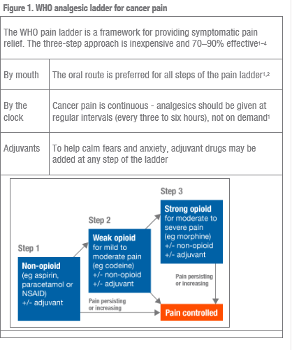
Notes:
Paracetamol=acetaminophen

Slide 41
Can WE turn this around?

Slide 42
Best Practices for Prescribing & Preventing Diversion
CDC Guideline for Prescribing Opioids for Chronic Pain (2016)
The American Pain Society (APS) and American Academy of Pain Medicine (AAPM) “Clinical Guidelines for the Use of Chronic Opioid Therapy in Chronic non-cancer pain”(2013)
The Federation of State Medical Boards (FSMB) “Model Policy for the Use of Controlled Substances for the Treatment of Pain” (2009)

Slide 43
The Dilemma Can we treat pain effectively without addiction?
IOM Report 2011
World Health Report
A 2011 study mandated by IOM reported that 100 million American suffer from chronic pain, costing up to 635 billion annually in treatment and lost productivity.
The number of patients with chronic pain exceeds diabetes, heart disease and cancer combined.
World Health Organization reports that substance abuse is the #1 most preventable health problem. It is costing our nation billions of dollars per year and contributing to the death of hundreds of people.

Slide 44
Safe Use, Storage and Disposal of Opioid Drug
USFDA Disposal of Unused Medicines: http://www.fda.gov/Drugs/ResourcesForYou/Consumers/BuyingUsingMedicineSafely/EnsuringSafeUseofMedicine/SafeDisposalofMedicines/ucm186187.htm
Risk Evaluation and Mitigation Strategy (REMS) http://www.fda.gov/NewsEvents/Newsroom/PressAnnouncements/ucm310870.htm
FDA’s efforts http://www.fda.gov/Drugs/DrugSafety/InformationbyDrugClass/ucm337852.htm
The Drug Take-Back Network http://www.takebacknetwork.com/

Slide 45
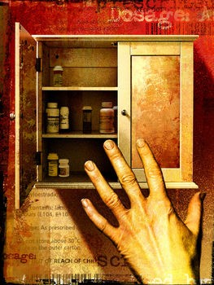
Disposal in Household Trash
If no medicine take-back programs or DEA-authorized collectors are available in your area, and there are no specific disposal instructions on the label, such as flushing as described below, you can also follow these simple steps to dispose of most medicines in the household trash:
Mix medicines (do not crush tablets or capsules) with an unpalatable substance such as dirt, kitty litter, or used coffee grounds;
Place the mixture in a container such as a sealed plastic bag
Throw the container in your household trash;
Scratch out all personal information on the prescription label of your empty pill bottle or empty medicine packaging to make it unreadable, then dispose of the container.

Slide 46
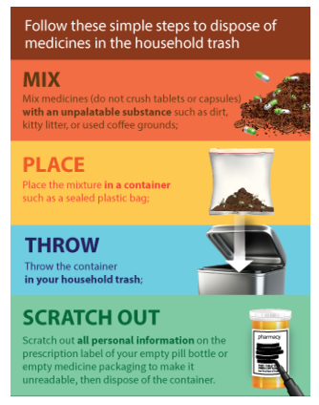

Slide 47
Flushing of Certain Medicines (FDA, 2016)
There is a small number of medicines that may be especially harmful and, in some cases, fatal with just one dose if they are used by someone other than the person for whom the medicine was prescribed. To prevent accidental ingestion of these potentially dangerous medicines by children, or pets, it is recommended that these medicines be disposed of quickly through a medicine take-back program or by transferring them to a DEA-authorized collector. If these disposal options are not readily available, it is recommended that these medicines be flushed down the sink or toilet as soon as they are no longer needed. Click here for a list of medicines recommended for disposal by flushing.

Slide 48
Flushing of Certain Medicines
For example, patients in assisted living communities using fentanyl patches for pain should immediately flush their used or unneeded patches down the toilet. When you dispose of these patches and certain other powerful medicines down the sink or toilet you help to keep others safe by ensuring that these medicines cannot be used again or accidentally ingested and cause harm.

Slide 49
Medicines Recommended for Disposal by Flushing
The FDA has a list to tell you which medicines you should flush down the sink or toilet when they are no longer needed to help prevent danger to people and pets in the home. Flushing these medicines will get rid of them right away and help keep your family and pets safe (Revised April 2016).
Go to https://www.fda.gov/Drugs/ResourcesForYou/Consumers/BuyingUsingMedicineSafely/EnsuringSafeUseofMedicine/SafeDisposalofMedicines/ucm186187.htm#Flush_List

Slide 50
According to WVBE Medication Policy, Remember to Report at School…
To the WV Poison Center at 1-800-222-1222
Any accidental exposure;
Any drug overdoses;
Administration of epinephrine;
Any medication errors; and
Etc.
http://www.wvpoisoncenter.org/

Slide 51
Accidental exposure to medicine in the home is a major source of unintentional poisonings in the United States
In 2007, there were 255,732 cases of improper medicine use reported to Poison Control Centers in the United States. Approximately 9% of these cases (23,783) involved accidental exposure to another person’s medicine. Approximately 5,000 of these accidental exposure cases involved children 6 years and younger.
Keeping medicines after they are no longer needed creates an unnecessary health risk in the home, especially if there are children present. Even child resistant containers cannot completely prevent a child from taking medicines that belong to someone else. In a study that looked at cases of accidental child exposure to a grandparent’s medicine,
45% of cases involved medicines stored in child-resistant
containers.

Slide 52
What does this mean as a nurse and a teacher?
SHARE YOUR EXPERIENCE:
Exposure/Accidental Exposure
Suspected abuse by student or coworker?
What is the appropriate action?
How can you make a change in your schools?
Current system supports in WV?

Slide 53
Solutions
By taking simple steps to ensure that opioids are prescribed safely and transparently, clinicians can help their patients achieve better outcomes and prevent misuse/abuse.

Slide 54
Take Home Messages
Prescription drug abuse is the fastest growing drug problem in America.
Nurses are in the best position to help prevent prescription drug abuse and diversion.
Lack of knowledge about current standards of care, addiction, appropriate pain management & risk are key contributing factors to prescription drug abuse & diversion.
Take Notice and Take Action!

Slide 55
Acknowledgement and credit to Ann Bostic, CRNA

