Slide 1
Trauma Sensitive Schools
Karen Yost, MA, LSW, LPC,NCC, ALPS, MAC, CCDVC, CSOTS
Prestera Center for Mental Health Services

Slide 2
Have you ever had a student who was…
irritable or hostile?
avoidant of school?
chronically poor in self-care health habits?
exhibiting confusion or poor memory when being questioned?
stoic and reluctant to admit to problems, or extremely needy and/or demanding?
presenting with a history of alcohol/substance abuse, depressive symptoms, chronic relationship difficulties ?
problems with learning?

Slide 3
You Are Not Alone!
Youth with histories of trauma are likely to present to schools with some (or many) of these characteristics.
Their behavior can interfere with learning, student-teacher communication, impede compliance with instructions/rules, and generally, frustrate the school staff.
More importantly, these youth are at high risk for academic failure and deteriorating health.
Most youth who have experienced trauma do not seek mental health services.

Slide 4
Trauma is the key
but is rarely on the radar!

Slide 5
Trauma Defined…
“an emotional shock that creates significant and lasting damage to a person’s mental, physical and emotional growth.”
Traumatic experiences can significantly alter a person’s perception of themselves, their environment, and the people around them. In effect, trauma changes the way people view themselves, others and their world.
Can impact safety, well-being, permanence.

Slide 6
Prevalence
70‐80% of mental health clients have severe trauma histories
In state hospitals, estimates range up to 95%
90% or more of women in jails and prisons are victims of physical or sexual abuse
Up to 2/3 of men and women in substance abuse treatment report childhood abuse or neglect
Similar statistics exist for foster care, juvenile justice, homeless shelters, welfare programs, etc
Boys who experience or witness violence are 1000 times more likely to commit violence

Slide 7
Trauma is…
NOT a diagnostic category
A series of experiences that elicits feelings of terror, powerlessness, & out-of-control psychological arousal; result in survival driven behaviors, thoughts, emotions, & needs.
Often misinterpreted & assigned as symptoms of disorders (depression, Bipolar Disorder, ADHD, Oppositional Defiant Disorder, Conduct Disorder, Attachment Disorder, etc.).
These diagnoses generally do not capture full extent of developmental impact of trauma.

Slide 8
Exposure to Trauma
Trauma can be:
A single event
A connected series of events
Chronic lasting stress
Trauma is under-reported and under-diagnosed.
(NTAC, 2004)

Slide 9
Types of Traumatic Experiences
Loss of a loved one
Abandonment
Accidents
Homelessness
Community/school violence
Bullying, including cyber-bullying
Domestic violence
Neglect
Frequent moves
Serious medical Illness
Physical abuse
Sexual abuse
Emotional/verbal abuse
Man-made or natural disasters
Witnessing violence
Terrorism
Refugee and War Zone trauma

Slide 10
Acute Trauma
Chronic Trauma
System Induced Trauma
Complex Trauma
Types of Trauma
A single traumatic event that is limited in time.
The experience of multiple traumatic events.
Vicarious Trauma
Both exposure to chronic trauma, and the impact such exposure has on an individual.
The traumatic removal from home, admission to a detention or residential facility or multiple placements within a short time.

Slide 11
Trauma can occur at any age.
Trauma can impact anyone.

Slide 12
Impact of Trauma Over the Life Span
ACE Study - effects are neurological, biological, psychological and social in nature, including:
Changes in neurobiology
Social, emotional and cognitive impairment
Adoption of health-risk behaviors as coping mechanisms
Severe and persistent behavioral health, physical health, social problems, and early death
(Felitti)

Slide 13
Adverse childhood experiences increase the risk of:
Adverse Childhood Experiences
Heart Disease
Chronic Lung Disease
Liver Disease
Diabetes
Cancer
Immune
Diseases
4 or more traumatic experiences shorten life expectancy by 20 years
Notes:
13

Slide 14
Adverse childhood experiences increase the risk of:
Adverse Childhood Experiences
Mental
Illness
Relationship
Problems
Behavior
Problems
Poor Self-Esteem
Substance Abuse
Suicide
4 or more traumatic experiences shorten life expectancy by 20 years
Notes:
14

Slide 15
Trauma & Cognitive Disability
Trauma interferes with the interpretation and
communication functions of the brain, leading to
non-verbal communication and misinterpretation
of non-verbal signals (language).
• Complex trauma/PTSD interferes with a
person’s ability to store and retrieve information
(memory).
• Understanding brain development and
functioning helps decipher how the person is
interpreting the world around him/her.

Slide 16
Impact on Learning & School Behavior
Loss of pleasure in learning & displays inconsistent or little effort
Belief that they are not smart - especially LD students
Re-live the painful, burning memories of shaming experiences
Exhibit chronic, habitual anger toward teachers and those in authority
Inconsistent attendance/truancy
Low appetite for risk-taking academically and in other areas (“I don’t care”)
Behavior problems

Slide 17
A word about punishment…
A U.S. Department of Education-sponsored research study acknowledges that punishment, "including reprimands, loss of privileges, office referrals, suspensions, and expulsions," is ineffective, "especially when it is used inconsistently and in the absence of other positive strategies".
“Teaching behavioral expectations and rewarding students for following them is a much more positive approach than waiting for misbehavior to occur before responding."

Slide 18
School Punishment
U.S. schools suspend millions of kids -- 3,328,750 in 2006 & 30,750 for WV
Since the 1970s, the suspension rates have nearly doubled for white kids, to nearly 6%; has more than doubled for Hispanics to 7 percent; to 15% for African Americans; For Native Americans, it's almost tripled, from 3% to 8%.
National Education Policy Center Report, October 2011

Slide 19
More Data
If you think all these suspensions are for weapons and drugs, recalibrate.
There's been a kind of "zero-tolerance creep" since schools adopted "zero-tolerance" policies. Only 5% of all out-of-school suspensions were for weapons or drugs, said the NEPC report, 2006.
The other 95% were categorized as "disruptive behavior" and "other", which includes violation of dress code, or being "defiant".

Slide 20
The Reality…
More importantly, they don't work for traumatized kids.
These "throw-away" kids get shunted off a track to college or vocational school and onto the dead-end spur of juvenile hall and prison.
One suspension triples the likelihood of a child becoming involved with the juvenile justice system, and doubles the likelihood of a child repeating a grade. And those suspensions begin early.

Slide 21
TRAUMA-SENSITIVE CARE
Provides the foundation for a basic understanding of the psychological, neurological, biological, and social impact that trauma and violence have on many people.
Incorporates proven practices into current operations to deliver services that acknowledge the role that violence and victimization play in the lives of most of the individuals entering our systems.
“What’s wrong with you?”
“What happened to you?”
Notes:
Maxine Harris (2004) describes a trauma-informed
service system as “a human services or health care system
whose primary mission is altered by virtue of knowledge
about trauma and the impact it has on the lives of
consumers receiving services.”
This means looking at all aspects of programming through a trauma lens and constantly keeping in mind how traumatic experiences impact your clients and staff..
Programs that are informed by an understanding of trauma respond best to client needs and avoid engaging them in re-traumatizing practices.
(National Center on Family Homelessness, 2007)

Slide 22
A Culture Shift: Core Principles of a Trauma- Sensitive System
Safety: Ensuring physical and emotional safety
Trustworthiness: Maximizing trustworthiness, making tasks clear, and maintaining appropriate boundaries
Choice: Prioritizing choice and control
Collaboration: Maximizing collaboration and sharing of power with students
Empowerment: Prioritizing student empowerment and skill-building

Slide 23
What Can a School Staff Do?
Recognize that exposure to trauma is the rule, not the exception, among children in the child welfare system.
Recognize the signs, symptoms & cumulative effect of child traumatic stress and how they vary in different age groups.
Recognize that children’s “bad” behavior is sometimes an adaptation to trauma.
Understand the impact of trauma on different developmental domains.
Help other staff understand how their own communication style brings on behavior that hinders learning (disruption, passivity, anxiety).

Slide 24
What Can a School Staff Do?
Recognize that education system responses/interventions have the potential to either exacerbate or decrease the impact of previous traumas.
Lessen the risk of system-induced secondary trauma by serving as a protective and stress-reducing buffer for children.
Develop trust with children through listening, frequent contacts, and honesty in order to mitigate previous traumatic stress.
Avoid making professional promises that, if unfulfilled, are likely to increase traumatization.

Slide 25
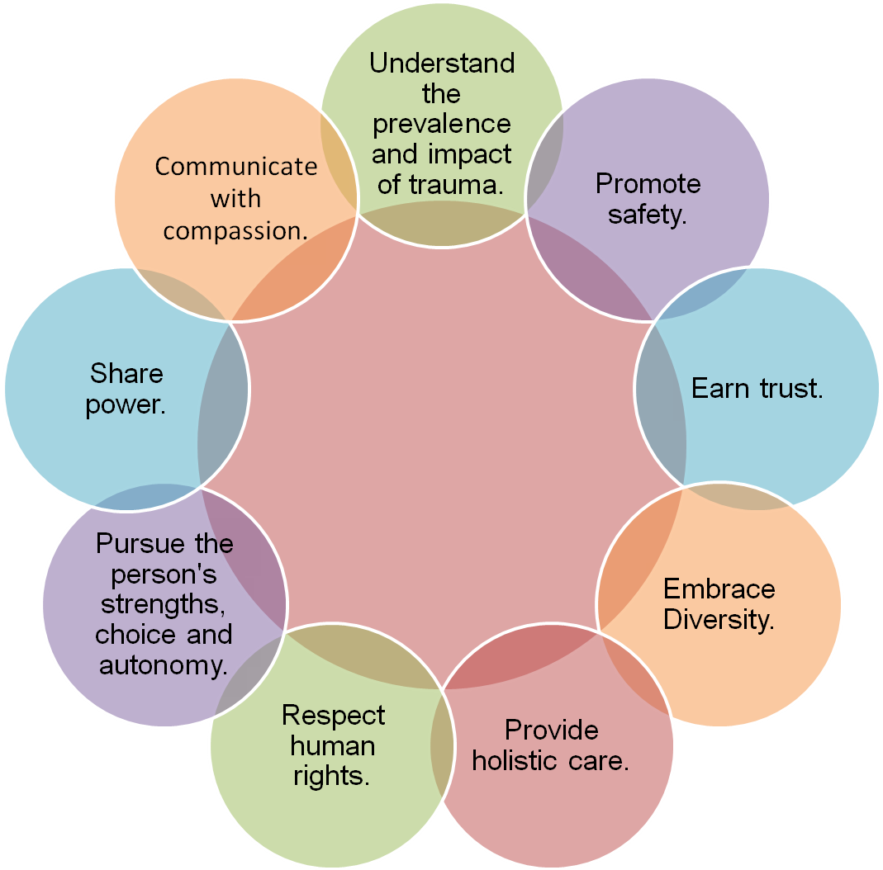
Guiding Values of Trauma-Informed Care “Healing Happens in Relationship”
Notes:
25

Slide 26
Thoughts from Helen Keller
The extraordinary Helen Keller, despite being blind and deaf, achieved so much in her life. She once said: “The world is moved not only by the mighty shoves of the heroes, but also by the aggregate of the tiny pushes of each honest worker.” Each of you is a “honest worker” caring and giving so much of yourselves to help others. If you all push a little you can move mountains and yourselves. You are so intertwined, you caregivers and your care recipients, that rules and regulations that are aimed at helping them also help you, and rules and regulations that are designed to help you also help them.

Slide 27
Questions?
Karen Yost, MA, LSW, LPC,NCC, ALPS,
MAC, CCDVC, CSOTS
Prestera Center for Mental Health Services

