Slide 1



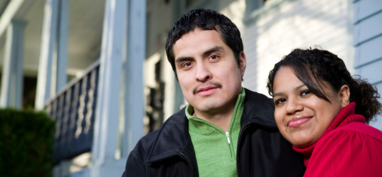
Medical Exemptions and
School Nurse Module

Slide 2

School Immunization Requirements
School immunization requirements
have played a major role in
controlling vaccine-preventable
diseases (VPDs) among school
children
All states and the District of
Columbia require children entering
school to provide documentation
that they have met the state vaccination requirements
This model for elimination and control of VPDs exists all over the world

Slide 3

Medical/Nonmedical Exemptions
Although immunizations are required for school entry, most states offer nonmedical exemptions (religious or personal belief)
All states allow medical exemptions to
school and daycare immunization
requirements
48 states allow religious exemptions
19 states have a provision for personal
belief exemptions

Slide 4
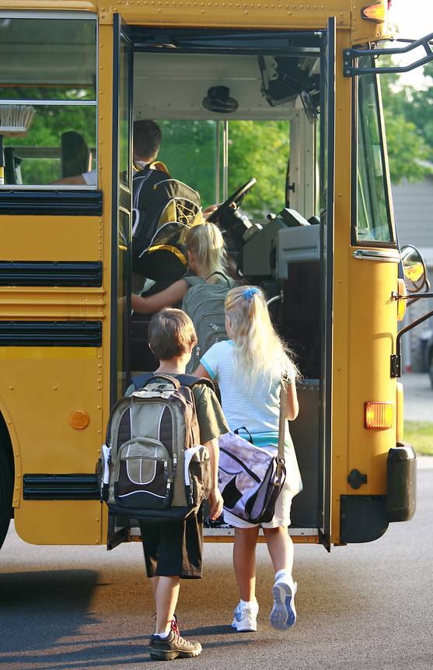
WV Medical/Nonmedical Exemptions
WV does not grant personal or
religious exemptions
WV is one of only two states that
allow only medical exemptions to
school immunization
Non-medical exemptions have been
associated with increased occurrence
of serious diseases spread by sick
school children

Slide 5
Historical Review
WV School Immunizations 1987-2013
1987: WV State Code 16-3-4
2008: WV code of state rules 64CSR95
2011: WV code of state rules 64CSR95
Compulsory immunization of school children Sets specific vaccine requirements for all children entering school for first time. Covers six diseases:
Diphtheria, Polio, Measles, Rubella, Tetanus and Pertussis
Three additional vaccines are added for school admission:
Adds two adolescent vaccines:
Tdap & MCV
Varicella, Hepatitis B, Mumps

Slide 6
State Code – Compulsory Immunization
§64-95-4
All students attending a West Virginia school for the first time shall show proof of immunization against the following diseases:
Diphtheria | Rubella
Hepatitis B | Rubeola (Measles)
Mumps | Tetanus
Pertussis (Whooping Cough) | Varicella (Chickenpox)
Poliomyeltis

Slide 7
State Code – Compulsory Immunization
§64-95-8
Vaccine requirements for adolescents
Effective June 1, 2012, and prior to the beginning of the school year 2012 – 2013, Tdap and MCV4 vaccines became required for children attending middle and high schools in West Virginia
Proof of vaccination shall be presented upon entry to the 7th and 12th grades, as indicated
Tdap: One dose before 7th or 12th grade entry
Meningococcal: One dose before 7th grade entry; 2nd (booster, age appropriate) dose required before 12th grade entry

Slide 8
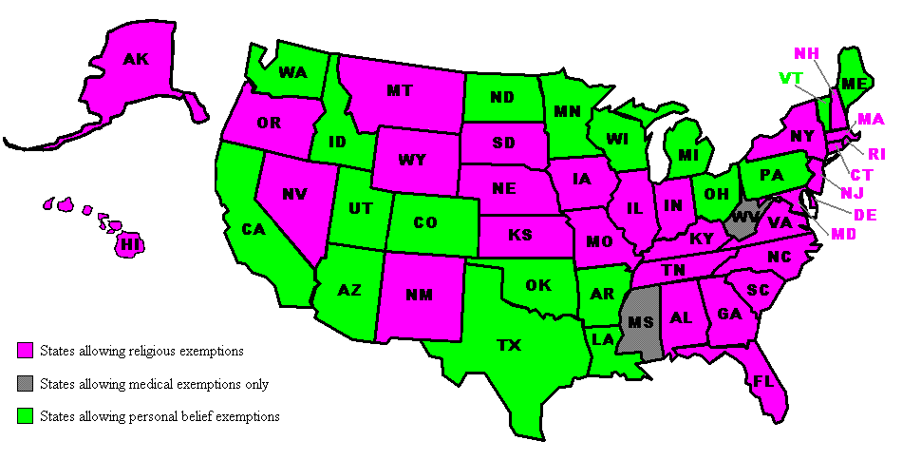
Exemptions by State

Slide 9
Medical Exemption Requests
§64-95-10 Medical Exemptions
The provisions of this rule may not apply if a child has a valid medical contraindication or precaution to a particular vaccine
Medical exemption request must be from a physician who has treated or examined the child and submitted to the local health officer in the county where the child will attend school

Slide 10
Valid Medical Exemption
Conditions which constitute a valid medical exemption
Weakened immune system due to a permanent or temporary condition – e.g. certain diseases, medications, cancer, chemotherapy, radiation treatment, etc.
Severe allergy to a vaccine component
Serious adverse event associated with a previous vaccination

Slide 11
Medical Exemption Requests - cont.
The physician’s request for exemption from immunization shall state specifically:
which vaccine or vaccines the child should be exempt from receiving
an explanation of the medical contraindication or precaution relied upon to make the request
whether the exemption is permanent or temporary

Slide 12
Invalid Medical Exemption Requests
Examples of Invalid Exemptions
Use of experimental or unlicensed products to provide immunization
Family has history of vaccine reactions
Requests which incorporate philosophical and religious objections to immunization
Common, non-serious side effect to a previous vaccination
Parental anxiety/adherence to “slow” vaccine schedule and any other reasons not supported by current medical standards

Slide 13
Medical Exemptions Process
1.
Requests for medical exemption from vaccine requirements shall be reviewed and approved or denied initially by the local health officer in the county where the requestor attends school
2.
Approval or denial of a request shall be in writing and a copy of the response shall be sent to the State Health Officer
3.
Local health officials shall verify that immunization exemptions are entered into the West Virginia Statewide Immunization Information System -- WVSIIS-- to enable support of individuals at increased risk of disease in an outbreak and to aid in disease control and surveillance (10.4)

Slide 14
Medical Exemptions Process - cont.
4.
The local health officer’s decision on a request for a medical exemption from immunization may be reviewed by the State Health Officer
5.
The request for state level review and the State Health Officer’s decision on such requests shall be in writing
6.
Decisions of the State Health Officer may be appealed as described in procedural rule 64CSR1

Slide 15
Medical Exemptions Process cont.
All requests for medical exemption from immunization shall be reviewed. Determinations are based on current medical science and recommendations from the:
- Advisory Committee on Immunization Practices (ACIP)
- American Academy of Pediatrics (AAP)
- American Academy of Family Physicians (AAFP)
10.7.

Slide 16
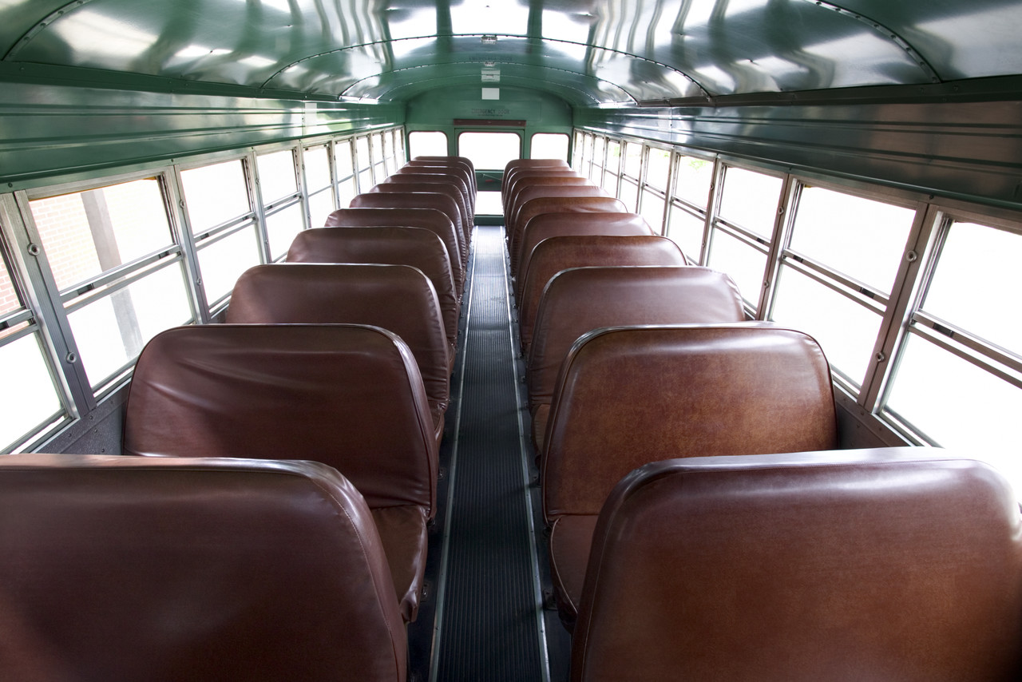
Importance of Tracking Medical Exemptions
To enable public health to
quickly identify children in
our schools who have a
medical exemption so
they may be excluded until
The outbreak is over
To track the number and
type of medical exemptions

Slide 17

Importance of Tracking Medical Exemptions cont.
To ensure that medical exemptions
are not requested/obtained because
they the are the only type of
exemption available
To report medical exemption data to
the public or legislature when
requested

Slide 18
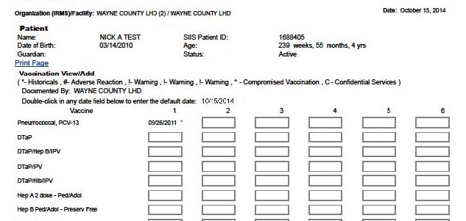
View/Add Screen

Slide 19
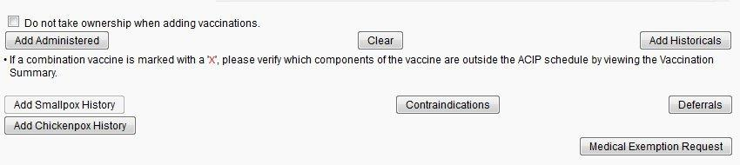
Exemption Request Button

Slide 20
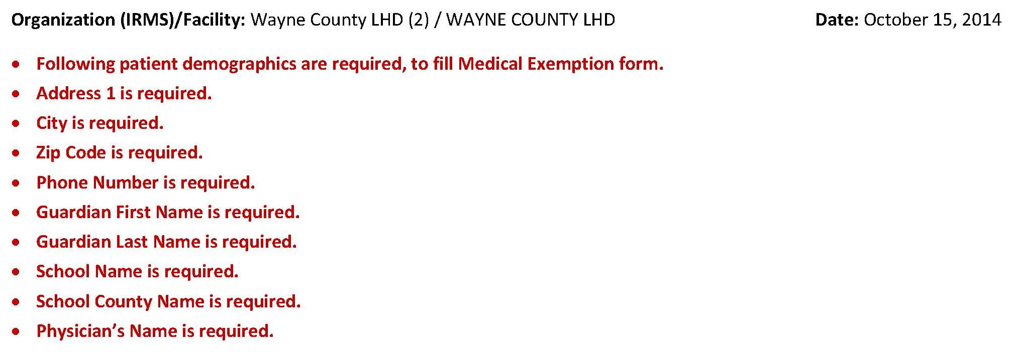
Required Fields

Slide 21
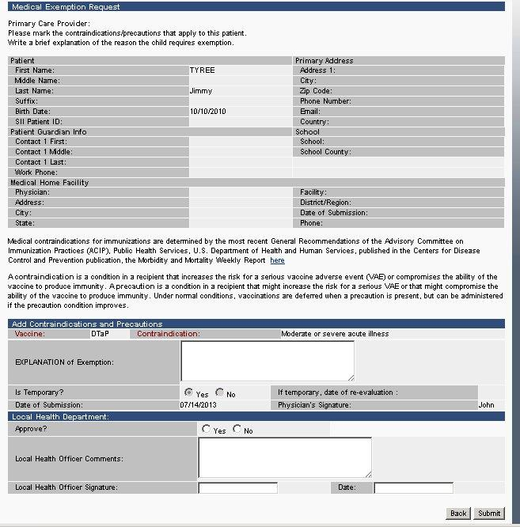
LHO Approval Screen

Slide 22
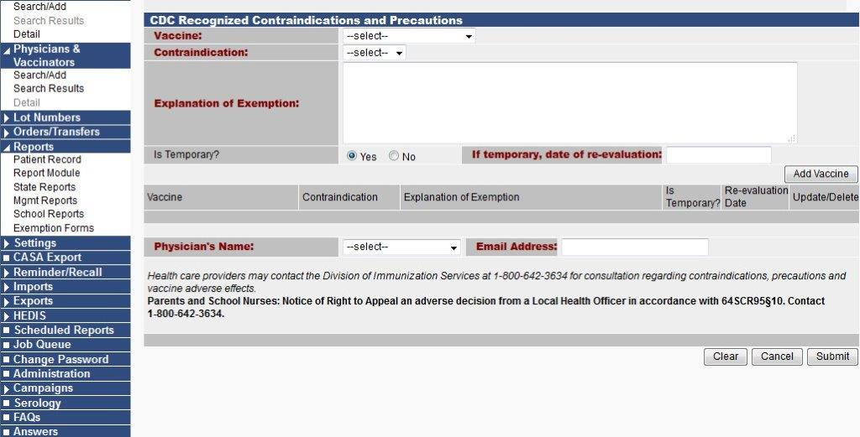
Request Section (Blank)

Slide 23
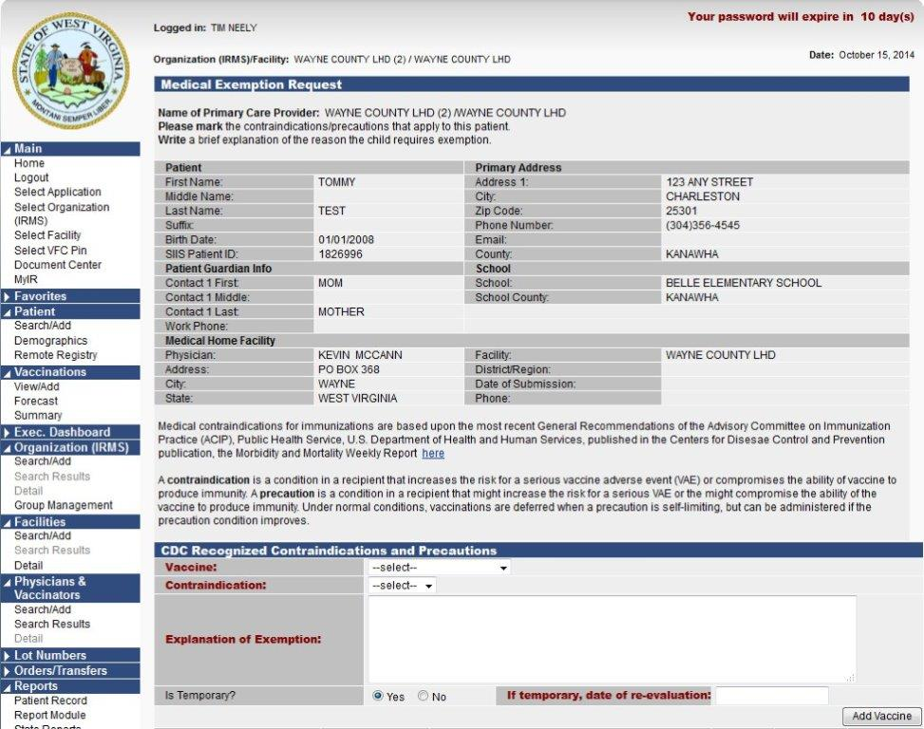
Demographics Completed

Slide 24
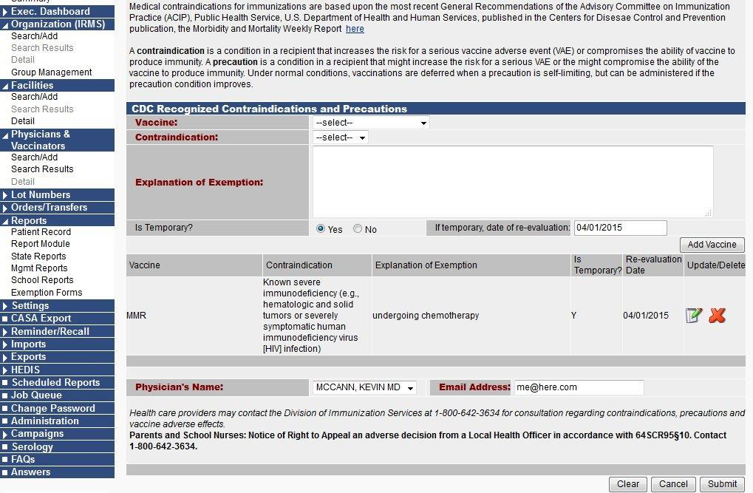
Exemption Details

Slide 25
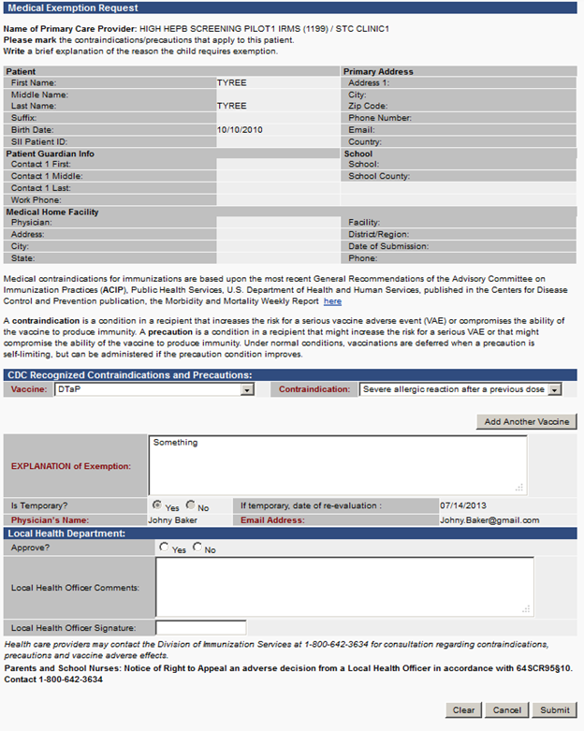
Exemption Request Summary

Slide 26
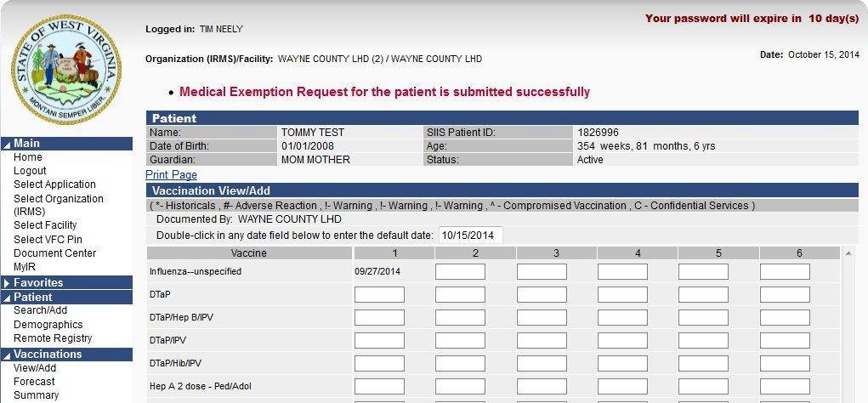
Exemption Acknowledgement

Slide 27
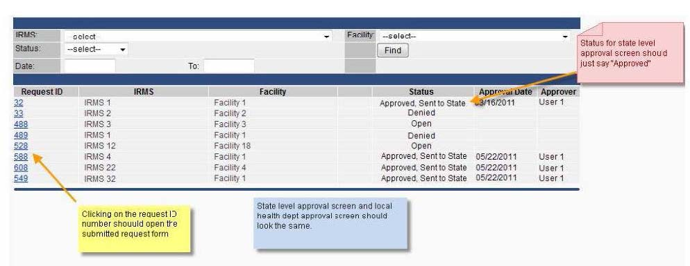
Exemptions Tracking Page

Slide 28
WVSIIS School Nurse Module
WVSIIS and its role in public health
Benefit to the school nurse
Why report to the registry
Entering historical vaccination records
Available reports

Slide 29
WVSIIS is a confidential, population-based, computerized database that can record all immunization doses administered by participating providers to persons within WV
WVSIIS (WV Statewide Immunization Information System)

Slide 30
At the Point of Clinical Care
WVSIIS . . .
provides consolidated immunization histories for use by the vaccination provider in determining appropriate vaccinations for patients

Slide 31
At the Population Level
WVSIIS . . .
provides aggregate data on vaccinations for use in surveillance and program operations
guides public health action with the goals of improving vaccination rates and reducing vaccine-preventable diseases

Slide 32
For the School Nurse
WVSIIS . . .
gives convenient access to student immunization and forecast records
gives the ability to enter historical vaccinations
gives the availability of additional school nurse module reports

Slide 33
School Nurse Module
Purpose
The school nurse module provides school nurses special access to the immunization REGISTRY and to allow the ability to create school specific reports in order to manage student immunization coverage

Slide 34
School Nurse Module
The school nurse module features an abbreviated demographic screen where users can view demographic data and immunization history contained in the registry
Users may add new students, update the student’s demographic data, and add historical immunizations

Slide 35
Why Report Vaccinations to the Registry?
WVIIS provides easy access to patient immunization records
Supports efforts to improve patient coverage rates within the state
Enables healthcare providers to make appropriate clinical decisions based on accurate data in the registry

Slide 36
Historical Vaccinations
WVSIIS is the official repository of WV immunization records
Historical vaccination entry is a way to ensure that the student’s vaccination record is complete in WVSIIS
School nurses are an invaluable resource for obtaining complete immunization histories and entering missing shot records as needed

Slide 37
Entering Historical Vaccination Records

Slide 38
Entering Historical Vaccination Records
Entering historical vaccination records is a simple process that goes beyond the traditional ‘view only’ access for school nurses
Entry of missing vaccinations will help complete the shot record for the student which will enable the school and health professional easy access to complete and accurate vaccination records

Slide 39
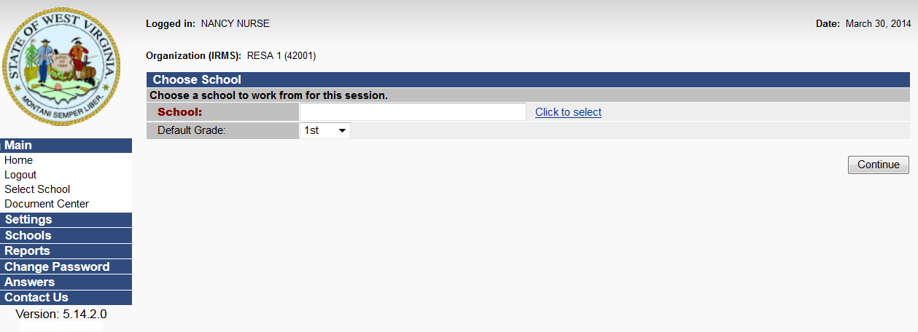
Selecting A School
When logging into the school nurse module, you see a slightly different format that requires you to select the school the student attends
To select a school, click on ‘click to select’

Slide 40
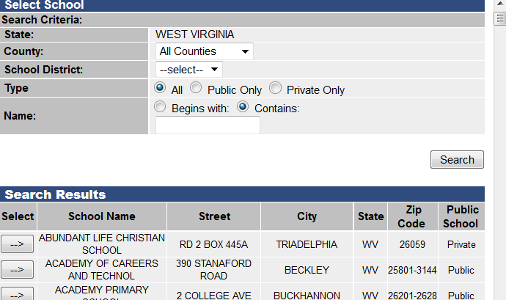
Selecting A School
Click on ‘search’ and select school from the list

Slide 41
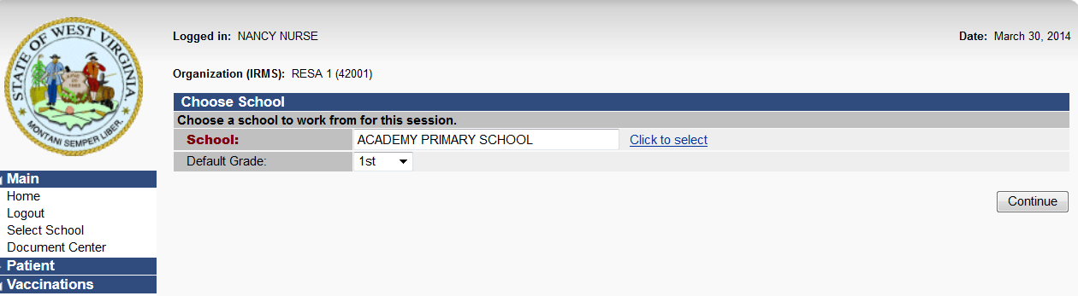
Selecting A School
After selecting the school, click ‘continue’

Slide 42
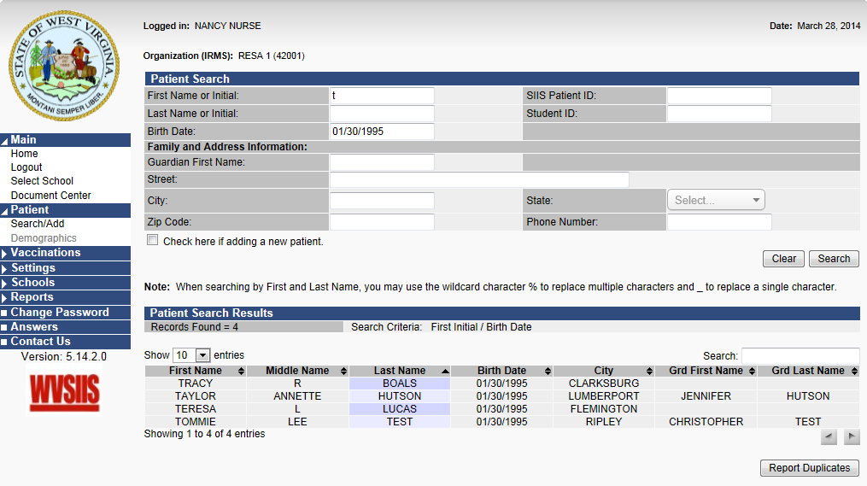
Selecting A Student
Next, select the student.
Fill in the search criteria and click on ‘search’
Choose the correct student from the search results

Slide 43
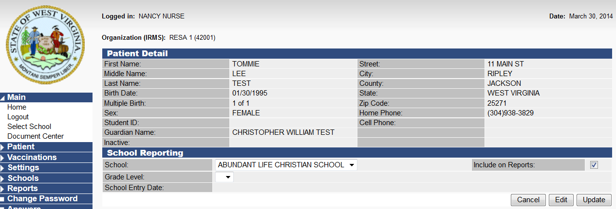
Selecting A Student
Check the ‘include on reports’ box and click ‘update’
This will assign the student to the appropriate school for report purposes

Slide 44
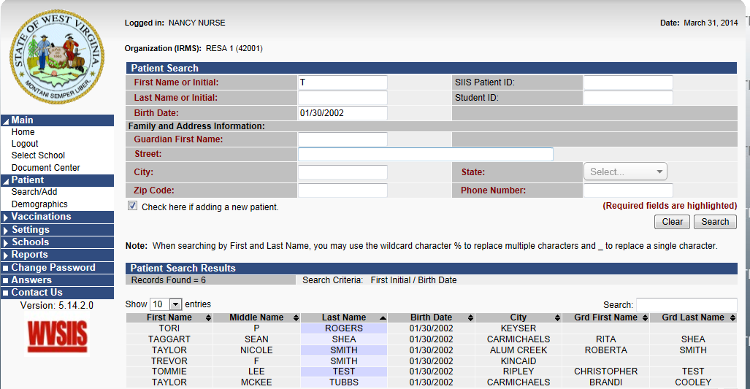
Adding A Student
If your search does not find the student you are looking for, you may add the student by checking the ‘check here if adding a new patient’ box. The required fields will be highlighted in red

Slide 45
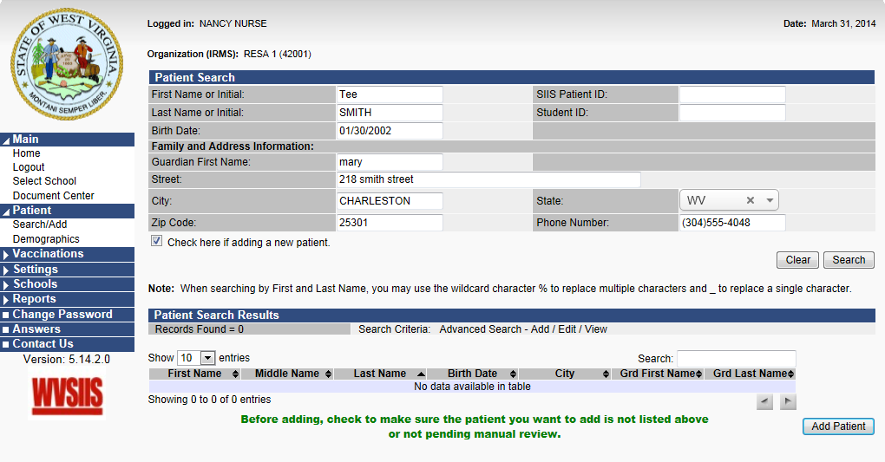
Adding A Student
After information is entered, click ‘add patient’

Slide 46
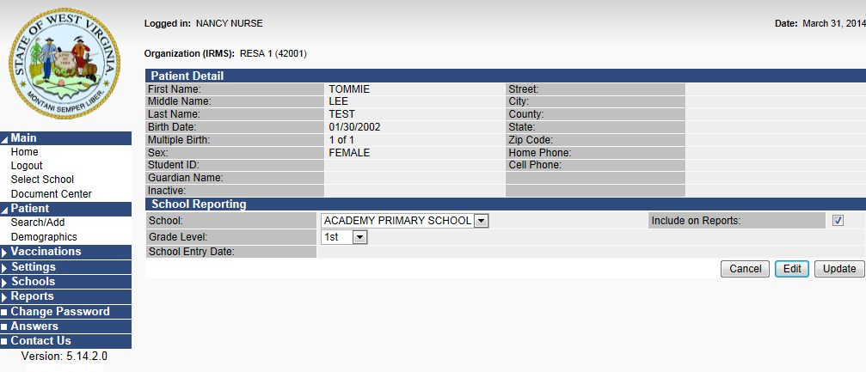
Editing Student Demographics
To change the address or phone number for a selected student click ‘edit’

Slide 47
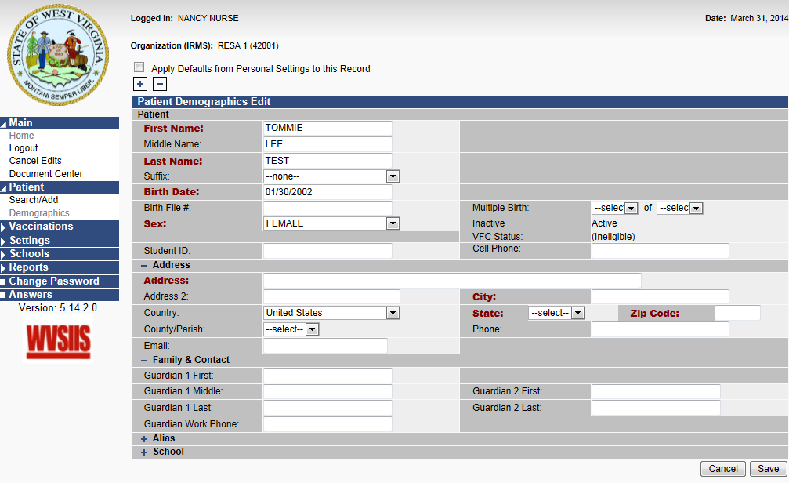
Editing Student Demographics
Enter the new information and click ‘save’

Slide 48
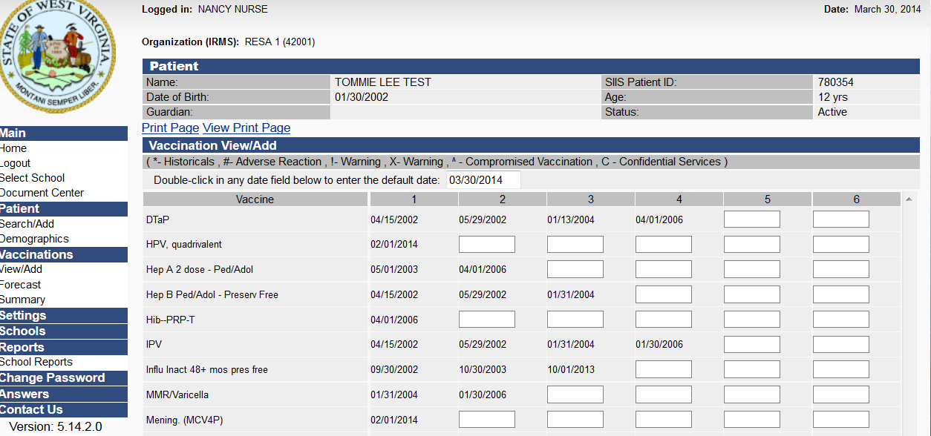
Entering A Historical Vaccination
To add a historical vaccination, under the vaccinations menu on the left, click on ‘view/add’
Enter the date the vaccination was administered in the box beside the correct vaccination

Slide 49
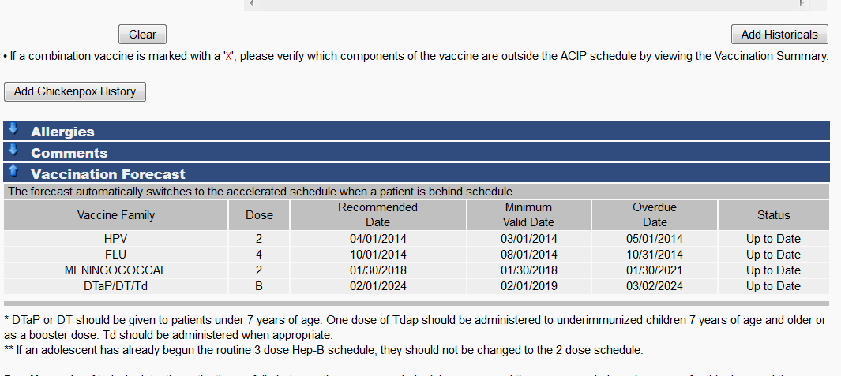
ENTERING A HISTORICAL VACCINATION
AFTER ENTERING THE VACCINATION DATE, SCROLL DOWN AND CLICK ON ‘ADD HISTORICALS’

Slide 50
Available Reports

Slide 51
Vaccination Forecast
The Vaccination Forecast Report is a tool utilized to show the future dates that the patient will need to be vaccinated according to the ACIP schedule. It can be used to determine at a glance if the student is missing necessary immunizations.
The forecast can also be used to determine when a provisional school enrollment period should expire
BPH recommends adding 15 days to the date of when the last forecasted, required immunization is due

Slide 52
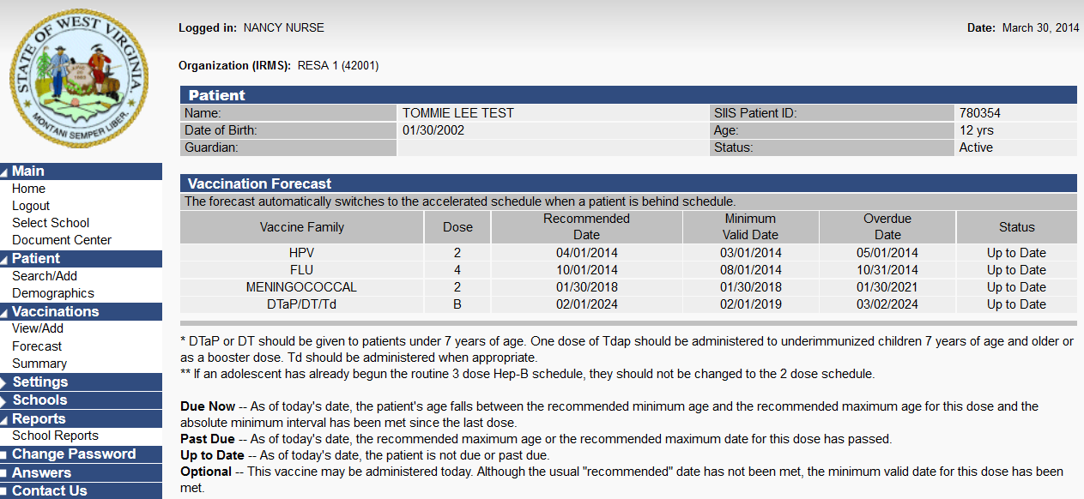
Vaccination Forecast
Under the vaccinations menu, click on ‘forecast’
This shows the vaccinations that are still due or overdue for the student
This report should be viewed only after the missing historical vaccinations are entered

Slide 53
Vaccination Summary
The Summary Patient Record report shows all vaccinations that have been recorded in the registry. The date and dose are listed along with the age it was administered.
If the student’s recorded vaccinations are up-to-date in the registry, the report shown will be an accurate account of the vaccinations given and will also show future vaccinations due for the selected student.

Slide 54
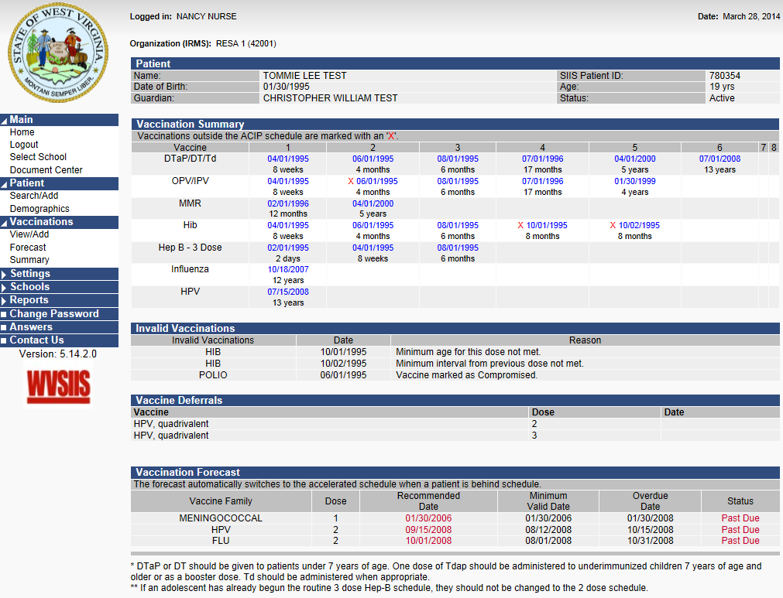
Vaccination Summary
Under the vaccinations menu, click on summary
This report should be viewed only after the missing historical vaccinations are entered

Slide 55
School Nurse Reports
School immunization report, first time enterer
Summary of school enterers data
Patient detail
Absentee report
*Note: these reports will only be valuable if all students have been assigned to a school roster

Slide 56
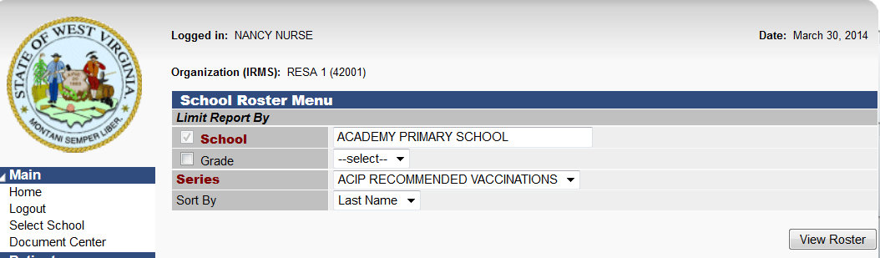
Adding Students To School Roster
From the schools menu, click on ‘roster’ and choose vaccination series
Click on ‘view roster’

Slide 57
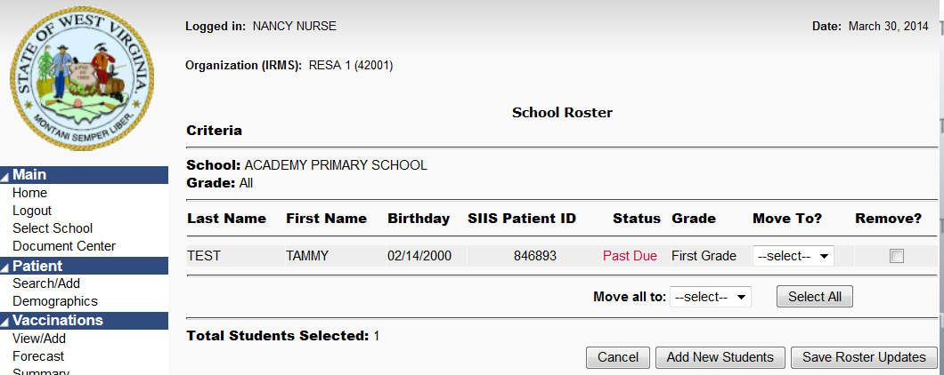
Adding Students To School Roster
Click on ‘add new students’

Slide 58
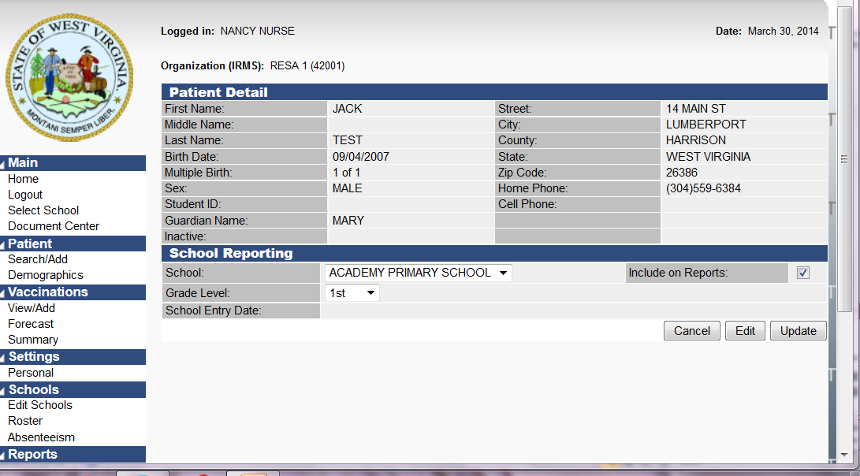
Adding Students To School Roster
From the patient menu, click on ‘search/add’ and choose patient
Check the box ‘include on school reports’, and click on ‘update’
Repeat for each student

Slide 59
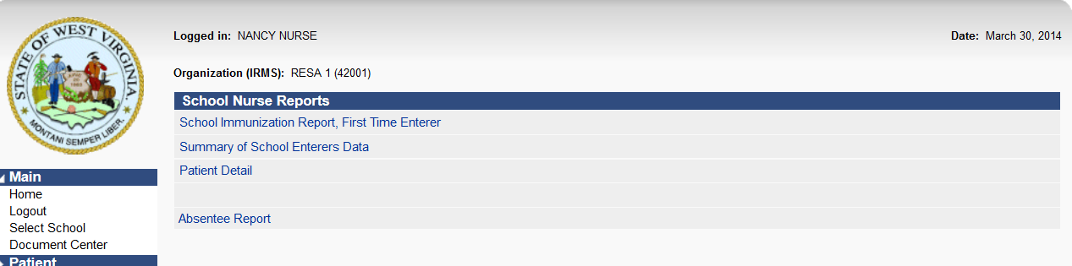
School Nurse Reports
From the ‘reports’ menu on the left, click on ‘school reports’ and choose the report you wish to run
You will see the following screen:

Slide 60
School Immunization, First Time Enterer
This report can be produced for new students you have assigned to a school.
It can show the number of students needing vaccinations or which students have completed vaccinations.

Slide 61
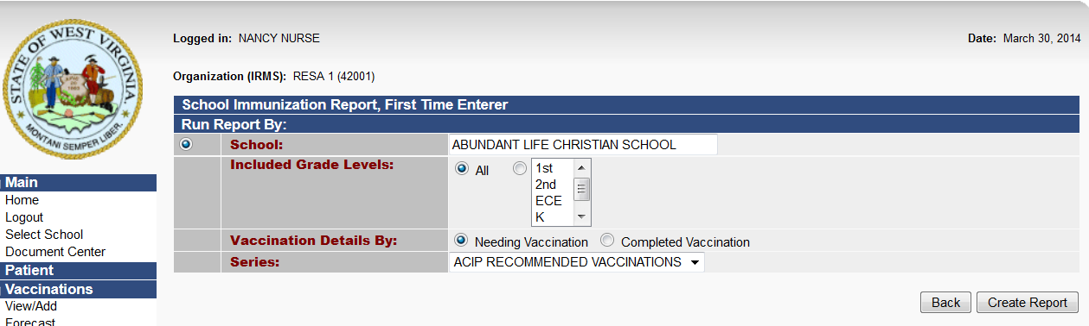
School Immunization, First Time Enterer
From the ‘reports’ menu on the left, click on ‘school reports’ and choose ‘school immunization report, first time enterers’
Click on ‘needing vaccination’ or ‘completed vaccination’ bubble and click on ‘create report’

Slide 62
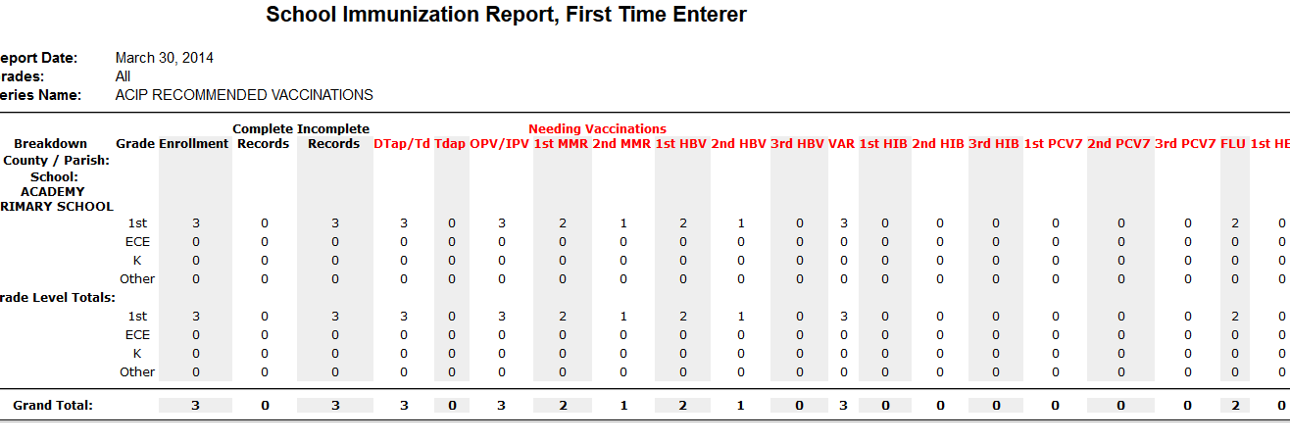
School Immunization, First Time Enterer
This report will show the number of incomplete or complete records for students added to the school roster

Slide 63
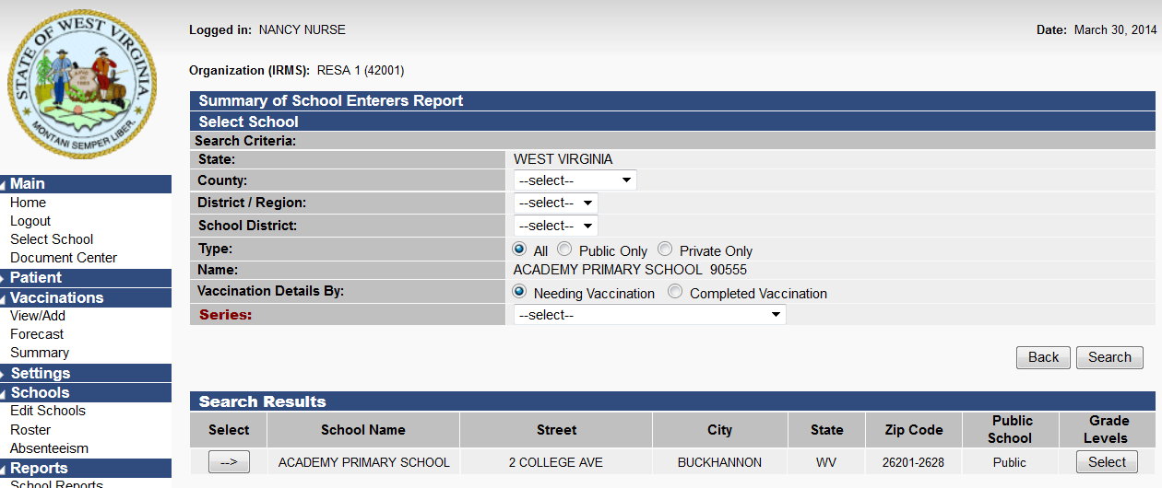
Summary of School Enterers Data Report
From the ‘reports’ menu on the left, click on ‘school reports’ and choose ‘summary of school enterers data’
Choose vaccination series
Click on ‘select’

Slide 64
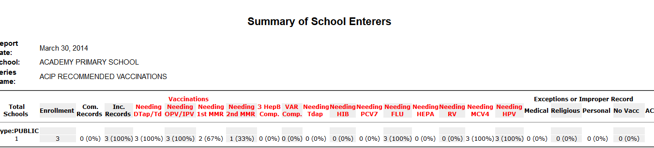
Summary of School Enterers Data Report
This report will show the percentage of incomplete or complete records for students added to the school roster

Slide 65
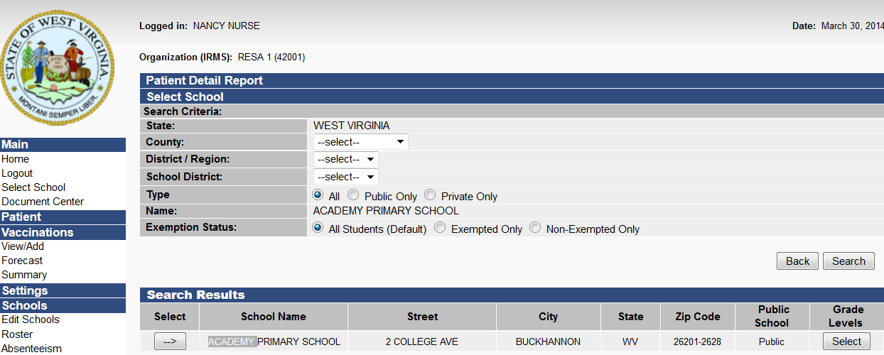
Patient Detail Report
From the reports menu, click on ‘school reports, and choose ‘patient detail report’
Select school

Slide 66
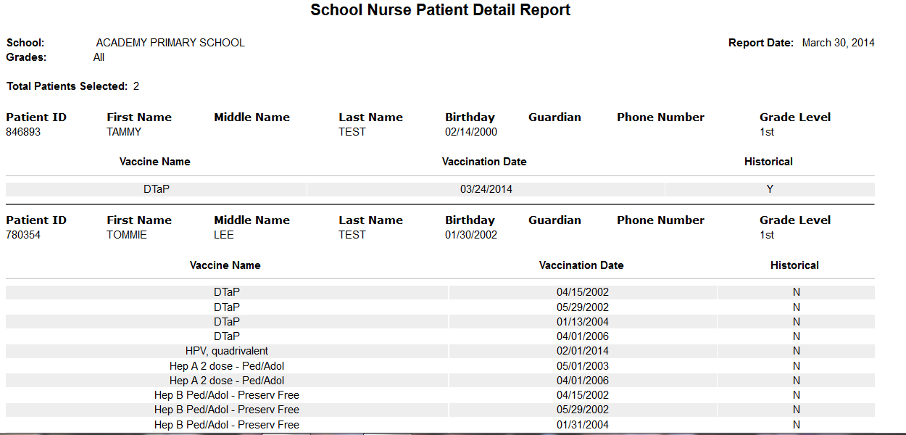
Patient Detail Report
This report will show the vaccination records for the students that have been added to the school roster

Slide 67
Tracking Absenteeism
The number of students absent each day can be tracked
and a report can be produced
to show the number of absentee days
for a specific time period

Slide 68
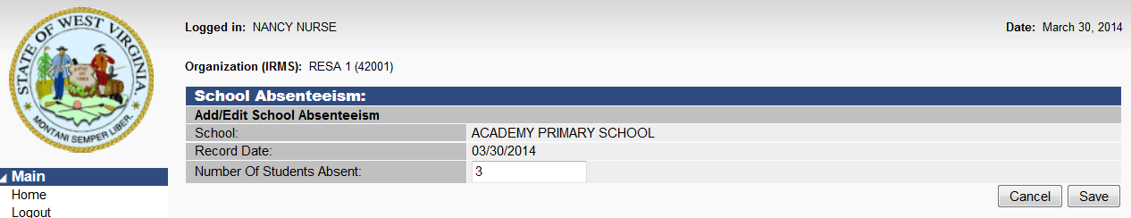
Tracking Absenteeism
From the ‘schools’ menu, click on ‘absenteeism’
Enter date or date period you will be entering absentee days for
Click ‘add’
Enter the number of students absent for that date or date period and click ‘save’

Slide 69
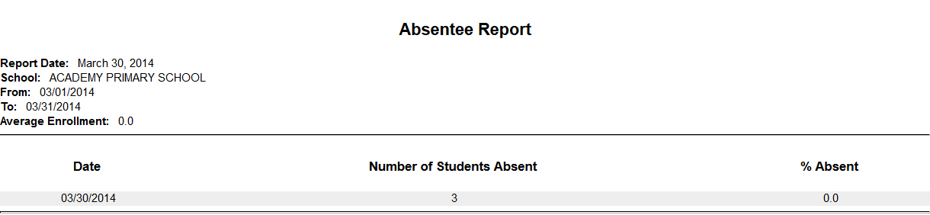
Absentee Report
Under the ‘reports’ menu, click on ‘school reports’ and select ‘absentee report’
Enter the period of absentee days you want to view and click on ‘create report’

Slide 70
Helpful Resources On Homepage
School Nurse Module Power Point Presentation
WVDIS Website
  ACIP immunization schedules
  Childcare, school, and college requirements
  Vaccine-preventable diseases

Slide 71
Verification Of Training
  In order to acknowledge you have completed this training
  and to request access to the school nurse module in WVSIIS,
  please click on the link below:
  Training Verification Survey

Slide 72
Points Of Contact
Jeff Neccuzi - Division of Immunization Services (WVDIS) Director
Jean Khoury - WVDIS (Consultant for Accelerated Vaccine Schedules, Minimum Intervals, etc.)
Sarah Lieu - WVDIS Public Information Specialist
304-558-2188 OR 1-800-642-3634
Pam Reynolds - WVSIIS Information Quality Services Coordinator
304-356-4048
Carol Smith – WVSIIS Information Quality Services Specialist 304-356-4945
Becky Pierson – WVSIIS Help Desk Analyst
877-408-8930 or 304-356-4047

