Slide 1
Good morning

Slide 2
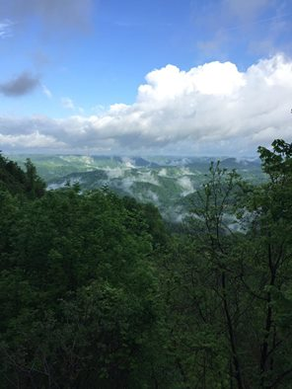
Letcher county Whitesburg, Kentucky
Whitesburg, population 1,300, county seat of Letcher County, population 22,773 is at the foothills of Pine Mountain on KY/VA border.
Per capita income: $17,194.00.
Unemployment rate: 11.9 (2016)
Persons in Poverty: 6,419 (2015)
Children in Poverty: 1,646 (2015)
Free/Reduced Lunch Rate: 72%
SNAP Recipients: 7,512 (2014)
Source: Economic Research

Slide 3
Letcher county health/wellness Kyhealthfacts.org
 | Letcher County | Kentucky
Infectious Disease (per 100,000) | 17.5 | 8
Premature Death (years lost per 100,000) | 14,202 | 9,612
Less than Good Health (% Adults) | 38% | 23%
Prevalence of Diabetes (% Adults) | 26% | 13%
Prevalence of Hypertension (% Adults) | 55% | 39%
Heart Disease Deaths (per 100,000) | 290 | 202
Stroke Deaths (per 100,000) | 53 | 42
Prevalence of Obesity (Percent Adults) | 40% | 33%
Prevalence of Overweight (Percent Adults) | 73% | 67%
Lack of Physical Activity | 45% | 30%
Recommended Fruit/Vegetable Intake | 18% | 19%

Slide 4
PARTNER Support
Community Farm Alliance Grow Appalachia Mountain Comprehensive Health Corporation Cowan Community Center The City of Whitesburg Central Appalachian Network KY State University University of Kentucky UK Super Fund Research UK College of AG Food & Environment UK Gill Heart Institute UK Appal TREE Project Marshall University Berea College Ap Fund Berea College Brushy Fork Virginia Tech Univ Duke/NC Robertson Scholars USDA Summer Food Service Division of School Comm. Nutrition Community Enterprises Nutritional Enterprises
Brook T. Smith Foundation MACED KCARD KY Division of Forestry Governors Office of AG Policy State Rep Angie Hatton WellCARE Passport Health Plan BBT Delta Dental LabCorp Humana ARH Partnership for a Fit KY Mountain Heart Center Annies Frugal Finery The Parlor Room KY Technical Assistance Program WIC Farmers MKT Program Senior Farmers MKT Program Appalshop/WMMT Hindman TV Mountain Eagle News Press Humans of Central Appalachia Letcher County Culture Hub Letcher County Public Schools Letcher County Veterans Museum
Letcher Health Department Letcher County Senior Citizens Letcher County Extension Letcher County Library Letcher County Jail Letcher County Fiscal Court Letcher Housing Authority Letcher JR ROTC Letcher County Conservation
USDA Natural Resources City of Whitesburg/Letcher Farmers Market Hand Barrow KY Headwaters Epsilon Phi
Hemphill Community Center
Mountain Shrine Club
Mountain Heritage Festival
Whitaker Bank
Community Trust Bank
Hindman Bank
KY Farm Bureau
Center of Disease Control
Appalachian Regional Commission
Icing on the Cake
LKLP Community Action Council
KY Proud
Appalachian Proud
KY Dept of Agriculture
KY Dept of Public Health
Heritage Kitchen
Thirsty Heifer
Foundation for Appalachian KY
Mountain Garden Initiative
Superior Printing

Slide 5
Farmers Market support program
Resources, Workshops and Trainings.
Market Networking.
Cost Share for Market Manager.
Double Dollars Support.
Become a member today.

Slide 6
Grow Appalachia Cowan Community Center
Funded by John Paul DeJoria, administered thru Berea College.
6th Year as a Grow Appalachia site.
75 Families Served
Free soil preparation
Free organic garden products
Cash for crops
129,000 lbs. of produce harvested in 2017.
Best practices in sustainable and organic gardening
Food preservation workshops, with 2400 jars of produce canned
Farmers Market Support
Grower support/certification fees, etc.

Slide 7
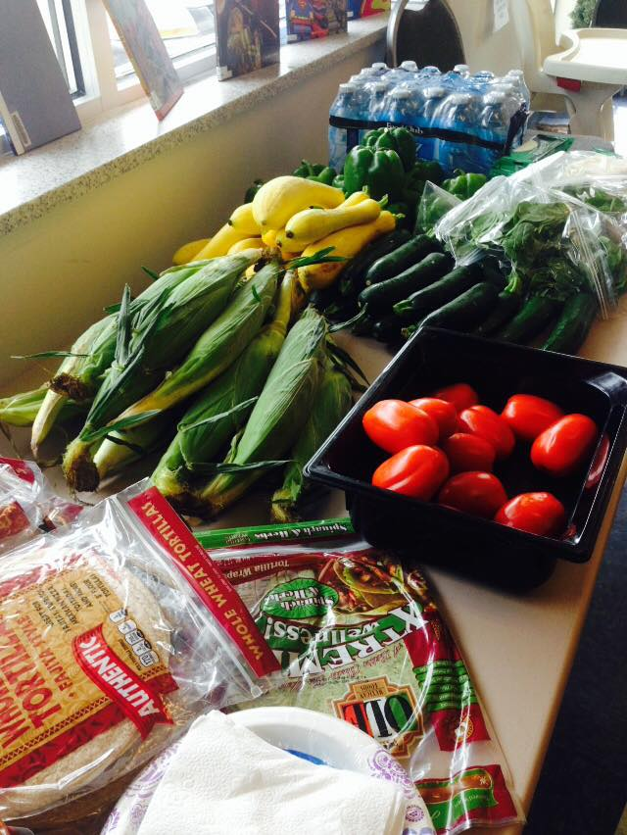
Appal-TREE Project ACT NOW Cooking Class
Appalachians together restoring the eating environment
UK/Community Farm alliance community based research project

Slide 8
Appal-TREE Water First Campaign
National Institute of Health UK/CFA Community Research Project
Partnership with Letcher County Public schools.
Filtered refillable water bottle stations installed in all middle and high schools.
70,000 water bottles filled in first semester.
If refunded will be partnering with neighboring counties.

Slide 9
Letcher county farmers market
City of Whitesburg
Design by John Haywood,
The Parlor Room Tattoo Shop

Slide 10
Letcher county farmers market sales whitesburg, kentucky

Slide 11
Letcher county farmers market whitesburg, kentucky
 | 2014 | 2017
Vendors | 12 | 46
Market Days | 20 | 44
Average # of Vendors @Market | 5 | 14

Slide 12
Summer feeding program
Youth <18 eat free at the market.
USDA Summer Feeding Site
Sponsored by Cowan Community Action Group, Inc.
Letcher County Free/Reduced rate is 72%. All students in LCPS receive free lunch.
Mountain Comprehensive Health a Corporation and UK sponsors when summer program ends.
Produce purchased from growers and prepared by cafeteria workers on site in food booth donated by Kentucky State University.
Over 2,400 meals served in 2017.

Slide 13
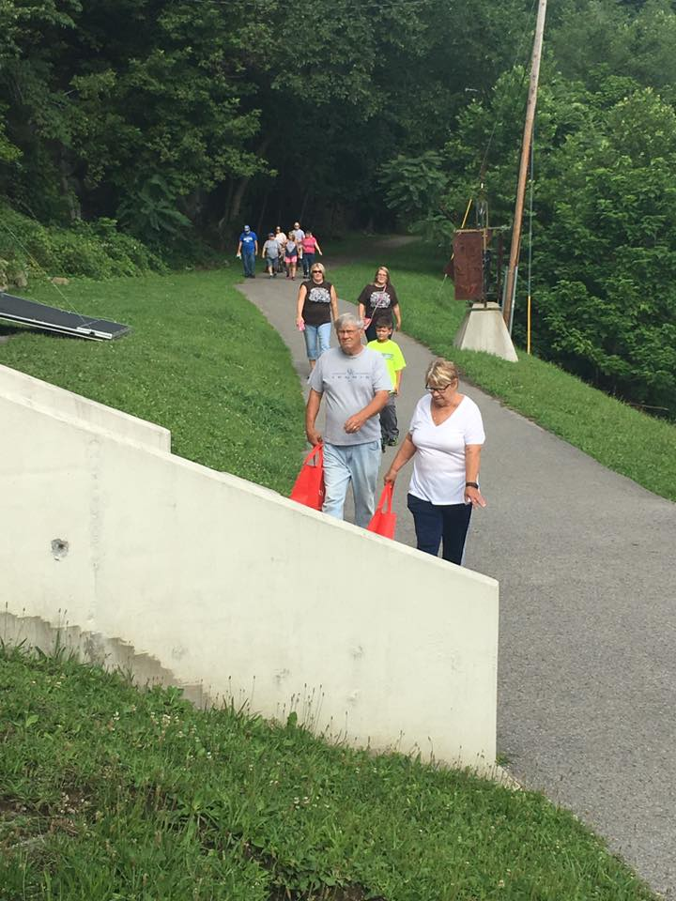
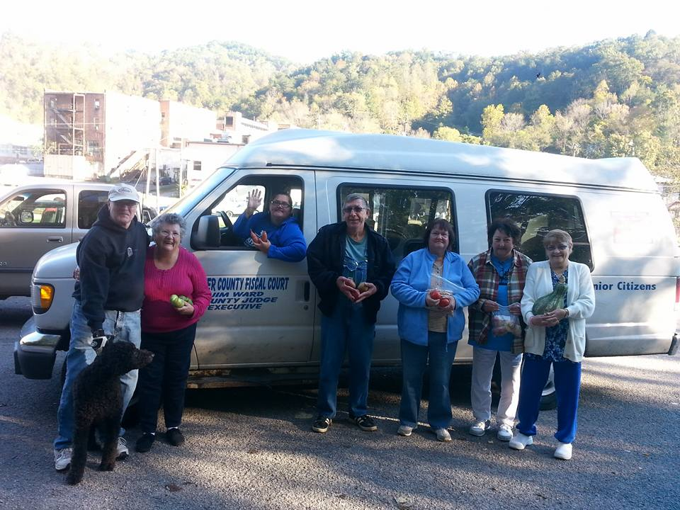
UK Tanglewood Trail Walking Program
providing a $10 voucher significantly improved several measurements from
pre – post-intervention in both groups (total cholesterol, LDL cholesterol, HbgA1c). But it seems that walking really made the difference in increasing HDL cholesterol as only the walkers significantly increased their HDL cholesterol from pre- to post-intervention.
We also saw the other measurements nudge in the direction of decreases, but they were not significant decreases.

Slide 14
A Prescription for Better Health

Slide 15
Mountain comprehensive health corporation, inc.
Mike caudill, ceo
A non-profit rural health care provider, established in 1971 in Leslie County, currently with clinics in Letcher, Harlan, Owsley and Perry County. MCHC serves 27,000 patients annually. MCHC supports the market thru the Summer Feeding Program, Market t-shirts and bags, and the FARMACY program, providing fresh fruits and vegetables to patients with diet related health issues.

Slide 16
farmacy

Slide 17
Communicate w/Market
Identify and Recruit Patients
Obtain Pre/Post Health Measures
Procure Funding w/Market & CFA
Renew Prescriptions Weekly
Monitor Patient Redemption
Provide Funding w/Market
Reports to Funders
Connect w/support Growers
Market Support
Farmacy Director @ MCHC
Staff Support @ Market (2)
Water

Slide 18
Farmacy At the market
Market Roles and Responsibilities
Build Relationship with Medical Care Provider
Understand their goals
Get Grower Support
Meet Supply Demands
Interact w/Patients
Meet Special Needs
Supply Financial Reports
Reimburse Growers
Maintain Financial Records
Manage the Demand
Relationships….Relationships

Slide 19
Farmacy program at the market
Step 1: patients Present prescription to market manager
Step 2: manager redeems for market money
Step 3: customers purchase fresh fruits/vegetables
Step 4: growers redeem market money at the end of the market

Slide 20
FARMACY Growth and expansion
2015 Whitesburg/Letcher County Farmers Market
2016 Whitesburg/Letcher County Farmers Market OWSLey County farmers Market
Pineville farmers market
2017 Whitesbrug/letcher county farmers market
leatherwood farmers market
Owsley county farmes market
Harlan farmers market
community farmers market-Bowling green

Slide 21
Farmacy program
Modeled from conversations with Fresh Stops in Louisville and Wholesome Wave in CT.
Roughly 50% of market sales.
Served over 300 Families in 2017.
$1 per day per family member each week. Example: A family of 4 receives a prescription for $28 per week. W/a minimum of $14.
Medical Care Provider prescribes at initial visit.
Patient then sees health care case worker for eligibility and prescription for market.
Must check back w/case worker weekly for new prescription.
88% redemption rate.
Health benefits monitored and improvements noted.

Slide 22
Mountain Comprehensive health corporation Farmacy program outcomes
89% of Farmacy participants answered YES they felt better during the Farmacy program reporting more energy, feeling better and losing weight.
99% of Farmacy participants reported the Farmacy program assisted them in meeting their nutritional needs.
58% of participants reported the Farmacy program assisted with maintaining optimal blood glucose levels.
64% of participants reported canning or freezing produce for winter months.
Average BMI index reduced 3 units.

Slide 23
Farmacy funders
Mountain Comprehensive Health Corporation, Inc.
USDA FINI Grant
Community Farm Alliance
WellCare of Kentucky Insurance
Passport Health Plan
Anthem Insurance
Delta Dental
BBT
University of Kentucky

Slide 24
What is in motion?
Community Kitchen
Tanglewood Trail
Market Pavilion

Slide 25
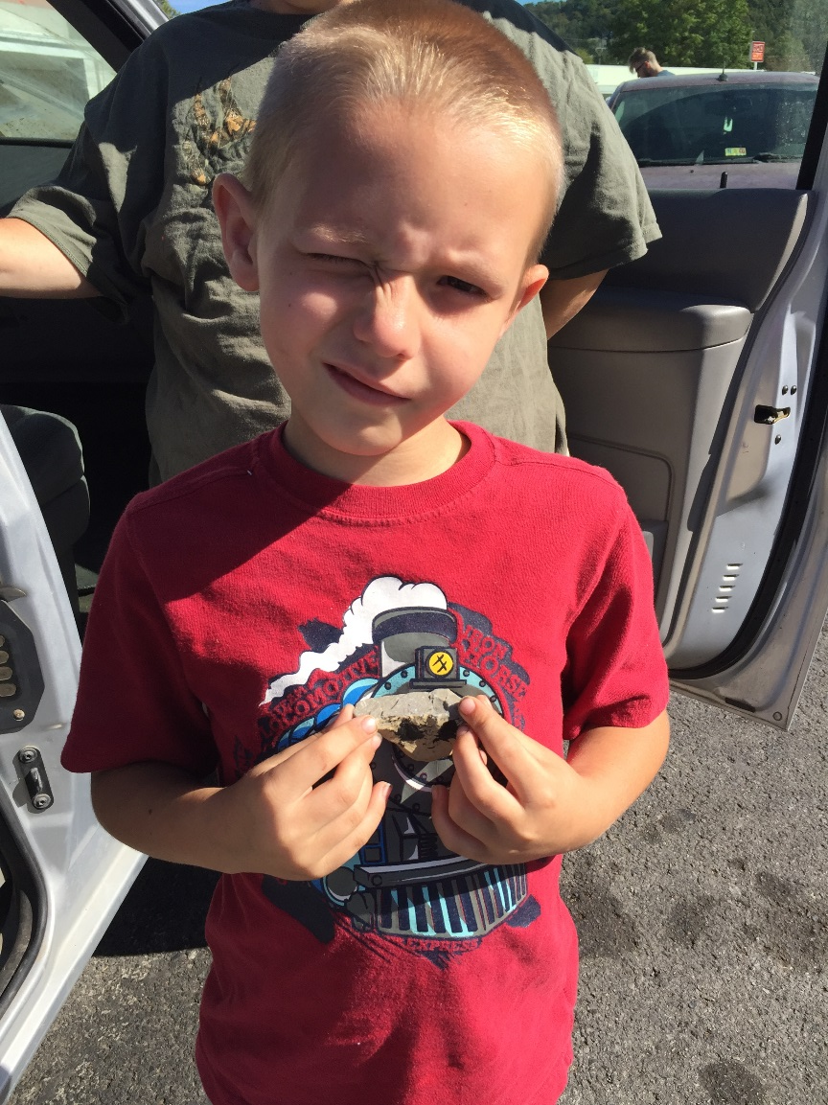
Thoughts

