Slide 1



Coosa County Health Coalition
Sharon A. Haynes
Coosa County Extension Coordinator

Slide 2

County Profile
Population: Approx. 10,588
Mostly 55 years of age and older
Unemployment: 5.7%
No major industry, school and local government major employers
One School System in the entire county approx. 2,017 students
No Grocery Stores in County Seat, nearest grocery store is 21 miles one way.
Only 1 dentist in the entire county
1 Health Clinic in the entire county
No Restaurants in County Seat, nearest 10 miles
Consumer Shopping: Dollar General (3) stores
Two (2) Food Pantries
Two (2) City Parks
Over 64 Faith-Based Churches

Slide 3

What is Live Well Faith Communities (LWFC)?
Notes:
Live well Faith Communities is a nine (9) week series based program that focuses on helping faith based organizations promote healthy eating and increase access and appeal to healthy foods and physical activity in communities of faith.

Slide 4
Goals of Live Well Faith Communities
Increase the number of faith communities participating in direct education opportunities
Utilize social marketing strategies
Establish policies, systems and/or environmental changes to foster healthy eating and physical activity.

Slide 5
Goals for the Faith Communities Members
Improve their planning, shopping and preparation practices
Increase fruit and vegetable consumption
Increase water consumption
Increase participation in regular physical activity

Slide 6
Implementation Process
Identify and Partner with a Faith Community
Identify LWFC Lay Leader
Identify LWFC Committee
Conduct a LWFC Lay Leader Meeting
Conduct LWFC Assessment and Planning Meeting
Conduct Pre-Assessments with participants
Conduct weekly lessons
Conduct Post Assessments with participants
Conduct a six-months follow up

Slide 7
Overview of Weekly Lessons
Lesson Topic | Direct Education Topic | Policy, System and Environmental Changes
1. Plan: Know What’s for Dinner | Plan meals to eat better and save time and money | Plan healthy meals to serve at the faith community
2. Shop: Get the Best for Less | Shop with a list to eat better and save money | Work with local farmer(s) to sell low-cost produce on faith communities grounds
3. Shop for Value, Check the Facts | Check with Nutrition Facts label when shopping to eat better | Shop for healthy foods to serve at the faith community
4. Fix it Fast, Eat at Home | Fix and eat more meals at home to eat better and save money | No PSE
5. Choosing More Fruits and Vegetables | Include a variety of colors of fruits and vegetables in your snack and meals each day to eat better | Discuss a faith community policy requiring fruits and vegetables be served at any faith community gathering

Slide 8
Overview of Weekly Lessons
Lesson Topic | Direct Education Topic | Policy, System and Environmental Changes
6. Fix it Safe | Clean, separate, cook and chill to keep foods safe | No PSE
7. Making Smart Drink Choices | Choose water in place of sugary beverages to eat better | Discuss a faith community policy requiring water be served at any faith community gathering
8. Choosing to Move More throughout the Day | Move more to be healthy | Start a walking or exercise group at the faith community
9. Making the Connection | Make a change to last a lifetime | Identify one policy, system or environmental change to begin or continue to discussing and/or implementing

Slide 9
Outcomes
A total of 26 Coosa County families participated in LWFC.
Extension personnel and coalition members provided 9 nutrition education classes and 11 food demonstrations.
Extension personnel/coalition members supported faith communities in implementing policies, systems, environments and practices promoting healthy eating and physically active lifestyles.
Adopted guidelines requiring fruits, vegetables, non-fried
foods, foods with low or no sugar added.

Slide 10
Outcomes
Launched an onsite garden
Began providing physical activity opportunities at meetings and other functions
Began offering aerobics classes
As a result faith communities are becoming healthier places and supporting individuals in adopting physical activity lifestyles.

Slide 11
Outcomes
Significant improvement from pre to post assessment demonstrate:
Individuals often think about healthy food choices when deciding what to feed their families
Compare prices before buying food
Use the “Nutrition Facts” on the food label to make food choices
Buy food with lower added sugar
Increase in average daily vegetable consumption from 1.49 cups at pre-assessment to 1.81 cups at post assessment

Slide 12
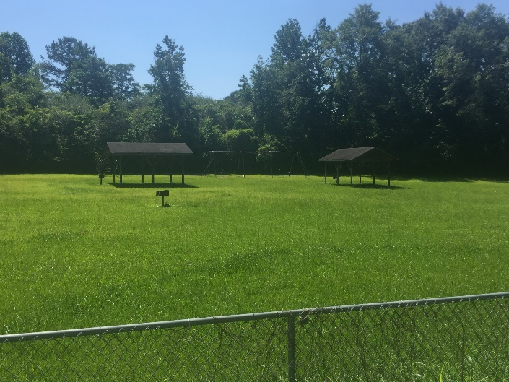
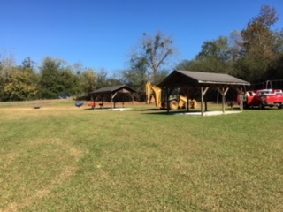
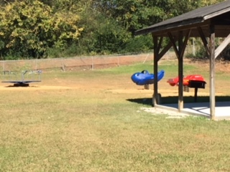
Park Improvements

Slide 13
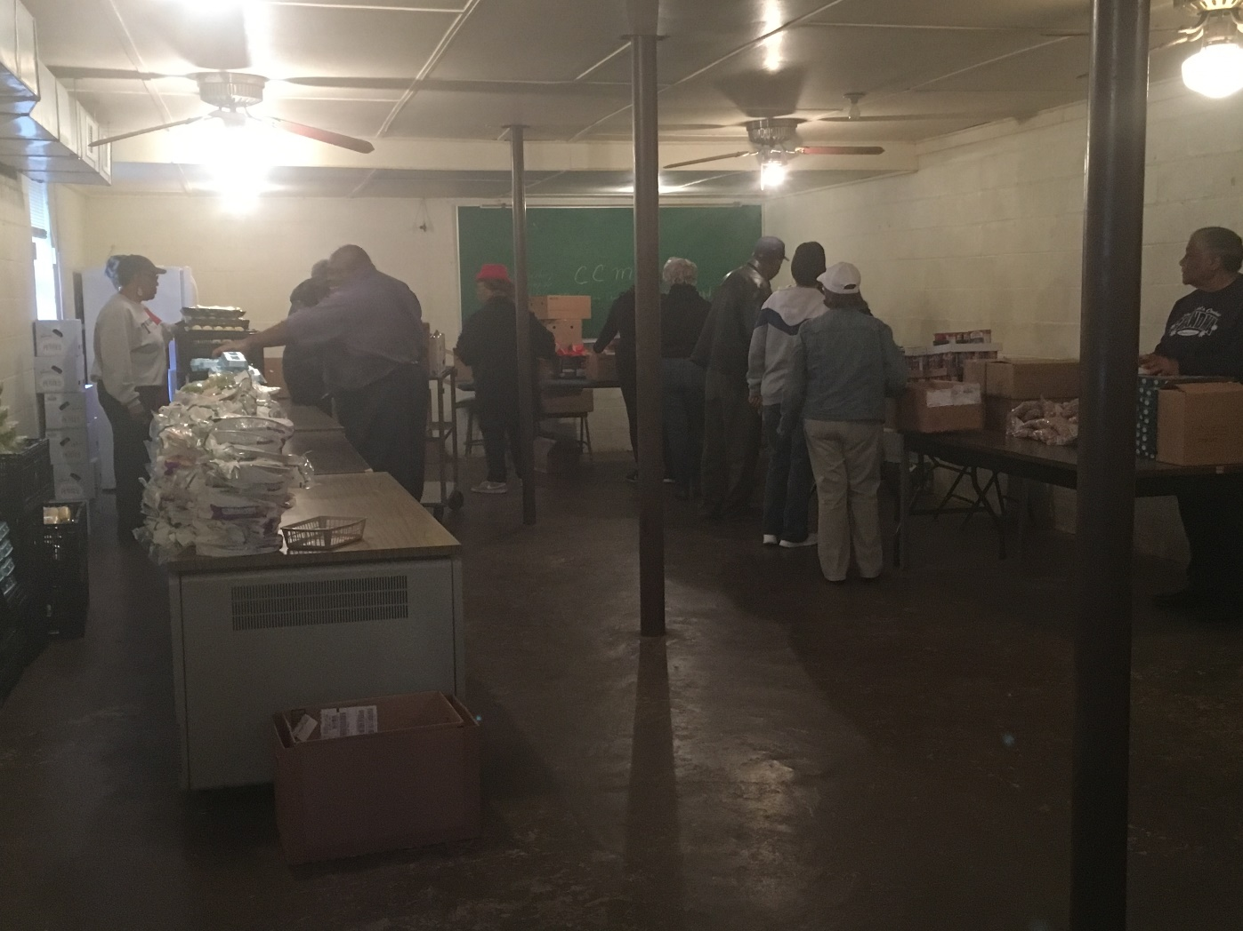
Ministerial Alliance Food Share Program

Slide 14
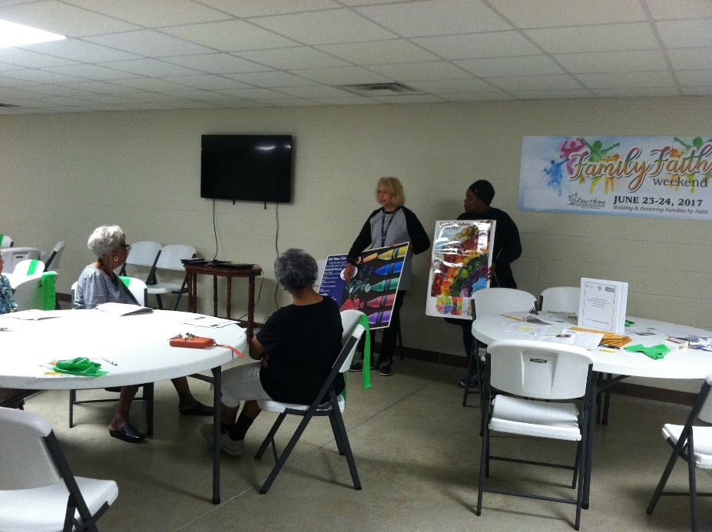
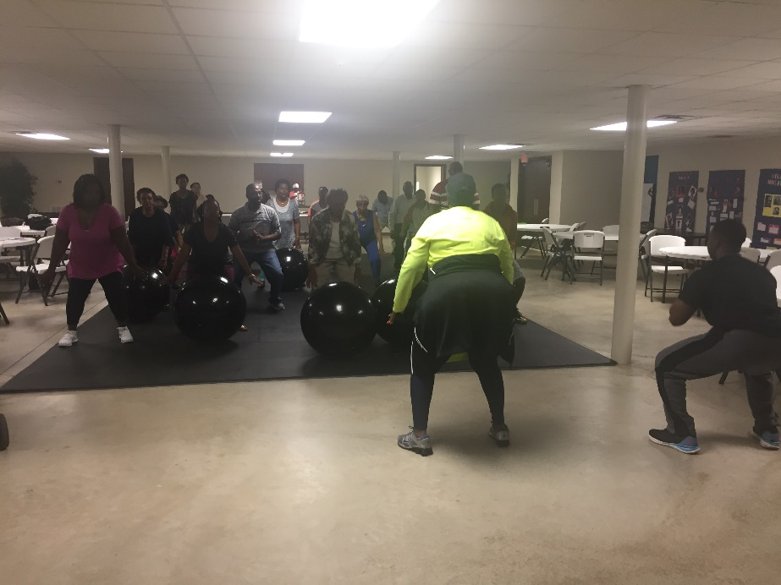
Live Well Education/Physical Fitness Engagement

Slide 15
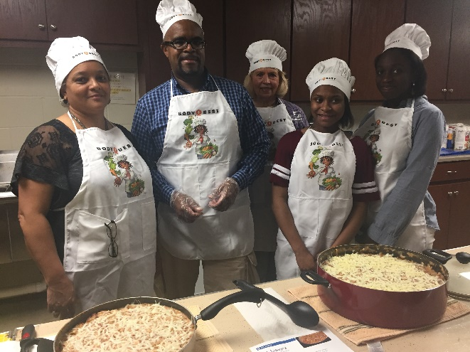
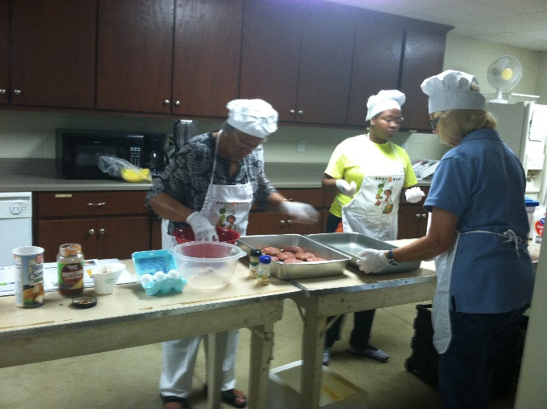
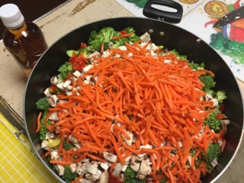
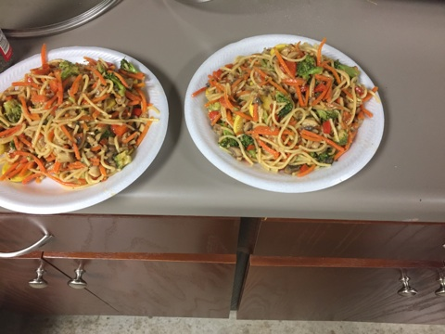
Live Well Education/Physical Fitness Engagement

Slide 16
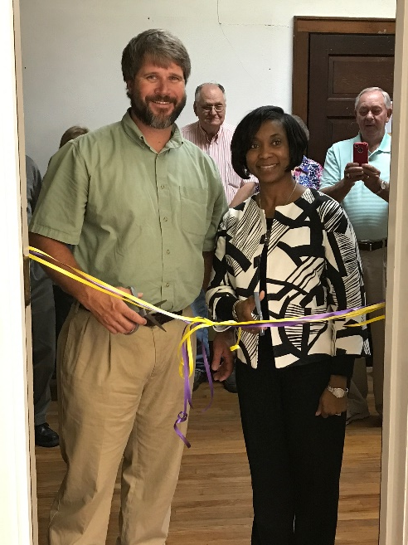
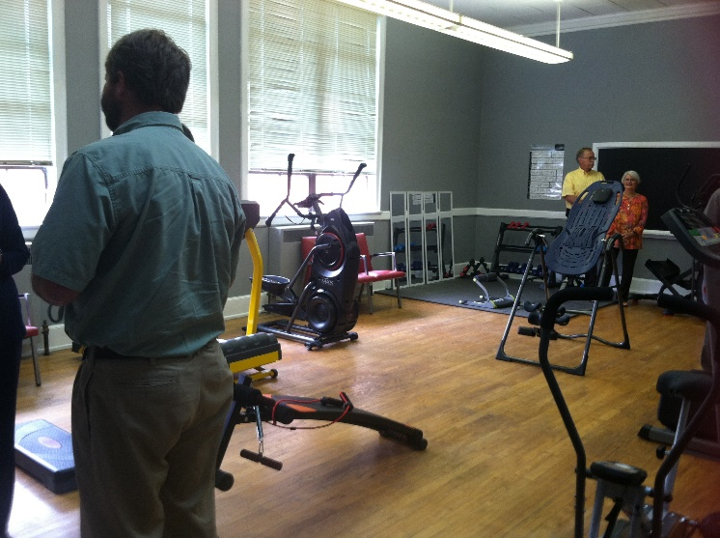
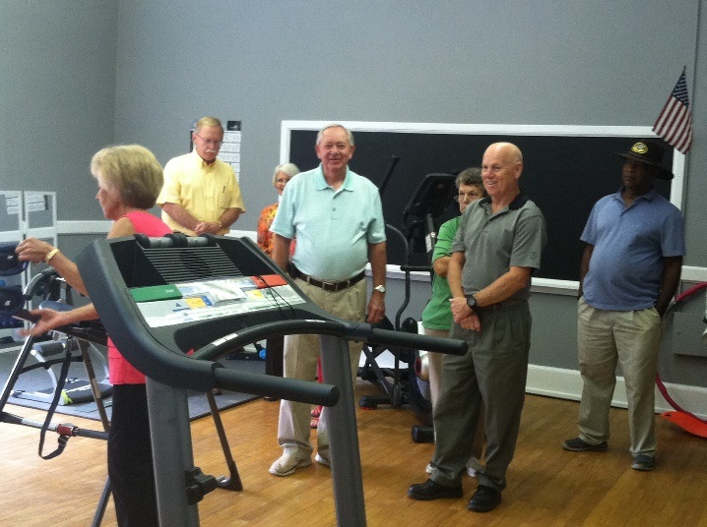
Gym Installation

Slide 17

Notes:
LiveSlide Site
https://www.youtube.com/watch?v=fLQdLCWdlD8

