Slide 1

Collaborating to Increase Health and Wellbeing in Rural America
Jessica donze black RD, MPH
Jessica.donzeblack@heart.org
@jdonzeblack

Slide 2


To Build Healthier Lives Free from Cardiovascular Disease and Stroke.
AHA 2020 Impact Goal
“By 2020, to improve the cardiovascular health of all Americans by 20% while reducing deaths from cardiovascular diseases and stroke by 20%.”
20%
2020

Slide 3






Cardiovascular Health Status Levels
Cardiovascular Health Definitions
LIFE’S SIMPLE 7 |  | POOR | INTERMEDIATE | IDEAL
 | Smoking Status Adults >20 years of age Children (12–19) | Current Smoker Tried prior 30 days | Former ≤ 12 mos | Never /quit ≥ 12 mos
 | Physical Activity Adults > 20 years of age Children 12-19 years of age | None None | 1-149 min/wk mod or 1-74 min/wk vig or 1-149 min/wk mod + vig >0 and <60 min of mod or vig every day | 150+ min/wk mod or 75+ min/wk vig or 150+ min/wk mod + vig 60+ min of mod or vig every day
 | Healthy Diet Adults >20 years of age Children 5-19 years of age | 0-1 components 0-1 components | 2-3 components 2-3 components | 4-5 components 4-5 components
 | Healthy Weight Adults > 20 years of age Children 2-19 years of age | ≥30 kg/m² >95th percentile | 25-29.9 kg/m2 85th-95th percentile | <25 kg/m² <85th percentile
 | Blood Glucose Adults >20 years of age Children 12-19 years of age | 126 mg/dL or more 126 mg/dL or more | 100-125 mg/dL or treated to goal 100-125 mg/dL | Less than 100 mg/dL Less than 100 mg/dL
 | Cholesterol Adults >20 years of age Children 6-19 years of age | ≥240 mg/dL ≥200 mg/dL | 200-239 mg/dL or treated to goal 170-199 mg/dL | <170 mg/dL
 | Blood Pressure Adults >20 years of age Children 8-19 years of age | SBP ≥140 or DBP ≥90 mm Hg >95th percentile | SBP120-139 or DBP 80-89 mm Hg or treated to goal 90th-95th percentile or SBP ≥120 or DBP ≥80 mm Hg | <120/<80 mm Hg <90th percentile
Notes:
THIS ONE>>>>>>>
The chart illustrates the detailed measures for the seven health factors and health behaviors at poor, intermediate and ideal cardiovascular health. You may note we have specific measures for adults, as well as children. Children are weighted according to the percentage of the overall population – approximately 25%.
There are three health factors: blood pressure, cholesterol, blood glucose; and four health behaviors: physical activity, healthy diet, smoking, healthy weight.
The goal is to reduce prevalence of poor CV health and increase prevalence of ideal CV health for a cumulative improvement of 20%.
As a reminder, our 20% improvement is based on the overall weighted average out “poor” and into “ideal”.

Slide 4
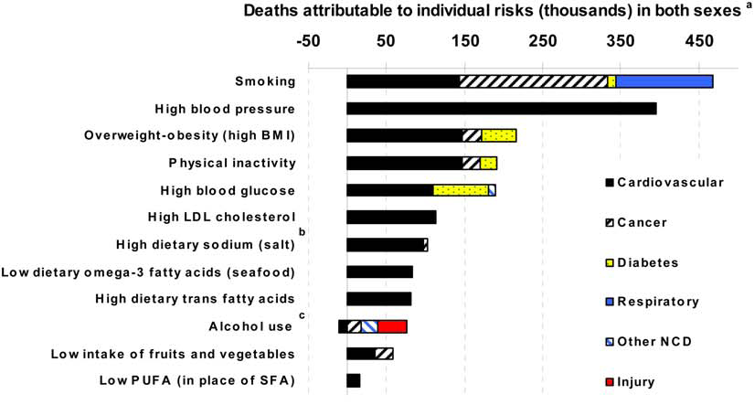
The Preventable Causes of Death in the United States:
Comparative Risk Assessment of Dietary, Lifestyle, and Metabolic Risk Factors (Danaei,2009)
Deaths attributable to individual risk (thousands) in both sexes

Slide 5

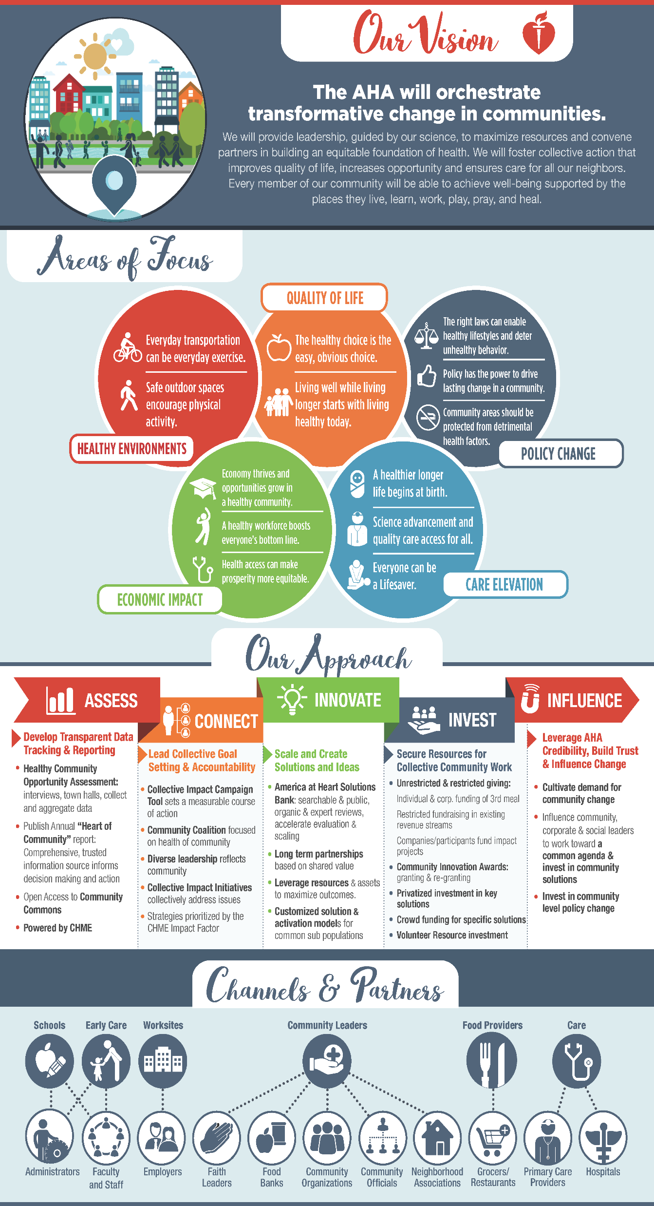
Blood Pressure
Blood Sugar
Healthy Eating
Cholesterol
Reduce hypertension and improve blood pressure control rates.
Physical Activity
Social Determinants
Weight
Tobacco
Cardiac Care
Stroke Care
Reduce diabetes and improve control rates.
Increase % of youth and adults that meet physical activity guidelines.
Improve access to and consumption of healthy foods.
Increase % of community at a healthy weight.
Eliminate tobacco use and exposure to secondhand smoke.
Improve outcomes for cardiac events.
Improve outcomes for stroke events.
Improve social determinants of health that contribute to cardiovascular health.
Identify and treat people at risk for high cholesterol.
Notes:
At the American Heart Association, our mission is to create a world free of heart disease and stroke and we believe that starts right here in Arlington. That’s why we are working in our community to solve complex issues that affect this generation and generations to come.
These are difficult challenges. There is no quick fix, no one way to create a healthier community. But we know that if our community works together to achieve a shared vision, we will truly make a difference. At the center of it all, we have Arlington at Heart.

Slide 6


http://targetbp.org/

Slide 7
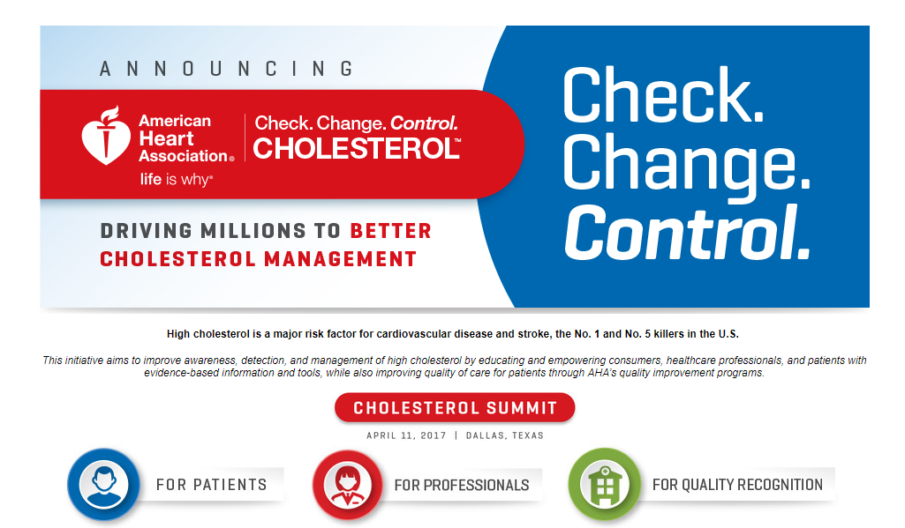
Check. Change. Control. Cholesterol

Slide 8
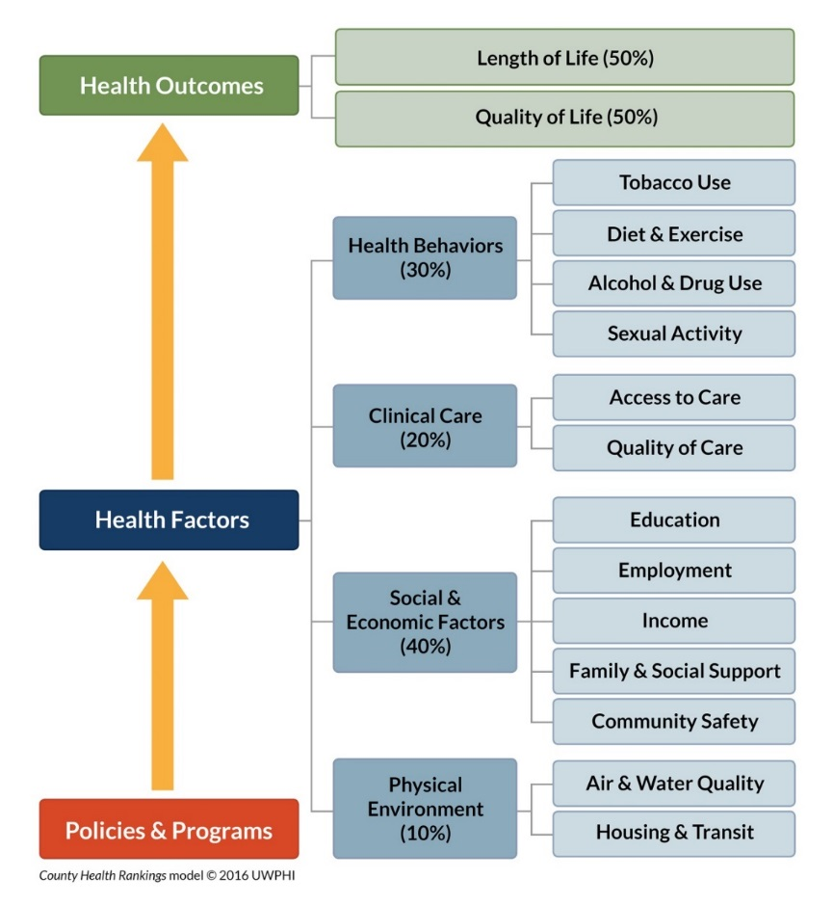
RWJF County Health Rankings Model
http://www.countyhealthrankings.org/
Notes:
KEY POINTS
Rankings model shows:
1. Health Outcomes: “Today’s health” (the green boxes)
Length of life – tells whether people are dying too early
Quality of life – tells how well people feel while living
2. Health Factors: “Tomorrow’s health” (the blue boxes)
Health behaviors
Clinical care
Social and economic factors
Physical environment
These are factors that determine how long people live and quality of their lives. The blue boxes are things communities can work on now to help improve their future health.
3. Policies and Programs impact health factors and ultimately health outcomes. (orange box)
Alternative: WALK THROUGH THE MODEL
Starting from the bottom, we believe … Effective local, state, and federal Policies and Programs (orange box) can improve a variety of factors that, in turn, shape the health of communities.
Many Health Factors (the blue boxes) shape our communities' health outcomes. We specifically look at health behaviors, clinical care, social and economic factors, and the physical environment.
We measure two types of Health Outcomes (the green boxes) to show how healthy each county is: length of life and quality of life.
Example: a clean indoor air policy is a policy that can influence health factors, such as tobacco use, which in turn influences health outcomes.
We often point to this image as one of our most important, because it outlines what we use to determine the County Health Rankings and what influences health in a community. Because much of what affects our health happens beyond medical care, the Rankings underscore how important it is to build a culture of health where getting healthy, staying healthy, and making sure our kids grow up healthy are top priorities.
-As an example, expanding early childhood education improves academic achievement. Higher levels of education lead to higher levels of income which then influence other health factors such as access to healthy foods, clinical care, and quality housing, which in turn influence health outcomes.
-Stepping back, you’ll note that we don’t include race or ethnicity in our health factors. We’ve selected health factors that reflect aspects that communities can improve. Race and ethnicity are not modifiable while poverty is something we can take action on, so you will see “income” as a key health factor. We do provide data, tools and resources that can help communities address health disparities, and we’ll show you later where to find these on our site. The bottom line is that factors such as one’s race, ethnicity and socioeconomic status should not play a role in how healthy we are or how long we live, but unfortunately, for many people across the nation, they do . If we are going to build a Culture of Health in every community, reducing health disparities needs to be a top priority - because everyone in our society deserves an equal opportunity to pursue a healthier life.
___________________________________________
NOTE TO PRESENTER:
This is THE MOST IMPORTANT SLIDE in the deck. It’s as important as the numbers that go into the Rankings. It helps people tell important story about the many factors that determine health.

Slide 9
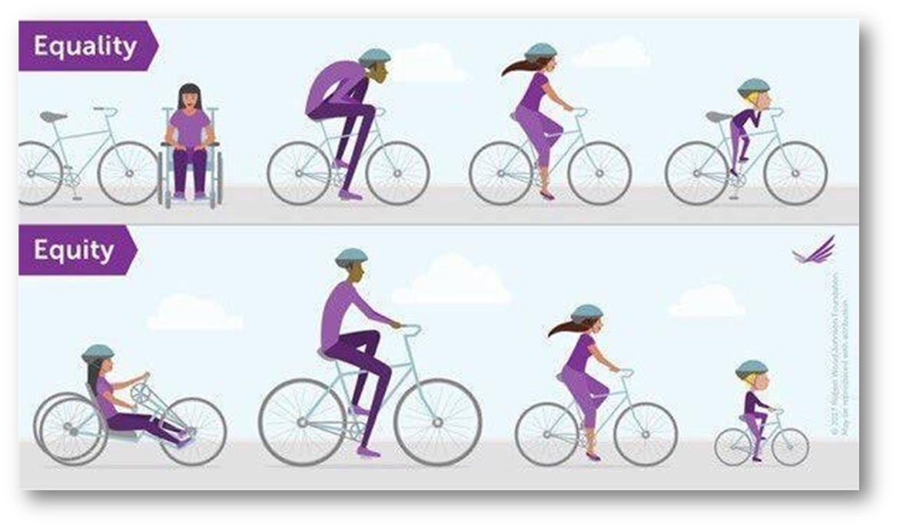
Equity

Slide 10
The Picture in Rural America
Americans living in rural areas suffer worse health and live shorter lives than their urban counterparts.
Rates of chronic disease such as diabetes, COPD, heart disease, and obesity are all higher in rural areas than they are in other parts of the country.
The mortality rate in rural counties can be up to 13% higher than in metro counties; residents of metro counties lived two years longer on average than did residents of rural counties.
Creating a Culture of Health in Appalachia: Disparities and Bright Spots demonstrated Appalachian region has poorer health than average across 33 of 41 indictors.
Meit, Michael, et al. "The 2014 update of the rural-urban chartbook." Rural Health Reform Policy Research Center (2014).
Singh and Siahpush. “Widening Rural-Urban Disparities in Life Expectancy, U.S., 1969-2009. American Journal of Preventative Medicine, 46, no. 2 (2014): e19-e29. Poverty level measured as percent of 2000 Census county population below the Federal poverty level.

Slide 11
The Picture
Americans living in rural areas are more likely to suffer from persistent poverty and lack of education.
The proportion of counties with persistently poor populations has increased from 12% in 2000 to 26% in 2010.
  Urban counties saw an increase from 4% to 15%
  Rural counties saw an increase from 17% to 32%.
Nearly two-thirds (64%) of rural counties are persistent poverty counties (counties in which 20% or more of the population was living in poverty over the last thirty years) compared to just 14% of urban counties.
The percentage of young adults (ages 25 to 34) who have completed college rose 6% in urban areas to 35% and just 4% in rural areas to 19% between 2000 and 2013.
Bennett, Kevin J. "Vulnerable Rural Counties: The Changing Rural Landscape, 2000–2010." South Carolina State Documents Depository (2016).
Miller, Kathleen, and Bruce Weber. Persistent Poverty Dynamics: Understanding Poverty Trends Over 50 Years. Rural Policy Research Institute, 2014.
Olshansky, S. Jay, et al. "Differences in life expectancy due to race and educational differences are widening, and many may not catch up." Health Affairs 31.8 (2012): 1803-1813.
Woolf, Steven H., and Paula Braveman. "Where health disparities begin: the role of social and economic
determinants—and why current policies may make matters worse." Health affairs 30.10 (2011): 1852-1859.

Slide 12
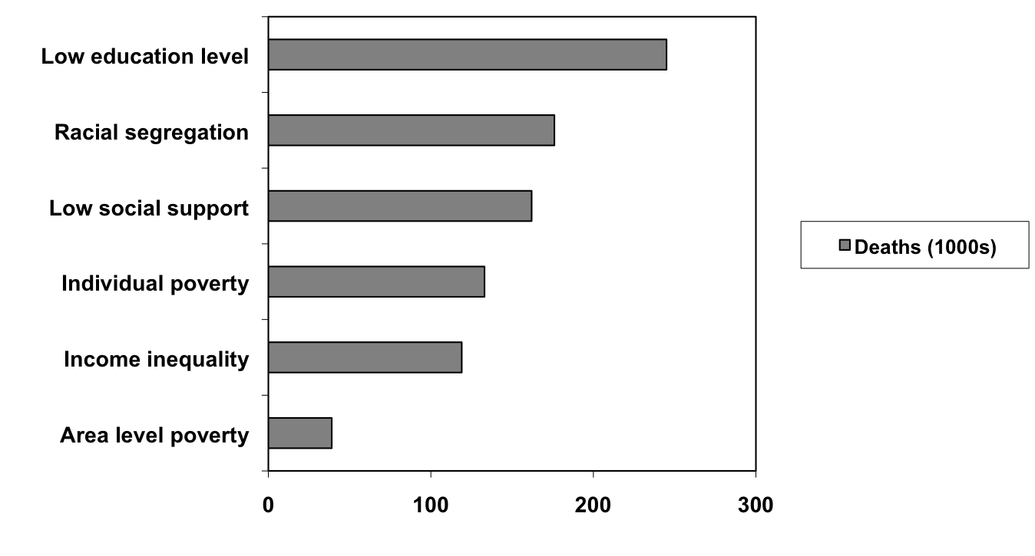
Relationship Between Social Factors and Mortality (2000)
Galea et al, Estimated Deaths Attributable to Social Factors in the United States ,
AJPH, August 2011, Vol 101, No. 8.

Slide 13
Critical social determinants of health
Geography (isolation and land ownership structure);
Wealth, Income, and poverty;
Education and labor markets
Access to care
Access to healthy food and physical activity
Social Determinants of Health: National Advisory Committee on Rural Health and Human Services Policy Brief, January 2017. Last downloaded on October 26, 2017 at: https://www.hrsa.gov/advisorycommittees/rural/publications/nac_brief_social_determinants_health.pdf
Social Determinants of Health for Rural People, Rural Health Information Hub. Last downloaded October 26, 2017 at:https://www.ruralhealthinfo.org/topics/social-determinants-of-health

Slide 14

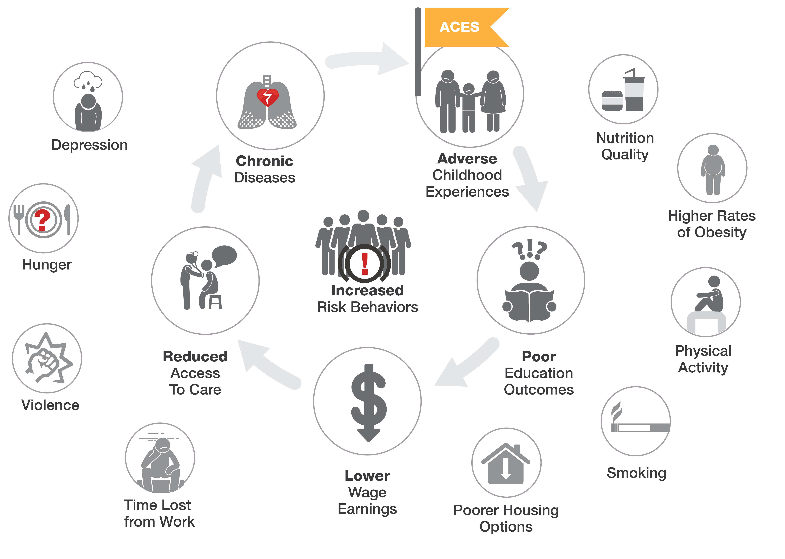
Complexity
of Chronic
Disease

Slide 15

Challenges
  Organizational priorities do not always resonate with local communities.
  Limited bandwidth/Systems
  Many challenging concerns
    Opioid/drug use
    Lack of Economic Opportunity
    Transportation/Distance all aspects (food, healthcare, education, etc.)
    Water/Air Quality
    Broadband Access
    Access to/Quality/Consistency of Medical Care
  Limited resources
  Short term grant funding.

Slide 16
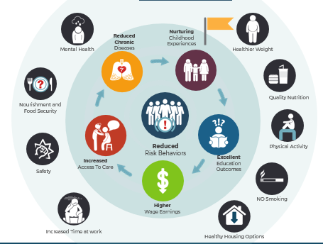
Flip the Narrative

Slide 17
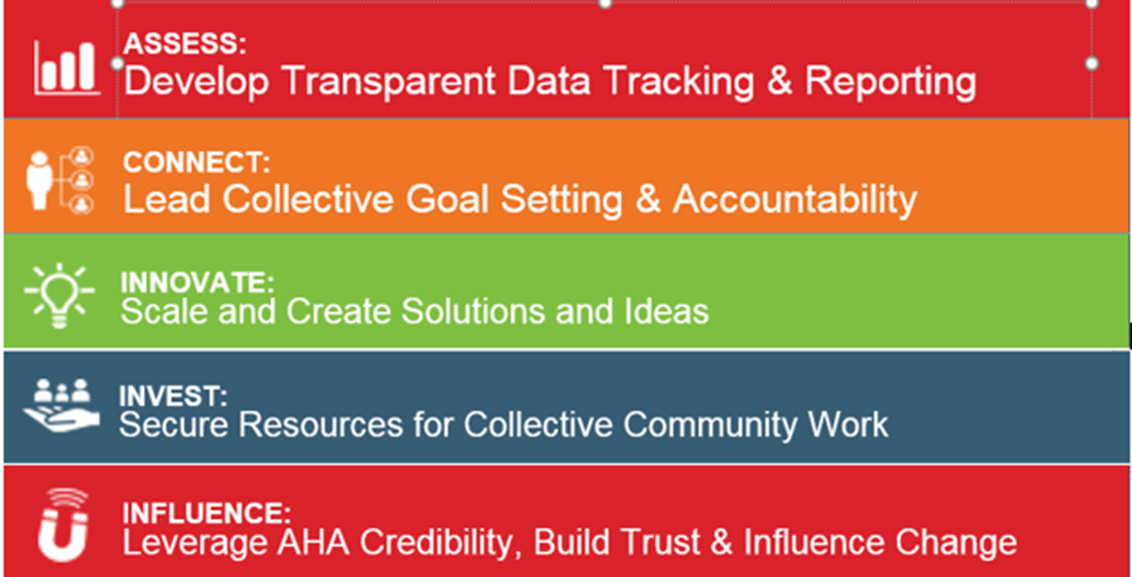
Unlocking a Better Future

Slide 18

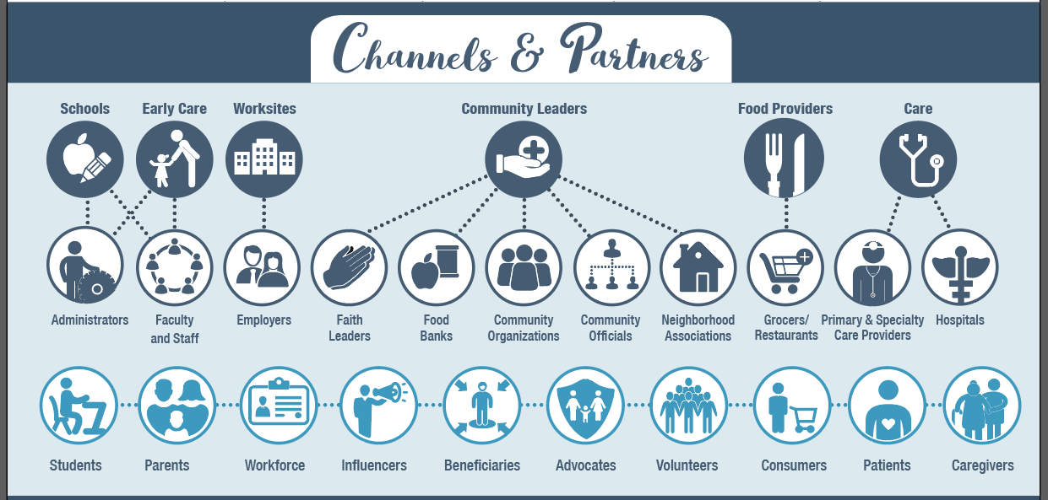
Food Manufacturers
& Distributors

Slide 19

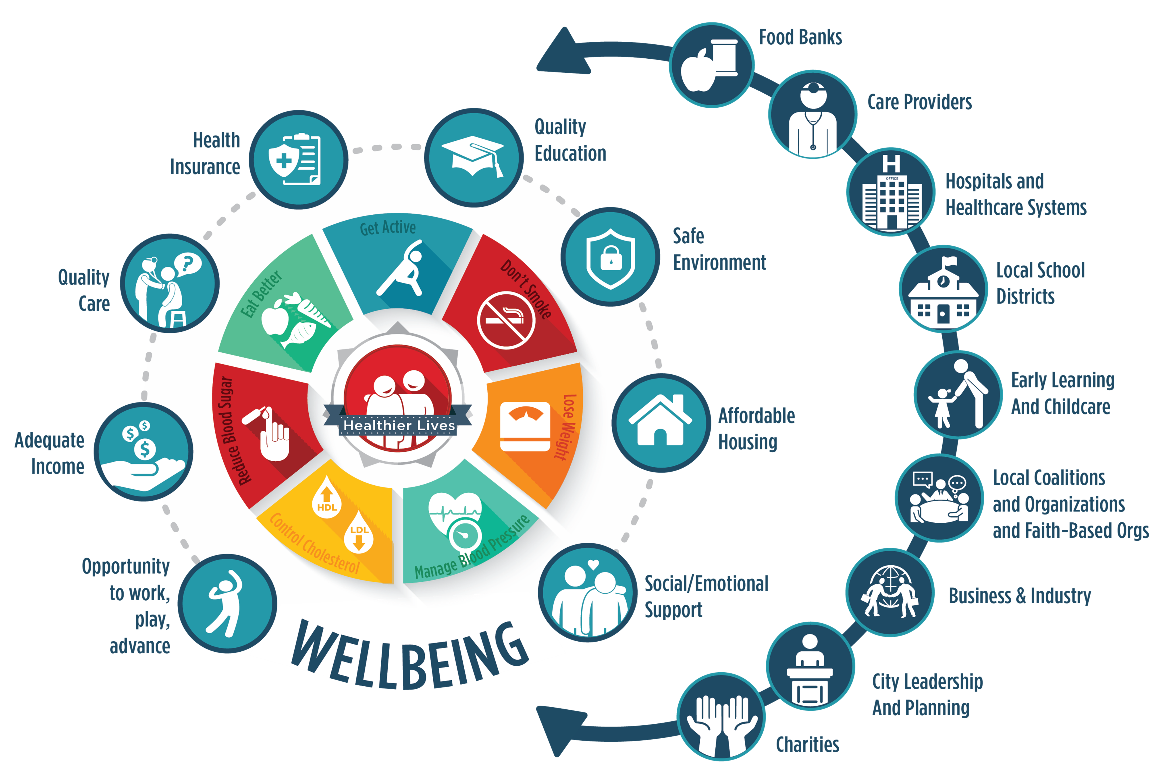
CONNECT

Slide 20
Collaboration in Rural Communities
  Cardiac Ready Communities
  Organize – Community leaders, public health, residents
  Inform - This includes access to automated external defibrillators (AEDs), awareness campaigns, and community AED and CPR training.
  Implement and Track.
  Request Review
  Mission Lifeline
  Main Street Initiatives
  Walkable communities
  Healthy Food Access

Slide 21
Collective Impact
Shared Measurement
Backbone Support
Common Agenda
Mutually Reinforcing Activities
Continuous Communication
Collective Impact
The commitment of a group of actors from different sectors to a common agenda for solving a complex social problem
Notes:
Include Healthy Houston example
Source: Kania, J. and Kramer, M., Collective Impact, Stanford Social Innovation Review, 2011.

Slide 22
Core elements for success
Connect
Common Agenda: shared vision for change, one that includes a common understanding of the problem and a joint approach to solving it through agreed upon actions.
Shared Measurement Systems agreed on approach to collecting data and measuring results consistently on a short list of indicators across all participating organizations.
Mutually Reinforcing Activities diverse stakeholders working together, not by requiring that all participants do the same thing, but by encouraging each participant to undertake the specific set of activities at which it excels in a way that supports and is coordinated with the actions of others.
Continuous Communication focusing efforts on building trust and establishing a common vocabulary for sharing across organizations.
Backbone Support Organizations Dedicated staff with a very specific set of skills to serve as the coordinator for the entire initiative. The collaboration cannot be successful without a supporting infrastructure.

Slide 23
Collective Impact in Rural America
Close-knit rural communities can often leverage their relationships to work together towards common goals and influence local policy. (But not all are close knit)
Common Challenges
  Limited Resources
  Limited non-profit infrastructure/investment
  Lack of connection to or capacity to get Federal, State, or Foundation funding
  Geographic distribution and lack of infrastructure and/or transportation for connecting.
  Competing priorities

Slide 24
Opportunities!
Regional Collaboration toward a common agenda
Building technology infrastructure to connect in lieu of more face-to-face
Shared anchoring or backbone
Enhanced training and technical assistance for local leadership
‘Mutually Reinforcing Activities’ could leverage capacity of organizations to help others
  Grant writing
  Advocacy
  Financial management

Slide 25
Never doubt that a small group of thoughtful, committed citizens can change the world; indeed, it's the only thing that ever has.
Margaret Mead

Slide 26
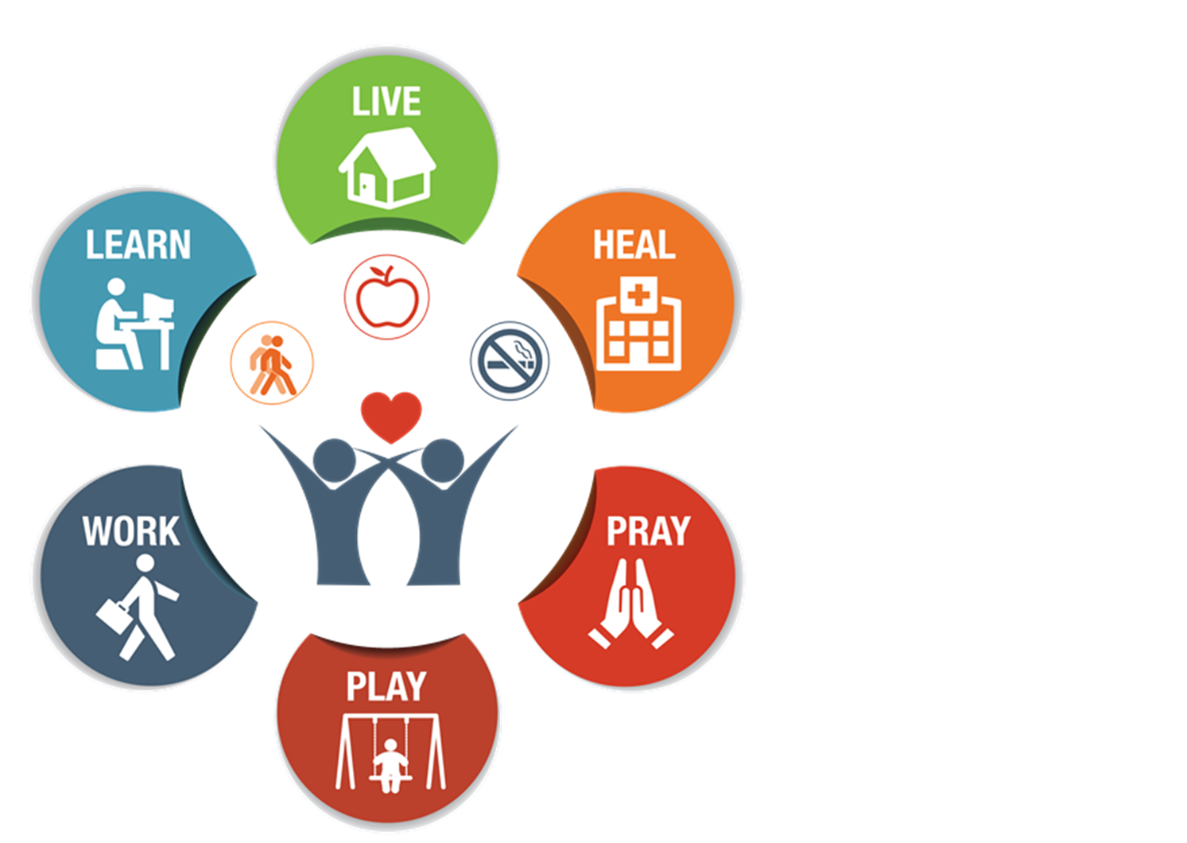
Discussion

