Slide 1
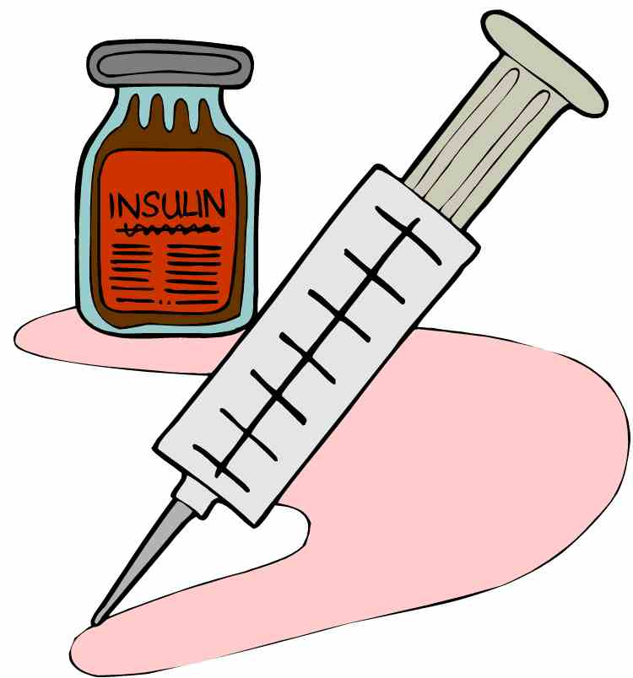
Type 2 Diabetes education and food Program
Norway Church of Christ Food Pantry
About the Program
Norway Church of Christ, along with Facing Hunger Foodbank & Feeding America, have worked to bring education and targeted foods to those with or at risk for type 2 diabetes with a goal of helping those effected to live healthier lives.
For More Information Contact:
Dr. Richard Crespo:
Crespo@marshall.edu
Bethany Freeman:
Bethany@facinghunger.org
What is Type 2 Diabetes?
With type 2 diabetes your body either makes not enough insulin or the insulin your body makes does not work right.
Many of the foods you eat your body brakes down into a sugar called glucose
Insulin helps your body move this sugar into your body's cells from the blood stream
When there is not enough insulin or insulin is not working properly, sugar levels stay high
When blood sugar levels stay high you have diabetes
Norway Church of Christ
Norway Church of Christ Food Pantry
1400 Norway Avenue
Huntington, WV 25705

Slide 2
Getting in Your Daily Exercise
Being active is one of best ways to help keep control of your blood sugar. Exercising helps your body process sugar.
Your goal should be to get at least thirty minutes of exercise each day.
Tips to Eat Healthy
USE THE CREATE YOUR PLATE METHOD
This method acts as a guide to show you how much of each food group you should eat during a meal.
50% of you plate should be non- starchy vegetables
25% of your plate should be protein
25% of your plate should be grains and other starchy foods
Add a serving of fruit and dairy as your meal allows
Chose low-calorie drinks like water, unsweet tea, and black coffee
You should also remember to not eat too much, eat slowly and until you feel full. Make sure that you do not eat too many of the same types of foods. You should space your meals evenly throughout the day and make sure not to skip meals.
Tips on Getting Started
Start of slow. Make sure to warm up before you exercise and cool down afterwards
Find a friend to exercise with you. They will help you stick with it
Wear comfortable shoes, clothes, and carry an ID showing you have diabetes
Check your feet before or after exercise
Try to exercise 1 to 3 hours after a meal. This is when your blood sugar will be high
Always have high sugar snacks on hand like peppermints if your sugar drops to low
Managing Type 2 Diabetes
Healthy Eating and Exercise
While type 2 diabetes is most common in adults, the number of children and young people with type 2 diabetes is growing. The key to living a healthy and full life with type 2 diabetes is healthy eating and exercise to keep your blood sugar in balance. You may also need to use insulin or take diabetic medication if prescribed by your doctor. While there is no cure for diabetes it can be managed.

